Slide 1

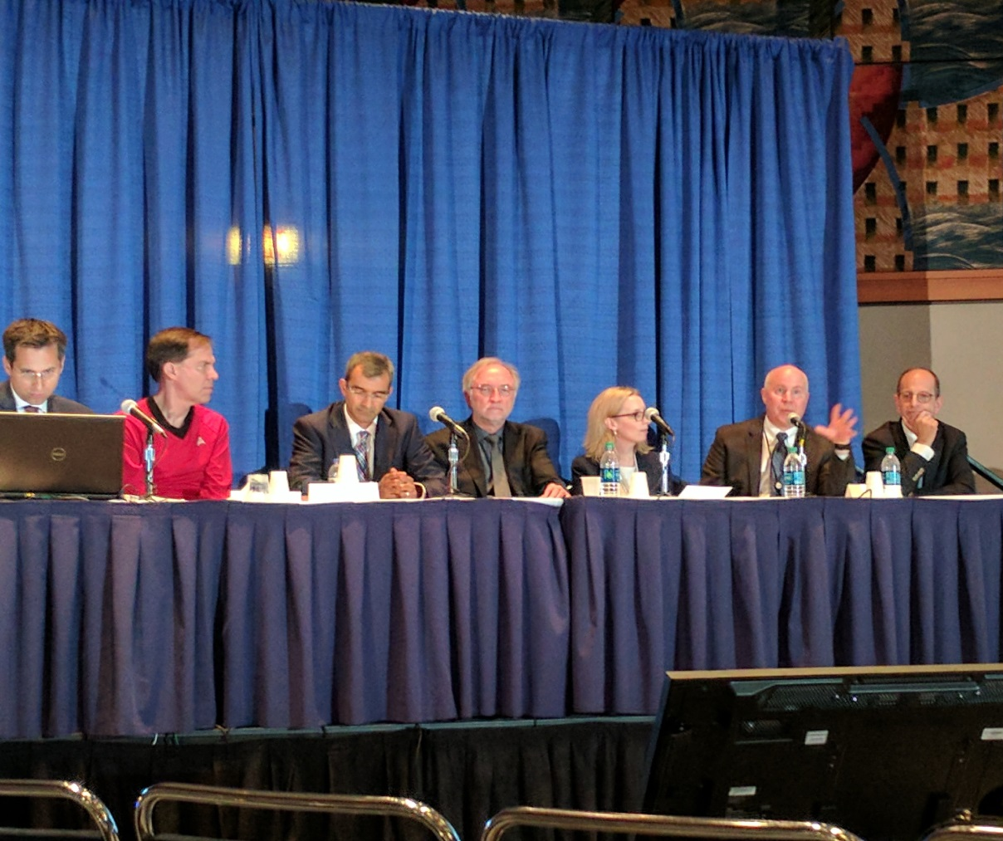
Treatment of Imatinib-resistant GIST:
The Next Generation
Dr. Michael Heinrich, M.D
OHSU Knight Cancer Institute
Portland, OR

Slide 2
Background
Small molecule kinase inhibitors of KIT/PDGFRA such as imatinib and sunitinib have transformed the medical treatment of advanced GIST
However, disease control in the metastatic setting is limited by the development of drug-resistant clones
Drug-resistance is commonly due to the development of acquired mutations in the disease causing mutant kinase (e.g. KIT)
To date, all approved TKIs used for the treatment of GIST are competitive ATP inhibitors and bind to the inactive kinase structure

Slide 3
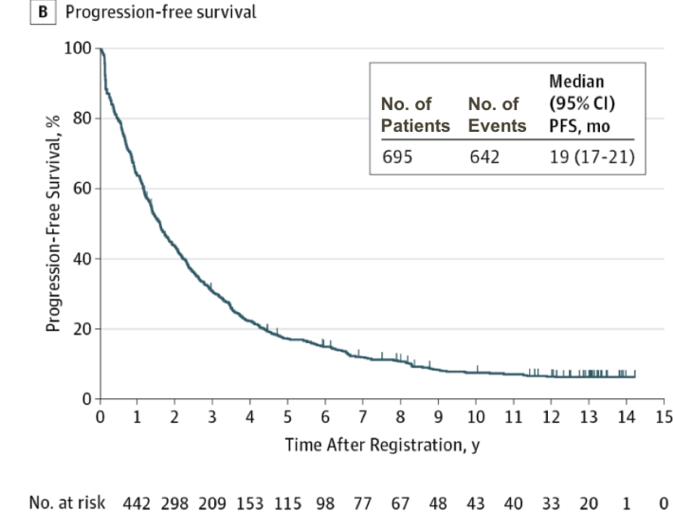
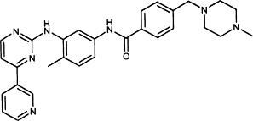
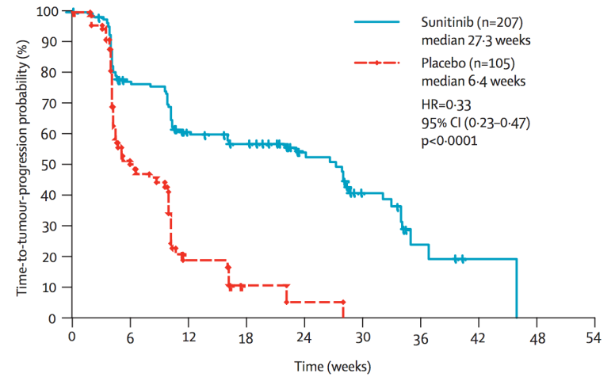
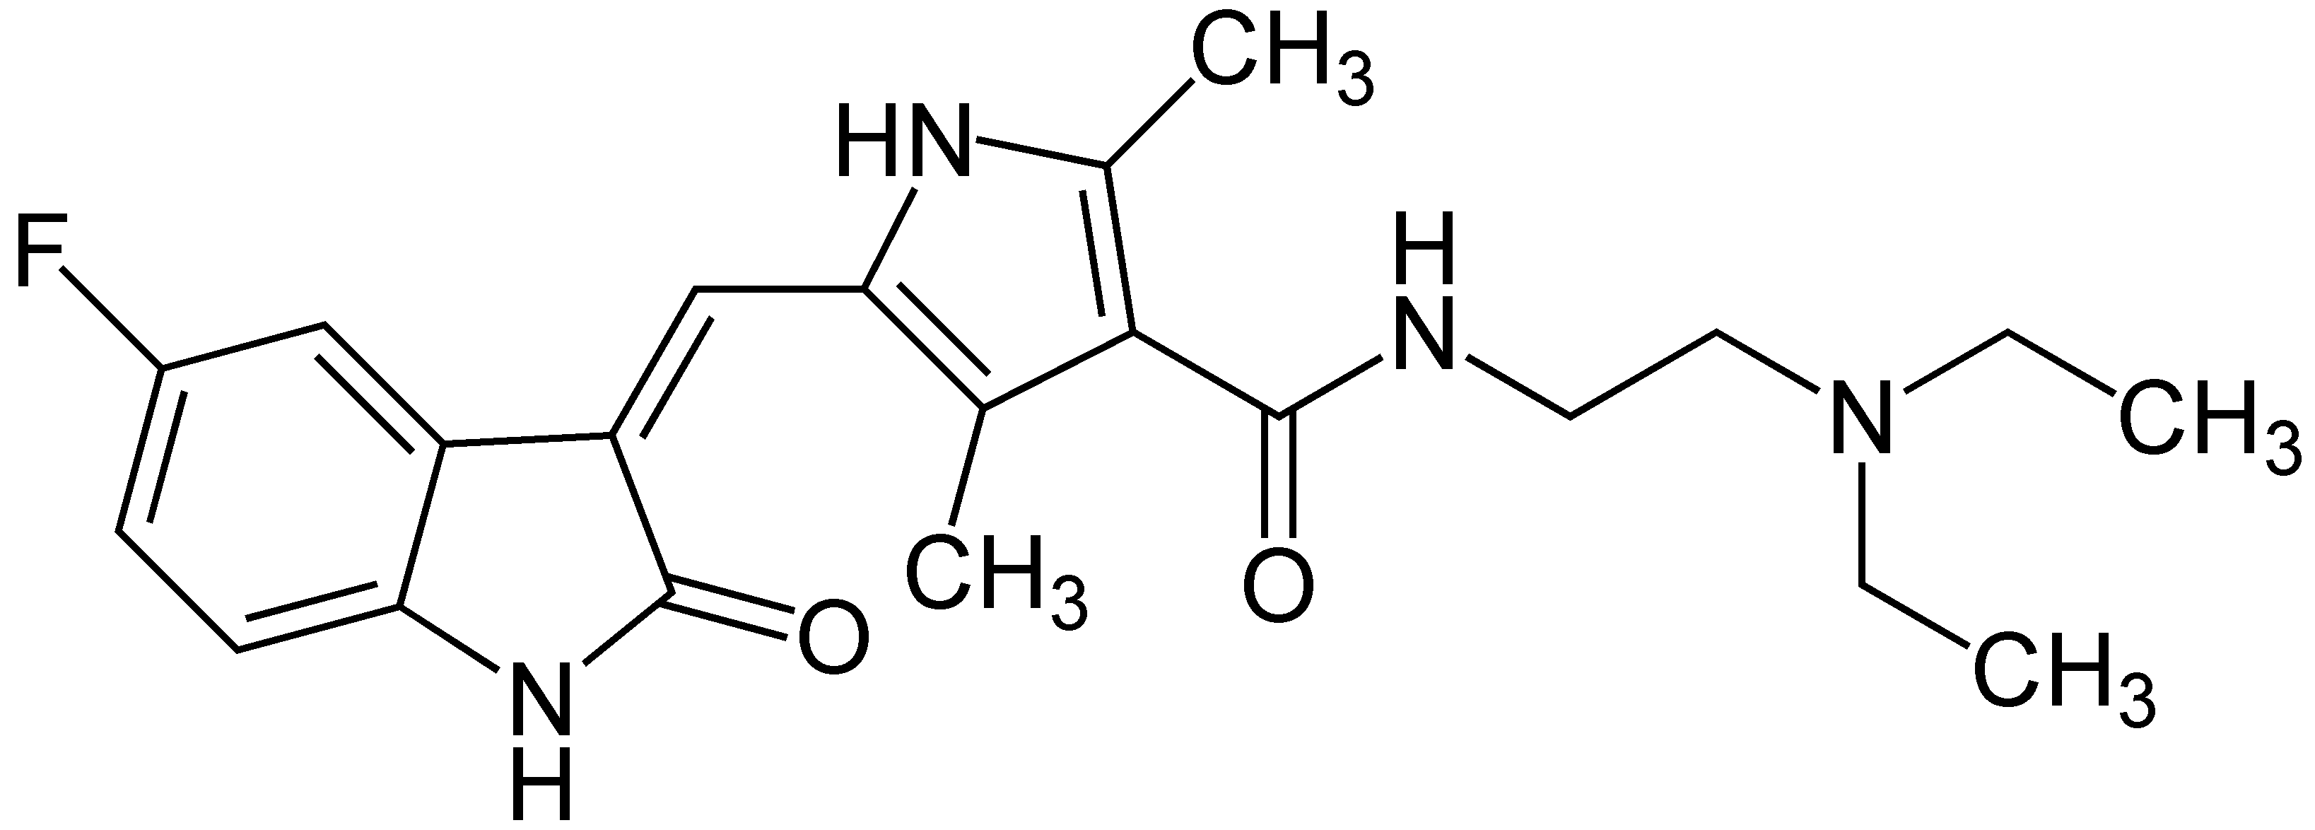
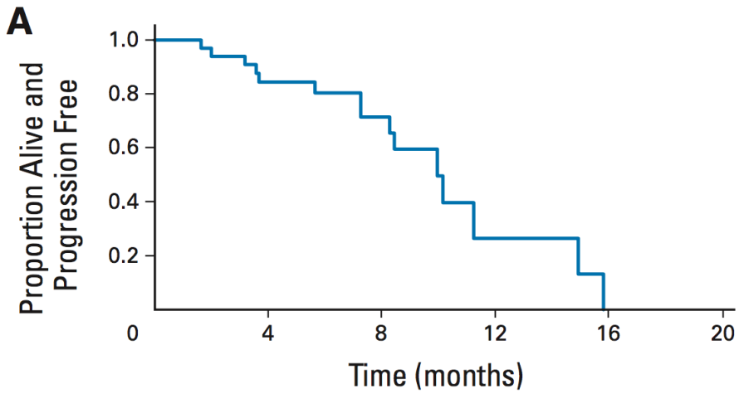
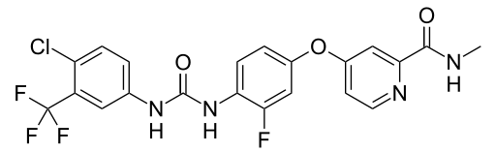
First line:
IMATINIB
Heinrich et al. JAMA (2017)
Second line:
SUNITINIB
Demetri et al. Lancet (2006)
Third line:
REGORAFENIB
George et al. JCO (2012)
Notes:
Additional KIT TKIs, namely sunitinib and regorafenib, have been developed and approved as second and third line therapies, but as you can see, progression in a problem with these drugs as well.

Slide 4
Primary
Mutations
Protein
Domains
Secondary
Mutations
Drug
Sensitivity
IM
SU
REG
Ligand binding
Exon 13
V654A
Exon 8
Exon 14
T670I
Exon 9
Membrane
Exon 11
JM
Exon 13
D816A/G/H/V
ATP binding
Exon 17
D820A/E/G/Y
N822H/K
Activation Loop
Y823D
Exon 17
Exon 18
A829P
Resistant
Intermediate
Sensitive
NR
Not reported

Slide 5
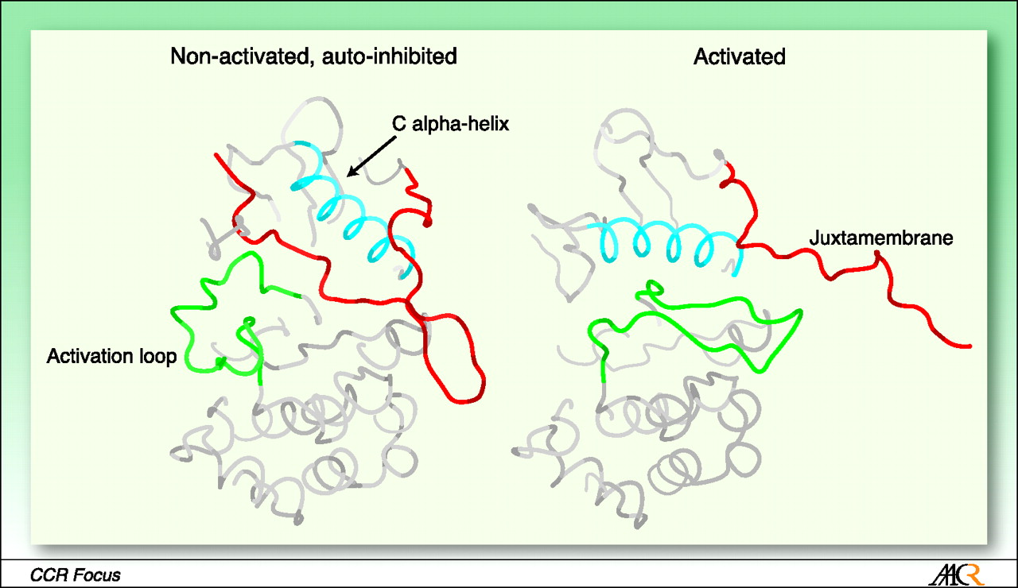
Structural Regulation of KIT Enzymatic Activity
Adapted from Gajiwala K. S. et.al. PNAS 2009;106:1542-1547
Notes:
In order to understand drug resistance to KIT inhibitors, we need to consider the structural biology of kinase activation. The non-activated form of KIT exists in the structure shown here, with the juxtamembrane domain encoded by exon 11, shown in red sitting down and forcing the activation loop shown in green to the left of the structure.
Activation of the kinase can occur when phosphorylation or mutation of the juxtamembrane domain disorders this protein region, so that it no longer is closely approximated to the substrate binding pocket and entrance to the ATP binding pocket. With displacement of the juxtamembrane domain, the green activation loop can swing into the active conformation.

Slide 6
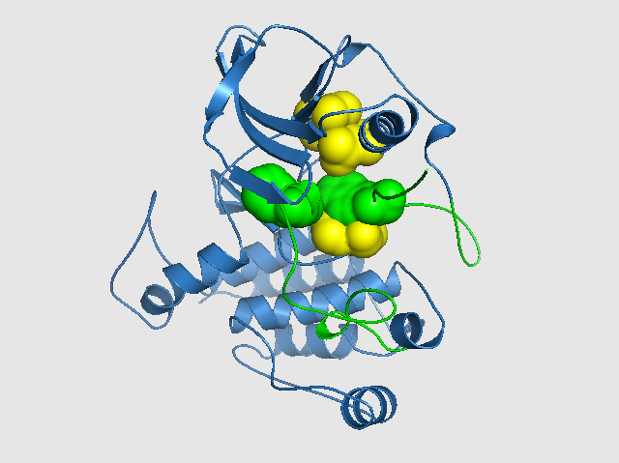
JM-Inhibited Inactive Kinase
1.
Snapshot 1. The rightmost green residue from the inhibitory JMD switch occupies the #3 position in the kinase vertical spine (the other three spine residues are shown in yellow).
In this conformation, KIT kinase is in its OFF state. Note that the ‘DFG’ phenylalanine amino acid (green) is in the left-most position, blocking the ATP pocket.
DFG
Phenylalanine
2.
JMD
Tryptophan
W557
3.
4.
Notes:
Shown here is a closer view of the inactive form of the KIT kinase. I call your attention to this vertical spine of 4 amino acids, labelled 1-4. In the active kinase conformation, a tryptophan from codon 557 of juxtamembrane domain sits in position. This causes the phenylalanine of the DFG domain to be forced to the left. The DFG is the hinge of the activation loop. If you think of the activation loop as a gate, then the trytophan shown here acts the gate latch.

Slide 7
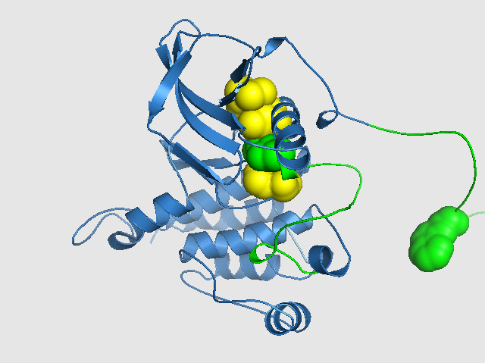
Activated Kinase Structure
1.
DFG
Phenylalanine
1.
Snapshot 2. The rightmost green residue from the inhibitory JMD switch has been moved out of the #3 position in the kinase vertical spine (the other three spine residues are shown in yellow).
In this conformation, KIT kinase is in its ON state. Note that the ‘DFG’ phenylalanine amino acid (green) is now in the #3 position in the vertical spine.
DFG
Phenylalanine
2.
JMD
Tryptophan
2.
3.
3.
4.
4.
JMD
Tryptophan
W557
Notes:
When the JM becomes phosphorylated and the JM trytophan is displaced from the vertical spine, the phenylalanine can rotate into the spine position 3, and the activtion lloop can swing into the active conformation.

Slide 8
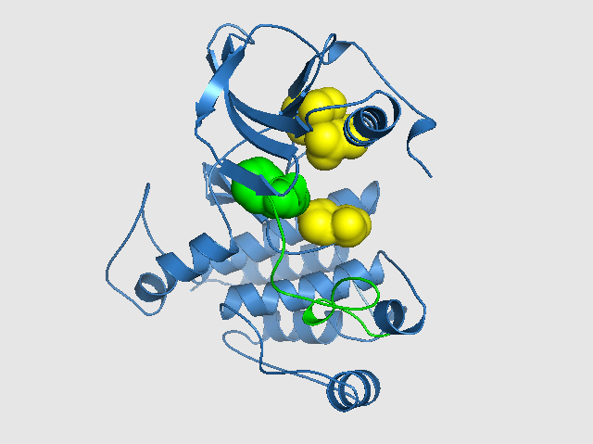
Effect of JM-mutation on Kinase Conformation
1.
1.
Snapshot 3. The rightmost green residue from the inhibitory JMD switch has been mutated and can no longer function as an inhibitory element to bind into the #3 position in the kinase vertical spine (the other three spine residues are shown in yellow).
In this mutant form, the ‘DFG’ phenylalanine (green) is free to move over and occupy the #3 spine position and activate the kinase since the inhibitory JMD has been mutated.
DFG
Phenylalanine
2.
DFG
Phenylalanine
2.
JMD
Tryptophan
3.
JMD
W557 is
mutated or
deleted
4.
4.
Notes:
Mutation of exon 11, mimics the naturally occuring JM displacement. Notably, deletion or mutation of trytophan 557 is the most common type of mutation found in GIST. Deletion or mutation of this codon frees up position 3 in the spine. Going back to our analogy, this is equivalent to removing the latch, those allowing the gate to swing in both directions.

Slide 9
Effect of Activation Loop Mutations on Kinase Structure
1.
DFG
Phenylalanine
1.
Snapshot 4. The rightmost green residue from the inhibitory JMD switch has been moved out of the #3 position in the kinase vertical spine (the other three spine residues are shown in yellow). Mutations of the activation loop stabilize the kinase in the active conformation.
In this conformation, KIT kinase is in its ON state. Note that the ‘DFG’ phenylalanine amino acid (green) is now in the #3 position in the vertical spine.
DFG
Phenylalanine
2.
JMD
Tryptophan
2.
3.
Codon 816, 820, 822, or 823 mutations
3.
4.
4.
JMD
Tryptophan
Notes:
Mutations of the KIT activation loop, shown here in red help stablilize the kinase in the active domain. In this situation, the phenylalanine of the DFG motif remains in spine position 3. Stablization of the ativation loop prevent the phenylanine from rotating back out of spine position 3. Functionally, the kinase remains stuck in the active conformation.

Slide 10
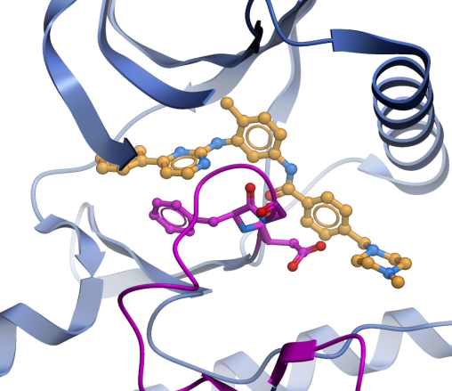
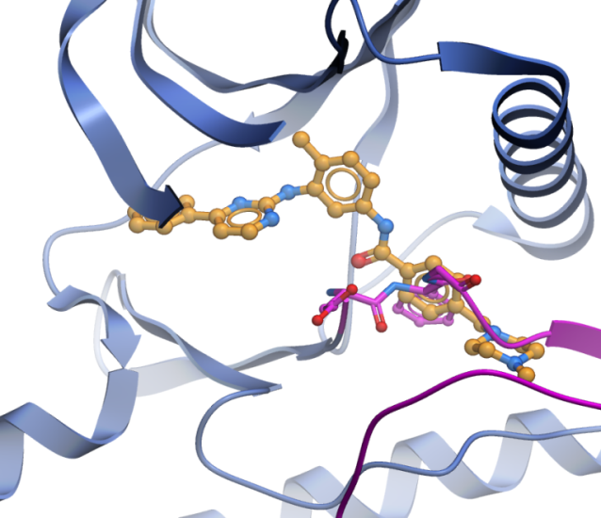
Imatinib can only bind (inhibit) the inactive form of KIT
KIT
PDGFRα
KIT
Inactive conformation
Active conformation
imatinib
A-loop
imatinib
A-loop
Imatinib binds the inactive kinase conformation and inhibits many primary mutants
Imatinib is a highly effective first-line GIST therapy

Slide 11
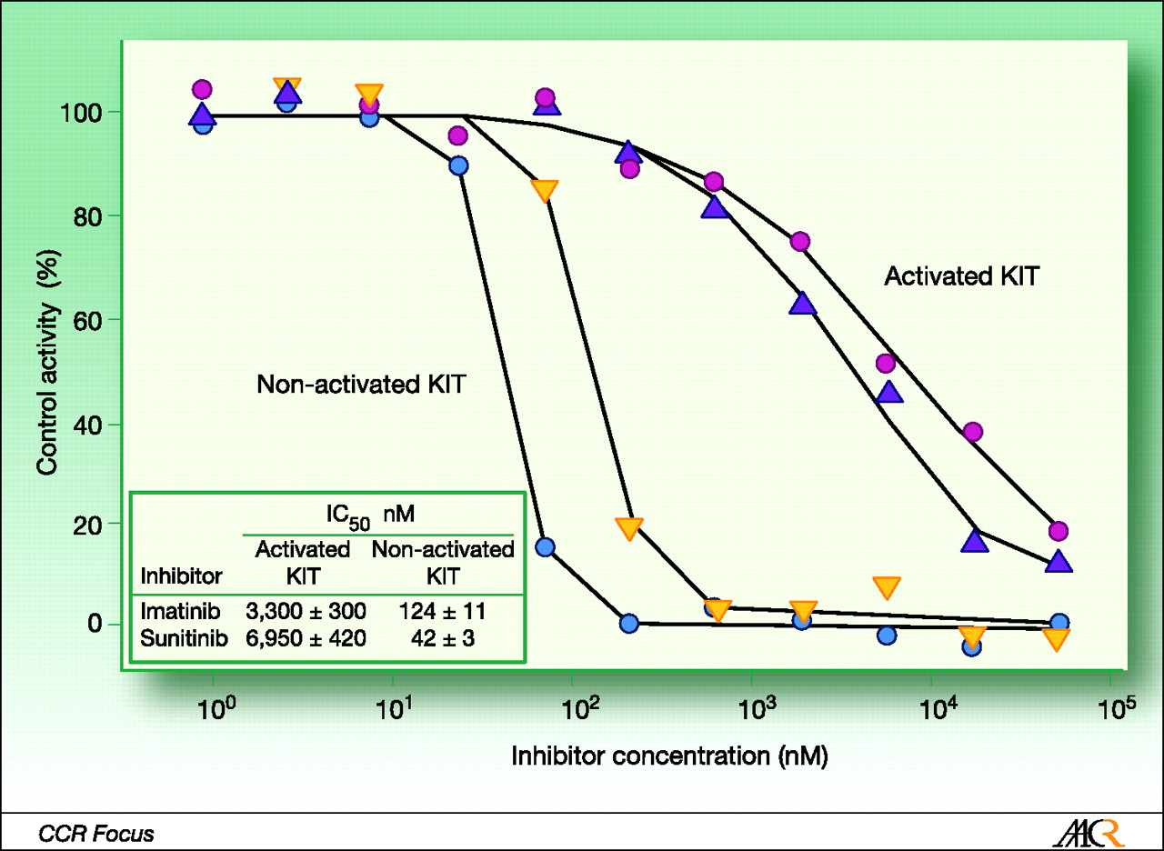
Imatinib and Sunitinib (and Regorafenib) Only Inhibit the Inactive Form of KIT
Adapted from Gajiwala K. S. et.al. PNAS 2009;106:1542-1547
Notes:
The biochemical consequence of activation loop mutations is to maintain the KIT kinase in a conformation that cannot be inhibited by imatinib or sunitinib. Shown here are biochemical assays of non-activated vs. activated forms of KIT. A shown in the lines with circle symbols, sunitinib can inhibit the non-activated form of KIT but only weakly inhibits the activated form. Similar results are seen in the case of imatinib, as shown by the curves with solid triangle symbols. The IC50 data is summarized on the table insert, with the IC50 for imatinib against of non-activated KIT being124 nM vs 3300 for the activated form.

Slide 12
Beyond imatinib, there are no highly effective therapies
Primary resistance
Secondary resistance
1L
imatinib
ORR ~60%
PFS 19 mo
2L
sunitinib
ORR ~7%
PFS 6 mo
3L
regorafenib
ORR ~5%
PFS 4.8 mo
4L
no approved therapy
ORR ~0%
PFS ≤1.8 mo*
*Imatinib re-challenged
 | Prevalence
Resistance mutation | Primary | Secondary
PDGFRα D842V | ~5–6% | Rare
KIT exon 17/18 | ~1% | 2L ~23% ≥3L ~90%
KIT exon 13 | N/A | 2L ~40%
  Primary and secondary mutations cause therapeutic resistance
  Approved agents are ineffective against PDGFRα D842V

Slide 13
Clinical activity of BLU-285 in advanced
gastrointestinal stromal tumor (GIST)
Michael Heinrich¹, Robin Jones², Margaret von Mehren³, Patrick Schoffski⁴, Sebastian Bauer⁵, Olivier Mir⁶, Philippe Cassier⁷, Ferry Eskens⁸, Hongliang Shi⁹, Terri Alvarez-Diez⁹, Oleg Schmidt-Kittler⁹, Mary Ellen Healy⁹, Beni Wolf⁹, Suzanne George¹⁰
¹Oregon Health & Sciences University, Oregon, USA; ²Royal Marsden Hospital/Institute of Cancer Research, London, UK; ³Fox Chase Cancer Center, Pennsylvania, USA; ⁴Leuven Cancer Institute, Leuven, Belgium; ⁵University of Essen, Essen, Germany; ⁶Institut Gustave Roussy, Paris, France; ⁷Centre Leon Berard, Lyon, France; ⁸ Erasmus MC Cancer Institute, Rotterdam, Netherlands; ⁹Blueprint Medicines Corporation, Massachusetts, USA; ¹⁰Dana-Farber Cancer Institute, Massachusetts, USA
Abstract no: 11011
ASCO 2017
Presented by: Dr. Michael Heinrich

Slide 14
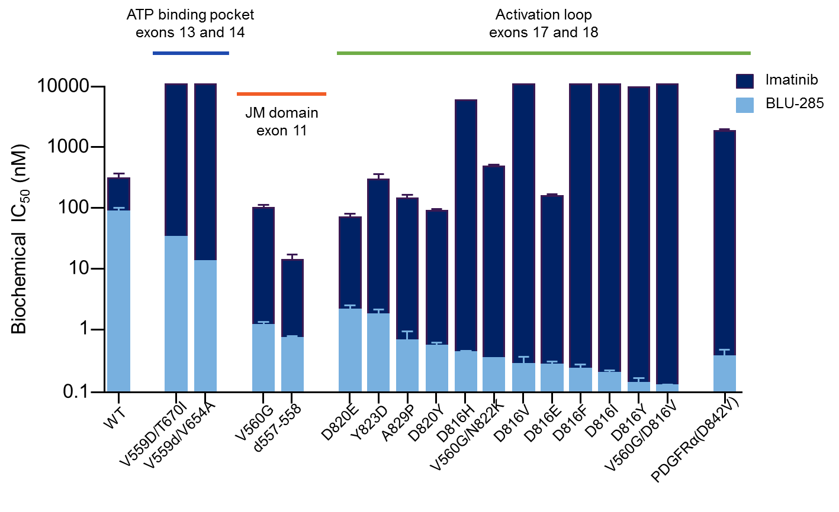
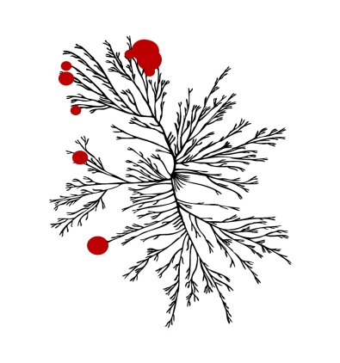
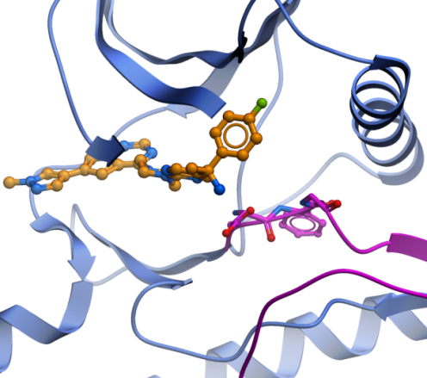
BLU-285: highly potent and selective targeting of KIT/PDGFRα mutants
High kinome selectivity*
Binds active conformation
BLU-285
*Image reproduced courtesy of CSTI (www.cellsignal.com)
Notes:
3 micromolar assay run on kinome trees

Slide 15
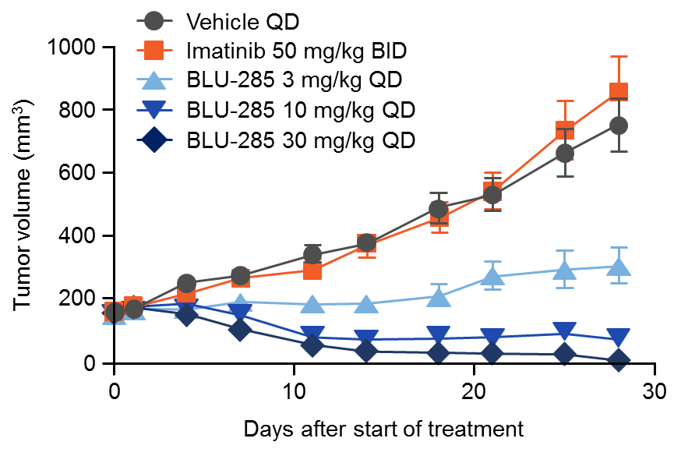
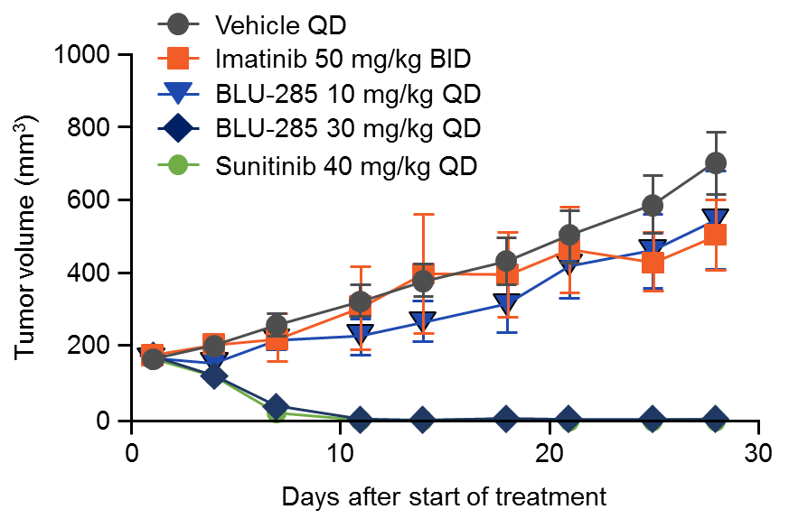
BLU-285: highly active against imatinib-resistant
GIST patient derived xenografts
KIT exon 11/17 mutant
KIT exon 11/13 mutant
Tumor regression at 10 and 30 mg/kg QD
Tumor regression at 30 mg/kg QD
Notes:
3 micromolar assay run on kinome trees
KIT exon 11 (del556–558) / 17 (Y823D) mutant
KIT exon 11 (V559D) / 13 (V654A) mutant
Left hand graph: Tumor regression at 10 and 30 mg QD
Right hand graph: Tumor regression at 30 mg QD

Slide 16
BLU-285 Phase 1 Study Design
Key objectives
Part 1: MTD, safety, pharmacokinetics, ctDNA analyses, anti-tumor activity
Part 2: response rate, duration of response, safety
Part 1
Dose escalation completed
Part 2
Dose expansion enrolling
PDGFRα D842V-mutant GIST (n=50)
Advanced GIST
MTD
Unresectable GIST after imatinib
and ≥1 other TKI (n=50)
3+3 design with enrichment
Dose levels: 30, 60, 90, 135,
200, 300, 400 and 600 mg QD
MTD determined to be 400 mg PO QD

Slide 17
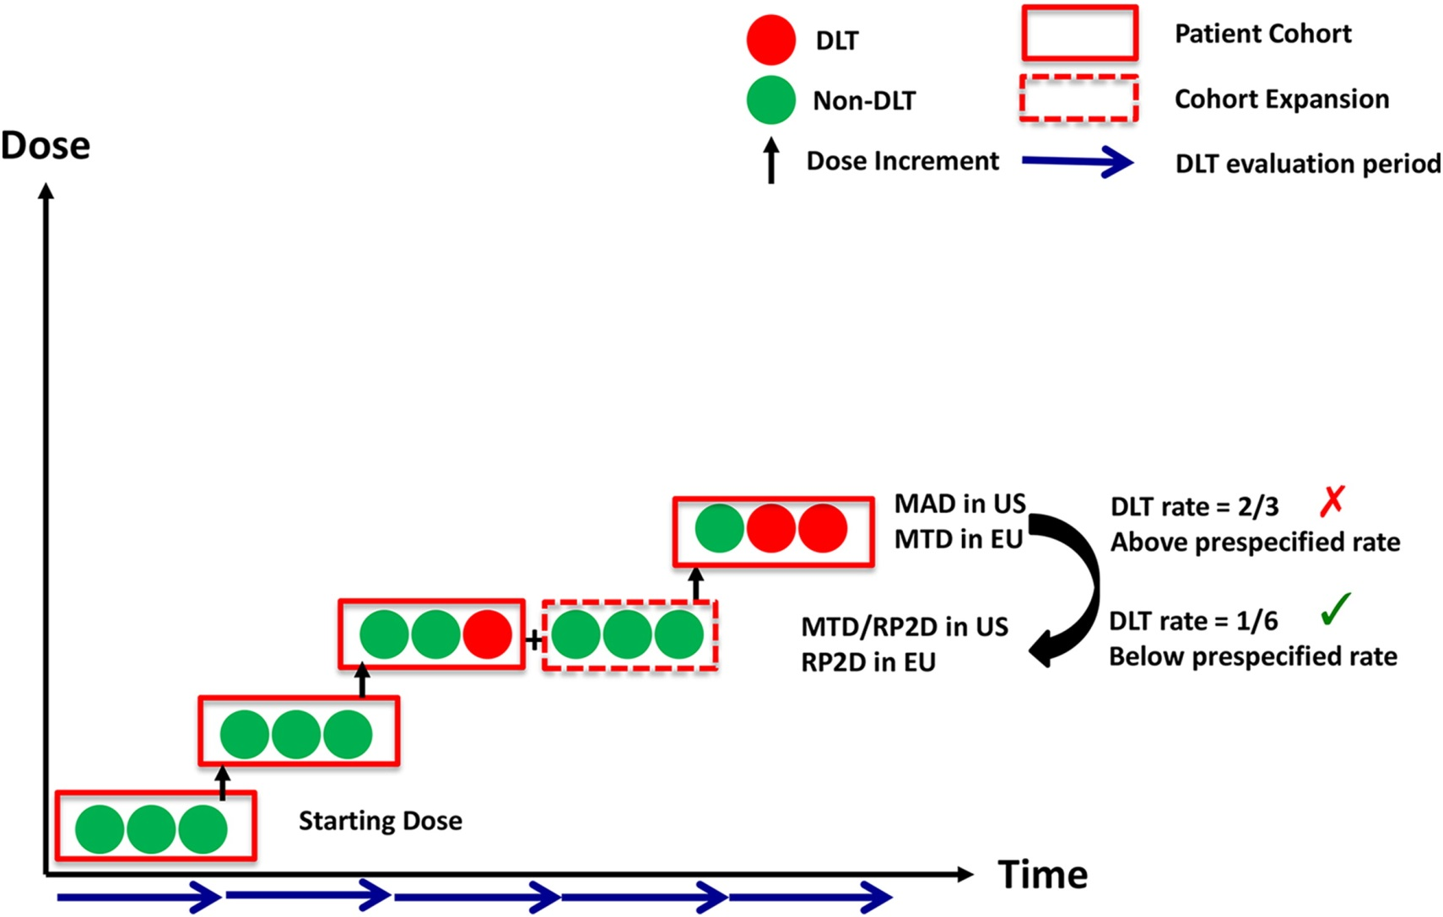
3+3 Dose escalation phase 1 study design
Cook et al., Molecular Oncology 2016

Slide 18
Demography and baseline patient characteristics
Parameter | All patients, N=72
Age (years), median (range) | 61 (25–85)
 | n (%)
GIST subtype KIT mutant PDGFRα mutant | 40 (56) 32 (44)
Metastatic disease | 69 (96)
Largest target lesion size (cm) ≤5 >5–≤10 >10 | 18 (25) 25 (35) 29 (40)
No. prior kinase inhibitors Median (range) ≥3 Prior regorafenib | PDGFRα 1.5 (0–6) 10 (31) 8 (25) | KIT 4 (2–11) 36 (90) 34 (85)
Data are preliminary and based on a cut off date of 28 April 2017

Slide 19
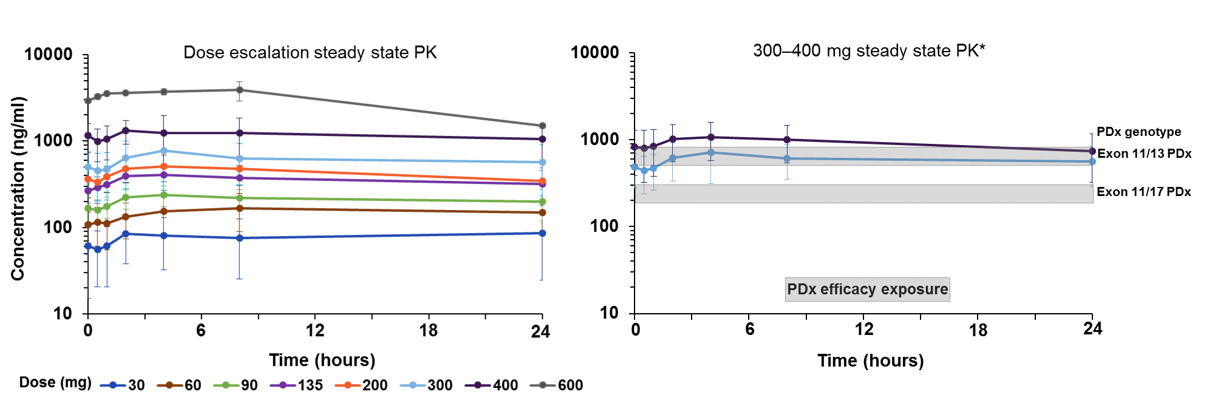
BLU-285 pharmacokinetics support once daily dosing and broad mutational coverage
*includes escalation and expansion data
Relatively rapid absorption Tmax ~2–8 hours and long half-life >24 hours
Exposure at the 300 and 400 (MTD) mg provides broad coverage of primary and secondary KIT/PDGFRα mutations based on patient derived xenografts (PDX)

Slide 20
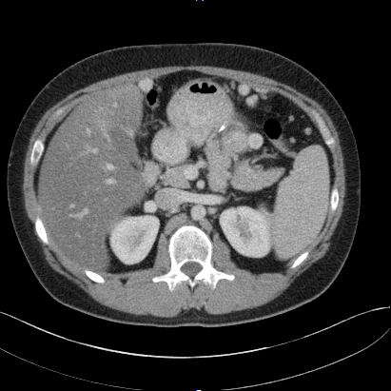
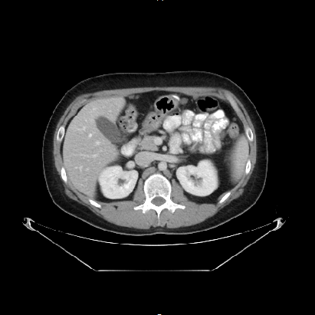
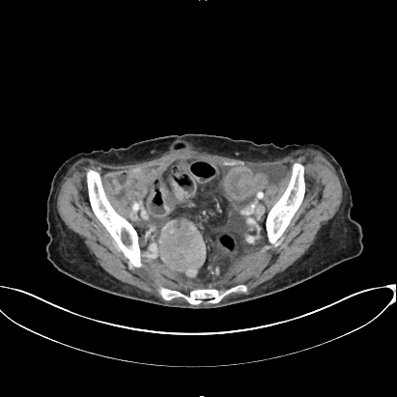
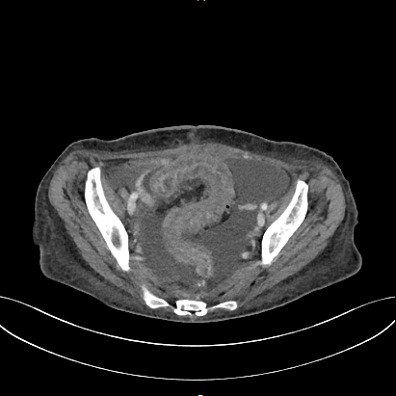
Radiographic response per RECIST 1.1 in PDGFRα D842V-mutant GIST
BLU-285 300 mg (dose escalation)
BLU-285 400 mg (dose expansion)
Target lesion resolution
Target lesion resolution
Baseline
After 4 months
Baseline
After 2 months
Ongoing at cycle 5
Prior imatinib and sunitinib
Confirmed PR, -63% target sum
Ongoing at cycle 3
Prior imatinib
PR (pending confirmation), -85% target sum

Slide 21
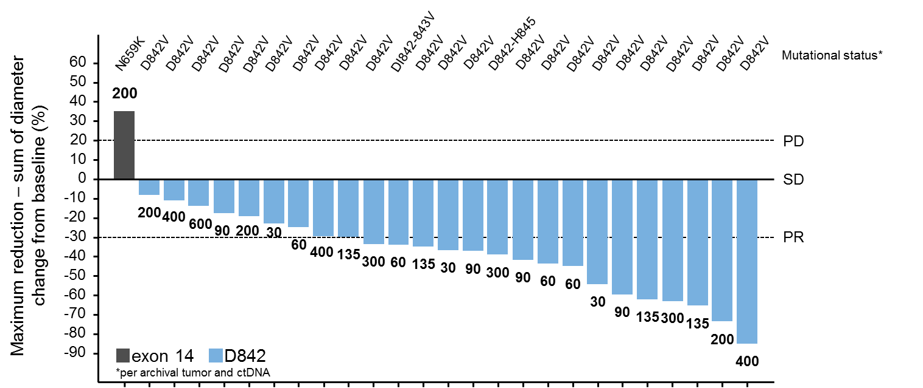
Tumor regression across all dose levels in PDGFRα
D842-mutant GIST (central radiology review)

Slide 22
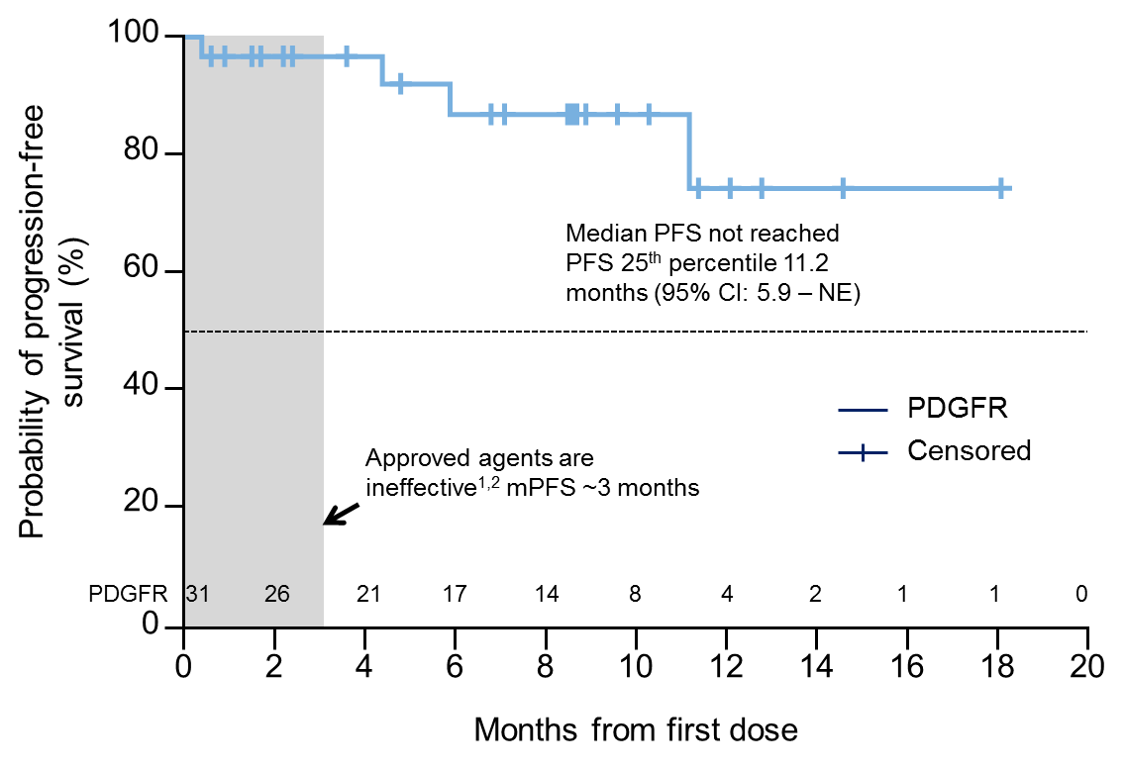
High response rate and prolonged PFS in PDGFRα
D842-mutant GIST
Central radiographic review
Best response (N=25) | Choi Criteria n (%) | RECIST 1.1 n (%)
PR | 25 (100%) | 15* (60%)
SD | 0 | 10 (40%)
DCR (PR + SD) | 25 (100%) | 25 (100%)
PD | 0 | 0
* 12 confirmed, 3 pending confirmation
  Approved agents are ineffective: ORR ~0%

Slide 23
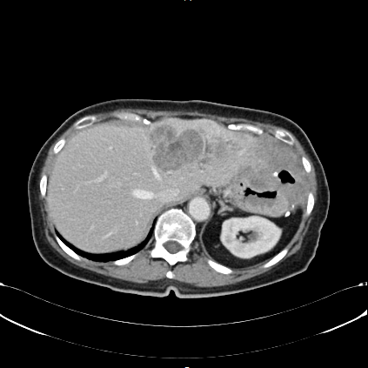
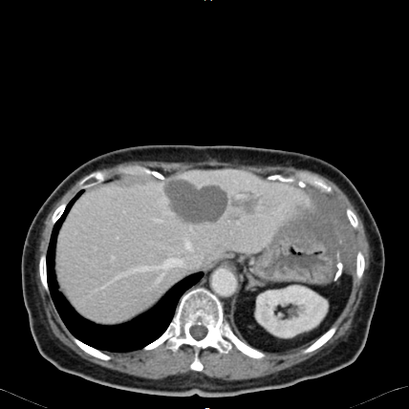
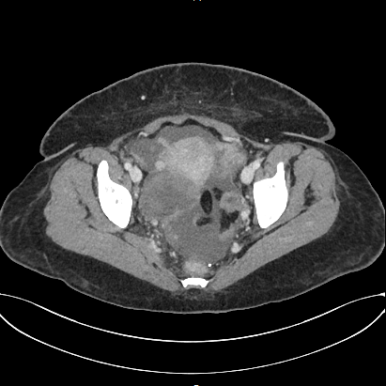
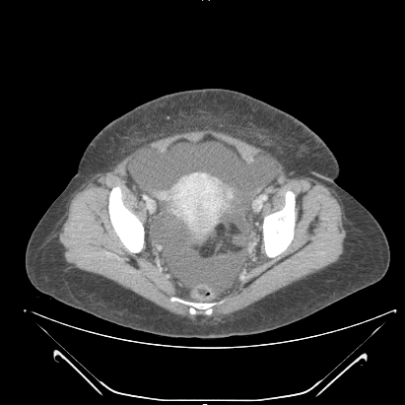
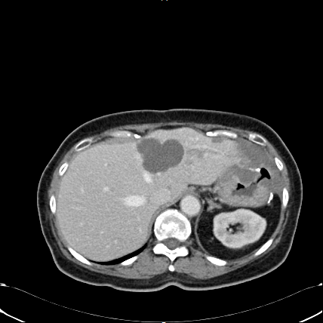
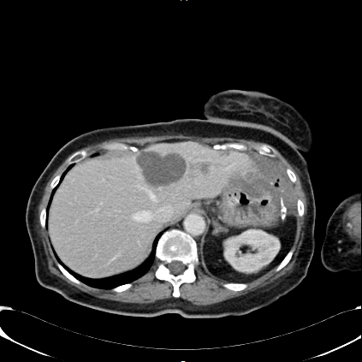
Radiographic response in heavily pre-treated
KIT-mutant GIST
BLU-285 300 mg (dose escalation)
BLU-285 400 mg (dose expansion)
Screening
Cycle 3
Screening
Cycle 3
Cycle 5
Cycle 7
Ongoing at cycle 12
6 prior TKIs; exon 11, 13, and 18 mutations
CHOI PR (density -53%); RECIST SD (-21%)
Ongoing at cycle 4
5 prior TKIs; 1° exon 11 mutation; ctDNA pending
CHOI PR (density -76%); RECIST PR (-41%)

Slide 24
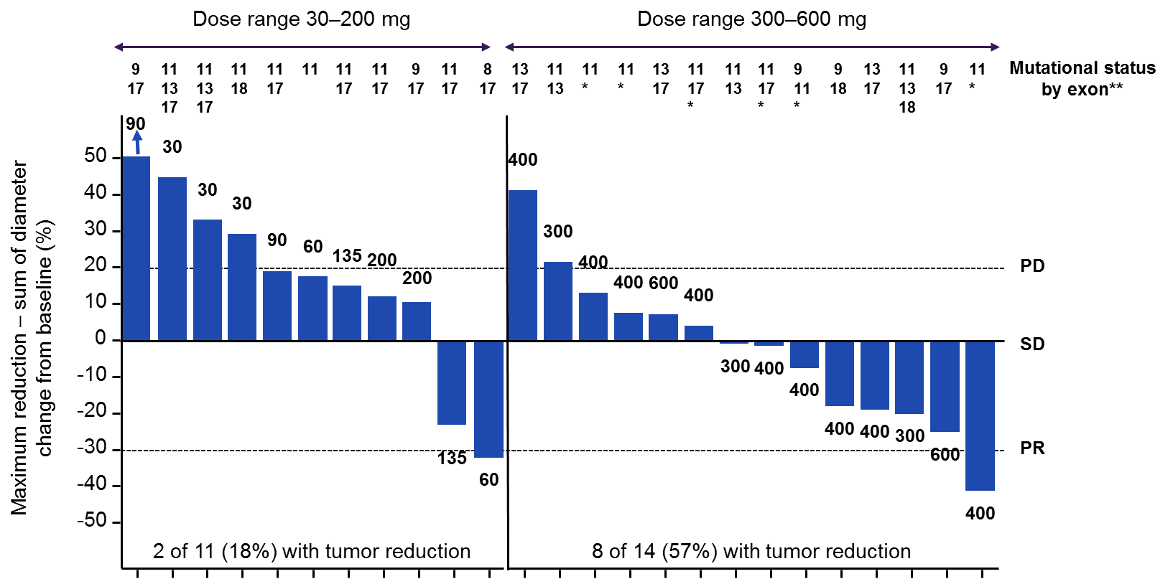
Dose-dependent tumor reduction across multiple
KIT genotypes (central radiographic review)
*ctDNA results pending
**per archival tumor and ctDNA

Slide 25
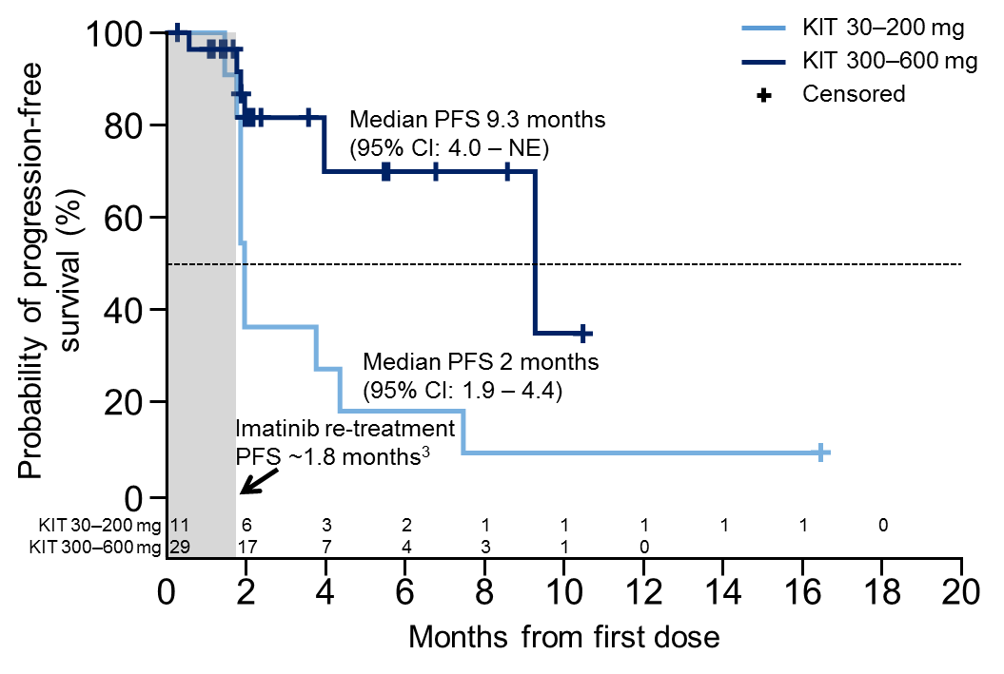
Important clinical activity in heavily pre-treated
KIT-mutant GIST
Central radiographic review
↑ PFS with BLU-285 ≥300 mg
Best response (N=25) | Choi Criteria n (%) | RECIST 1.1 n (%)
PR | 8 (32) | 2* (8)
SD | 6 (24) | 12 (48)
DCR (PR + SD) | 14 (56) | 14 (56)
PD | 11 (44) | 11 (44)
* 1 confirmed, 1 pending confirmation
Beyond third-line regorafenib there are no approved therapies
Imatinib re-treatment in ≥third-line GIST ORR ~0%

Slide 26
Adverse events (AE) associated with BLU-285
Safety population, N=72 |  | Severity, n (%)
AEs in ≥20% of patients | n (%) | Grade 1 | Grade 2 | Grade 3 | Grade 4/5
Nausea | 43 (60) | 31 (43) | 9 (13) | 3 (4) | 0
Fatigue | 38 (53) | 16 (22) | 16 (22) | 6 (8) | 0
Vomiting | 30 (42) | 21 (29) | 6 (8) | 3 (4) | 0
Periorbital edema | 26 (36) | 22 (31) | 4 (6) | 0 | 0
Diarrhea | 24 (33) | 19 (26) | 4 (6) | 1 (1) | 0
Edema peripheral | 22 (31) | 18 (25) | 4 (6) | 0 | 0
Decreased appetite | 20 (28) | 15 (21) | 4 (6) | 1 (1) | 0
Anemia | 18 (25) | 4 ( 6) | 8 (11) | 6 (8) | 0
Lacrimation increased | 17 (24) | 12 (17) | 5 (7) | 0 | 0
Dizziness | 16 (22) | 13 (18) | 3 (4) | 0 | 0
18 (25%) patients had Grade (G) ≥3 treatment-related (Fatigue [8%], hypophosphatemia [6%], anemia [4%], nausea, vomiting, hyperbilirubinemia [3% each])
DLT in 2 patients at 600 mg: 1 G2 hyperbilirubinemia; 1 G2 rash, hypertension, memory impairment
BLU-285 discontinuations: disease progression n=19, treatment-related toxicity (G3 hyperbilirubinemia) n=1, and investigator’s decision n=1

Slide 27
Conclusions from BLU-285 ASCO Presentation
BLU-285 is well tolerated on a QD schedule at doses up to the MTD of 400 mg
BLU-285 has strong clinical activity in PDGFRα D842-mutant GIST with an ORR of 60% per central review and median PFS not reached
  Potential expedited paths for approval are being evaluated
BLU-285 demonstrates important anti-tumor activity including radiographic response and prolonged PFS in heavily pre-treated, KIT-mutant GIST at doses of 300–400 mg QD
Based on these encouraging data, planning is underway for a Phase 3 randomized study of BLU-285 in third-line GIST (BLU-285 vs. regorafenib)

Slide 28

2017 ASCO - Abstract 2515, Board #7
Pharmacokinetic-driven phase I study of DCC-2618 a pan-KIT and PDGFR inhibitor in patients (pts) with gastrointestinal stromal tumor (GIST) and other solid tumors
Filip Janku, Albiruni Abdul Razak, Michael S. Gordon, David Brooks, Daniel Flynn, Michael Kaufman, Jama Pitman, Bryan Smith, Neeta Somaiah, John De Groot, Guo Chen, Julia Jennings, Samer Salah,
Deb Westwood, Eric Gerstenberger, Oliver Rosen, Suzanne George

Slide 29
  DCC-2618 BACKGROUND
DCC-2618 is a KIT and PDGFRA
inhibitor resilient to gain-of-function
and drug resistance mutations
  Potency independent of ATP
  concentration
  DCC-2618 was designed to potently
  inhibit a broad range of mutations
  in KIT and PDGFRA kinases
  Gastrointestinal stromal tumor (GIST) is an important disease to achieve proof-of-concept in the FIH study due to the multiplicity and heterogeneity of resistance mutations within KIT
Deciphera’s Switch Control Inhibition

Slide 30
JM-Inhibited Inactive Kinase
1.
Snapshot 1. The rightmost green residue from the inhibitory JMD switch occupies the #3 position in the kinase vertical spine (the other three spine residues are shown in yellow).
In this conformation, KIT kinase is in its OFF state. Note that the ‘DFG’ phenylalanine amino acid (green) is in the left-most position, blocking the ATP pocket.
DFG
Phenylalanine
2.
JMD
Tryptophan
3.
4.
Notes:
Shown here is a closer view of the inactive form of the KIT kinase. I call your attention to this vertical spine of 4 amino acids, labelled 1-4. In the active kinase conformation, a tryptophan from codon 557 of juxtamembrane domain sits in position. This causes the phenylalanine of the DFG domain to be forced to the left. The DFG is the hinge of the activation loop. If you think of the activation loop as a gate, then the trytophan shown here acts the gate latch.

Slide 31
Activated Kinase Structure
1.
DFG
Phenylalanine
1.
Snapshot 2. The rightmost green residue from the inhibitory JMD switch has been moved out of the #3 position in the kinase vertical spine (the other three spine residues are shown in yellow).
In this conformation, KIT kinase is in its ON state. Note that the ‘DFG’ phenylalanine amino acid (green) is now in the #3 position in the vertical spine.
DFG
Phenylalanine
2.
JMD
Tryptophan
2.
3.
3.
4.
4.
JMD
Tryptophan
Notes:
When the JM becomes phosphorylated and the JM trytophan is displaced from the vertical spine, the phenylalanine can rotate into the spine position 3, and the activtion lloop can swing into the active conformation.

Slide 32
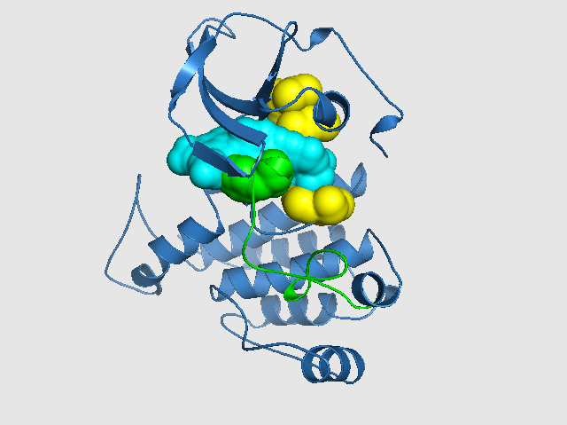
Switch Pocket Inhibitor Locks Kinase Into Inactive Conformation
1.
1.
1.
2.
Snapshot 5. Switch Pocket Inhibitor binds to mutant KIT, with part of the inhibitor structure (blue) occupying the #3 position of the spine. This binding mode provides a biomimetic surrogate for the deleted inhibitory switch of mutant KIT.
The ‘DFG’ phenylalanine residue (green) is forced to occupy the out/inhibited conformation.
3= DFG
Phenylalanine
DFG
Phenylalanine
2.
DFG
Phenylalanine
2.
JMD
Tryptophan
3.
Inhibitor occupies
#3 spine
position
3.
JMD
Tryptophan is
mutated or
deleted
4.
4.
4.
Notes:
To combat the problem of drug resistance associated with activation loop mutations, we sought to develop switch pocket inhibitors that can bind into spine position 3. These compounds with mimic the actitvity of wild-type kit exon 11 and would force the phenylanine hinge of the DFG motif into the inacitive conformation.

Slide 33
  RATIONALE FOR DCC-2618 STUDY
Activity regardless whether primary mutation is in KIT Exon 9, Exon 11, or Exon 17
  IC₅₀ for KIT Exon 11 deletion 3 nM, IC₅₀ PDGFRA D842V 60 nM
Broad activity in secondary KIT mutations across Exons 13, 14, 17, and 18
  Active metabolite DP-5439 possesses comparable activity across all mutations
KIT T670I and V654A secondary mutations are the least sensitive to DCC-2618
  IC₅₀ for KIT T670I 221 nM , IC₅₀ for 189 nM for KIT V654A

Slide 34
  DCC-2618-01-001: DESIGN AND OBJECTIVES
  Design (NCT02571036)
  Pharmacologically-guided 3+3 escalation phase I study of oral DCC-2618 administered BID every 28 days
Objectives
  Primary: Safety, tolerability, maximum tolerated dose (MTD), dose-limiting toxicities (DLT)
  Secondary: Pharmacokinetic profile, antitumor efficacy
  Exploratory: Determination of KIT and/or PDGFRA mutations in plasma cell-free DNA (NGS) and serum tryptase
Major eligibility criteria
  Patients with advanced refractory cancers and molecular rationale for activity
  ECOG 0-1
  Adequate organ function
  Prior KIT/PDGFRA inhibitors were allowed

Slide 35
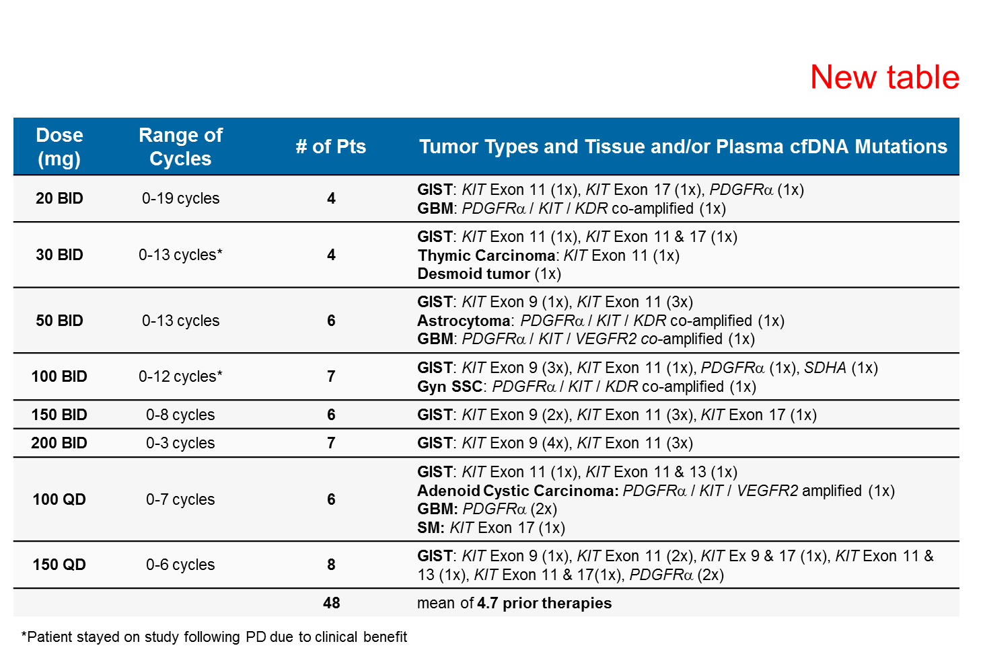
DCC-2618 Dose Levels & Patient Characteristics (N=48)
Cutoff date – 08/May/2017
  DCC-2618 is well tolerated up to 200 mg BID.
    No patient discontinued DCC-2618 due to toxicity.
    All DLTs were not clinically significant.
  DCC-2618 produced encouraging disease control with objective responses and prolonged stable disease in heavily pre-treated GIST patients.
    The DCR for KIT- and PDGFRα GIST for cohorts for daily dose equivalents of ≥100 mg at 6 months is 60% (9/15 patients), and at 3 months is 78% (18/23 patients).
  Notable reductions in MAF of imatinib resistance mutations across all relevant exons in KIT suggests activity across a wide range of imatinib resistance mutations in advanced GIST.
  A durable partial response >18 months in a GBM patient (94% tumor reduction to date) at 20 mg BID warrants further evaluation in this indication.
  150 mg QD is the recommended dose of DCC-2618 for the Phase 1 expansion stage, which includes the following cohorts:
    Patients with GIST who have progressed on or are intolerant of imatinib.
    Patients with advanced systemic mastocytosis.
    Patients with other KIT- and PDGFRα driven diseases e.g., gliomas.

Slide 36
Summary of TEAEs by Grade [≥5 (≥10%)]*
Grade 3/4 by Cohort - All Grades Regardless of Causality
Event Term | Total Events | Grade 1/2 |  | Grade 3 &4 | 20mg BID (N=4) | 30mg BID (N=4) | 50mg BID (N=6) | 100mg BID (N=7) | 150mg BID (N=6) | 200mg BID (N=7) | 100mg QD (N=6) | 150mg QD (N=8)
Fatigue | 22 | 21 |  | 1 |  |  | 1
Alopecia | 13 | 13
Anaemia | 13 | 6 |  | 7 |  | 1 | 2 | 2 | 2
Lipase increased | 12 | 6 |  | 6 | 1 |  |  | 2 |  | 1 | 1 | 1
Decreased appetite | 11 | 10 |  | 1 |  |  |  |  |  |  | 1
Abdominal pain | 9 | 8 |  | 1 |  |  |  |  |  |  | 1
Dyspnoea | 9 | 9
Weight decreased | 9 | 9
Amylase increased | 8 | 7 |  | 1 |  |  |  |  |  |  | 1
Nausea | 8 | 8
Arthralgia | 7 | 7
Constipation | 7 | 7
Diarrhoea | 7 | 7
Hypertension | 7 | 4 |  | 3 |  |  |  | 1 | 1 | 1
Myalgia | 7 | 7
Vomiting | 7 | 6 |  | 1 |  |  |  |  | 1
Blood bilirubin increased | 6 | 5 |  | 1 |  |  |  |  |  |  |  | 1
Cough | 6 | 6
Blood creatine phosphokinase increased | 5 | 3 |  | 2 |  | 1 |  |  |  |  |  | 1
Hypokalaemia | 5 | 4 |  | 1 |  |  | 1
Urinary tract infection | 5 | 4 |  | 1 |  |  |  |  | 1
 |  |  |  |  |  |  |  |  |  | * Data Cut 08/May/2017
All lipase and creatine phosphokinase elevations were not clinically significant.
Two G3 lipase elevations and a G4 creatine phosphokinase elevation were DLTs and occurred at 100 mg & 200 mg BID and 150 mg QD, respectively.

Slide 37
Cycle 1 Plasma Pharmacokinetics Total Exposure Across QD and BID Dosing Cohorts (N=48)
DP-5439, an active metabolite of DCC-2618, exhibits comparable activity across all KIT mutations and substantially contributes to total drug exposure.
QD dose cohorts show a dose proportional increase in total exposure from 100 to 150 mg.
BID dose cohort exposures are dose proportional from 30 to 100 mg BID and then plateau from 100 to 200 mg BID.
At doses as low as 50 mg BID, reductions in cfDNA were observed across KIT mutations (Fig 6) that include those mutations with the highest in vitro IC₉₀ values to DCC-2618 (data not shown)
Comparison of Day -7 (Fed) to Cycle 1 Day 1 (Fasted) support administration of DCC-2618 with or without food (data not shown).

Slide 38
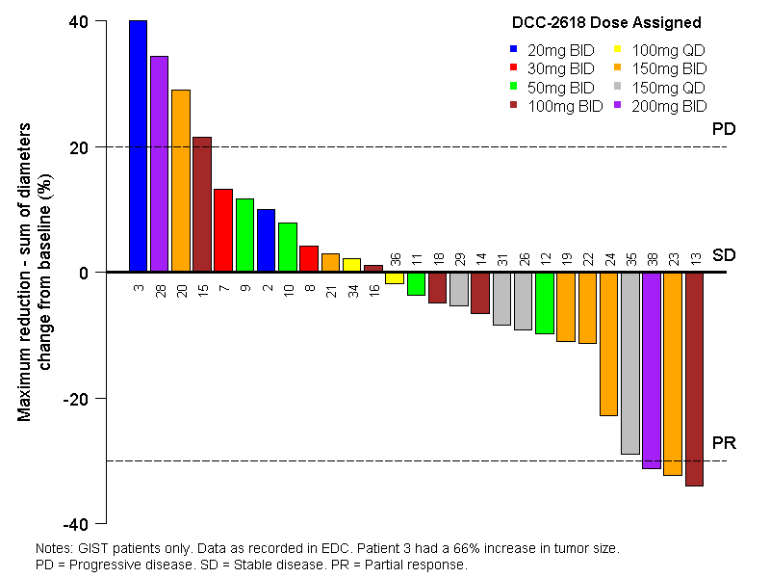
Waterfall Plot (Best Response, N=27)
Cut off May 8th, 2017

Slide 39
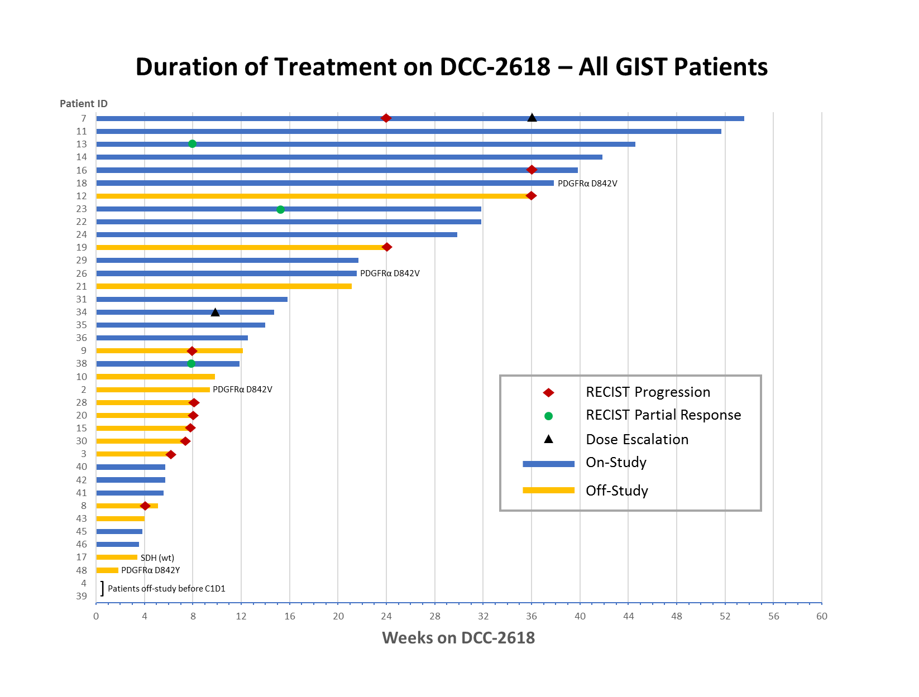
Duration of Treatment on DCC-2618 – All GIST Patients (N=38)
The Disease Control Rate (DCR) for KIT- and PDGFRα GIST cohorts for daily dose equivalents of ≥100 mg
at 6 months is 60% (9/15 patients)
at 3 months is 78% (18/23 patients)

Slide 40
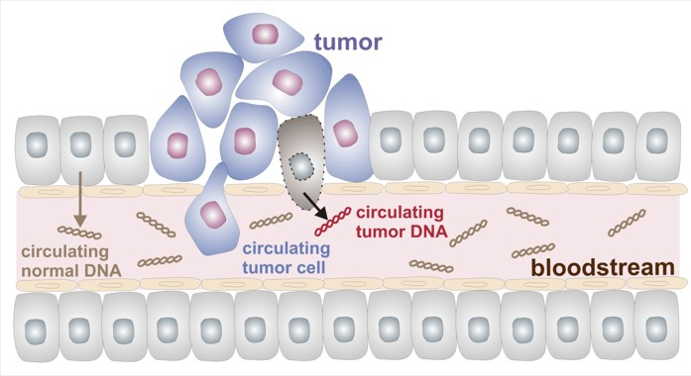
Circulating Tumor DNA (ctDNA)

Slide 41
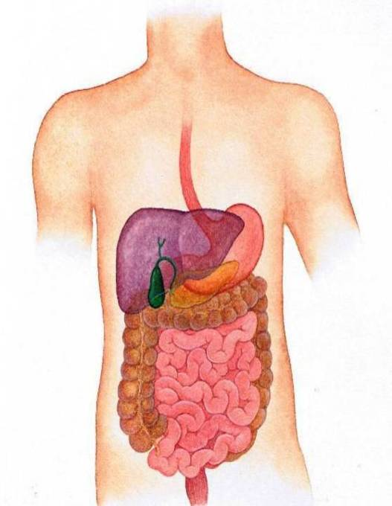
Implications of Mutational Heterogeneity
Drug/ATP binding pocket
Imatinib resistant
Sunitinib sensitive
prim. mut.
sec. mut.
D820G
ex.11
V654A
V654A
D816HG
Kinase activation loop
Imatinib resistant
Sunitinib resistant
D820G
ex.11
N822K
N822Y
N822Y
ex.11
ex.11
N822K
Notes:
41

Slide 42
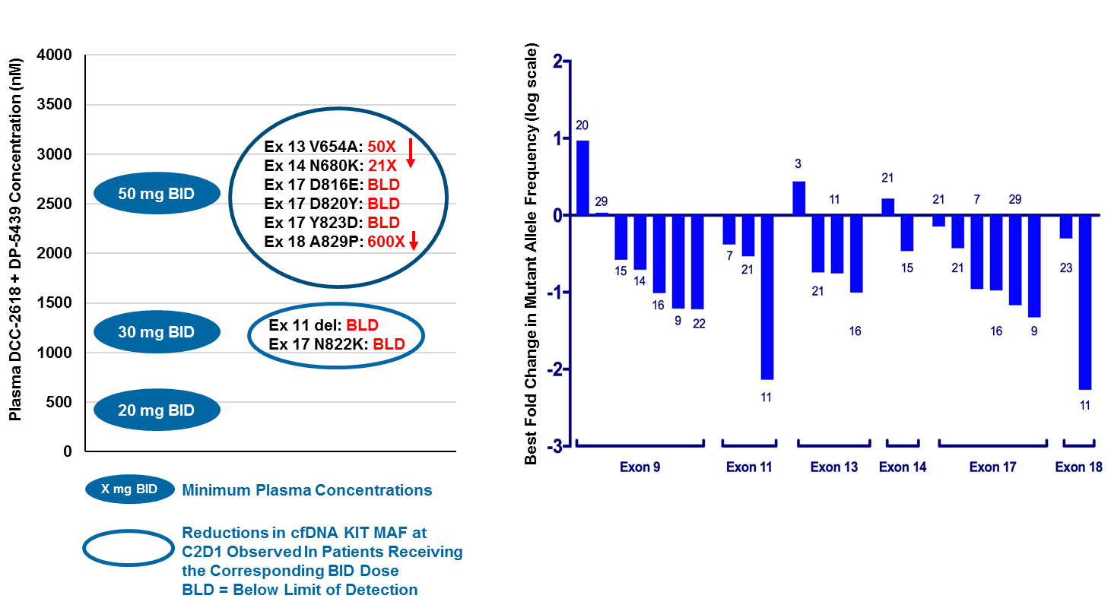
Use of cfDNA as Pharmacodynamic Biomarker to Demonstrate pan−KIT Activity of DCC-2618 in KIT GIST Patients (N=12)
Reduction of MAF observed across all KIT exons
Waterfall plot of best response for MAF reductions for Exons 9, 11, 13, 14, 17, and 18 (reduction from baseline; log scale for Y axis); only patients with detectable plasma cfDNA and follow up are included.
Several patients harbored multiple mutations (see patient numbers at each bar).

Slide 43
Use of cfDNA as Pharmacodynamic Biomarker Demonstrates DCC-2618 Activity at Lower Dose Cohorts
Comparison of DCC-2618 + DP-5439 plasma concentrations (mean C_{min} on Cycle 1 Day 15) with effect on human cfDNA MAF
Moderate doses of 30 to 50 mg BID produce robust plasma concentrations
(1 to 3 μM)
At these doses, MAF of all KIT mutations were reduced including Exons 13, 14, 17, and 18 mutations (shown as % reduction in MAF from baseline)
Ex 13 V654A: 50X
Ex 14 N680K: 21X
Ex 17 D816E: BLD
Ex 17 D820Y: BLD
Ex 17 Y823D: BLD
Ex 18 A829P: 600X
50 mg BID
Plasma DCC-2618 + DP-5439 Concentration (nM)
DCC-2618 Concentration in Cell Assay (nM)
Ex 13 V654A
Ex 14 T670I
30 mg BID
Ex 11 del: BLD Ex 17 N822K: BLD
PDGFRα D842V
Ex 18 A829P
20 mg BID
Ex 13 N655S
Ex 17 D820E
Ex 17 N822K
Ex 17 Y823D
X mg BID
Minimum Plasma Concentrations
IC90 Value Cell Assay
Reductions in cfDNA KIT MAF at C2D1 Observed In Patients Receiving the Corresponding BID Dose
BLD = Below Level of Detection on treatment

Slide 44
Conclusions from DCC-2168 ASCO Presentation
  DCC-2618 is well tolerated up to 200 mg BID.
    No patient discontinued DCC-2618 due to toxicity.
    All DLTs were clinically insignificant.
  DCC-2618 produced encouraging disease control with objective responses and prolonged stable disease in heavily pre-treated GIST patients.
    The DCR for KIT- and PDGFRα GIST for cohorts for daily dose equivalents of ≥100 mg at 6 months is 60% (9/15 patients), and at 3 months is 78% (18/23 patients).
  Notable reductions in MAF of imatinib resistance mutations across all relevant exons in KIT suggests activity across a wide range of imatinib resistance mutations in advanced GIST.
  150 mg QD is the recommended dose of DCC-2618 for the Phase 1 expansion stage, which includes the following cohorts:
    Patients with GIST who have progressed on or are intolerant of imatinib.
    Patients with advanced systemic mastocytosis.
    Patients with other KIT- and PDGFRα driven diseases e.g., gliomas.
  Based on these data, a randomized phase 3 study is planned four treatment of patients after imatinib, sunitinib, and regorafenib

Slide 45
Summary
BLU-285 and DCC-2618 are novel potent KIT inhibitors with unprecedented activity against KIT exon 17 mutations
  Both drugs have pre-clinical activity against primary KIT mutations as well as KIT exon 13 and 14 mutations
Both drugs appear safe and tolerable and have moved from dose-escalation to dose-expansion phases of clinical study
In the future, circulating tumor DNA tests may be useful clinically to follow the status of GIST patients being treated with kinase inhibitors
  Although some of these tests are clinically available, it is premature to use them to guide drug therapy
Currently, both studies are open at OHSU (and other sites)
  Contact my study nurse (Tracy Walker) at walkertr@ohsu.edu or 503-346-1183 if you are interested in being considered for these studies
Both drugs will be further studied in phase 3 studies that will open in late 2017 or early 2018

Slide 46
Acknowledgement
Blueprint Medicines for sharing slides and data
Deciphera Pharmaceuticals for sharing slides and data
Patients, families, investigators, and study team support members who participated in the ongoing BLU-285 and DCC-2618 studies

