Slide 1

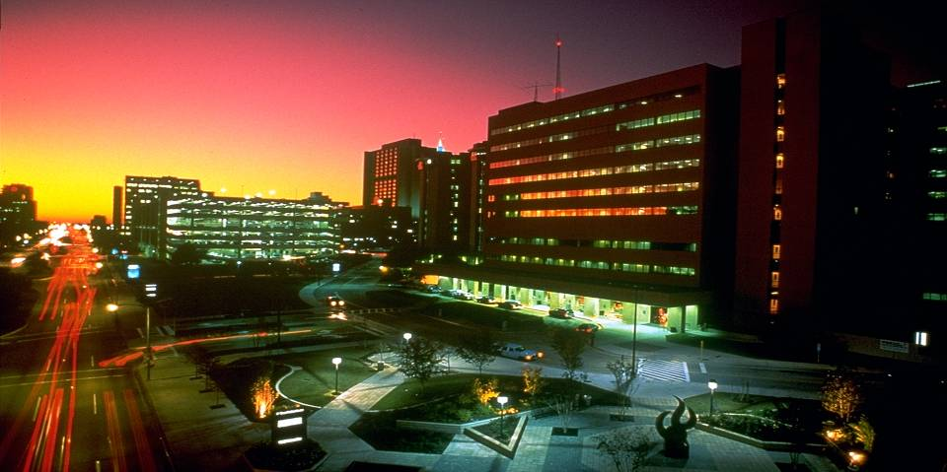

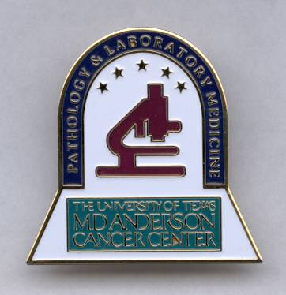
GIST 201: The Pathology of GIST:
9th Annual GIST Summit (GSI)
Alexander Lazar MD/PhD
Professor, Departments of Pathology & Genomic Medicine
Director, Sarcoma & Melanoma Molecular Diagnostics
Section of Soft Tissue/Sarcoma Pathology
Faculty, Sarcoma Research Center
Saturday 16 September 2017

Slide 2
Disclosures
Research Support / Consulting
  AstraZeneca / Medimmune
  BMS
  Novartis
  Roche / Genentech
  Merck
  GlaxoSmithKline
  Myriad
  Oncothyreon
  Life Tech
  Illumina
  GE Healthcare
  Beta-Cat
  ArcherDX

Slide 3
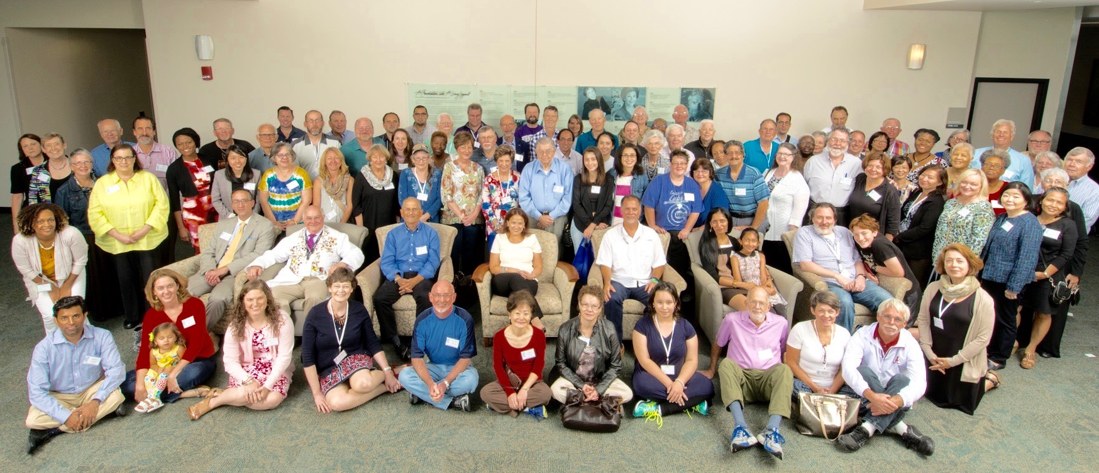

Slide 4


Slide 5
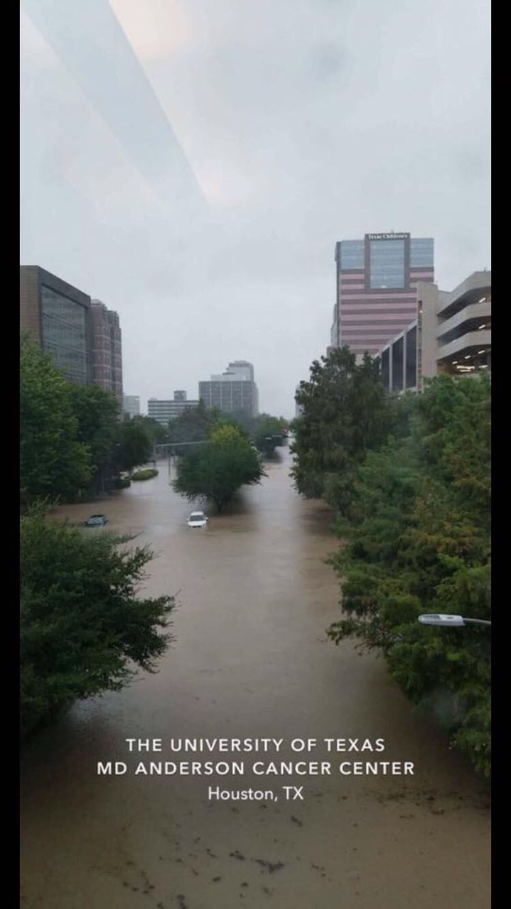


Slide 6


Slide 7
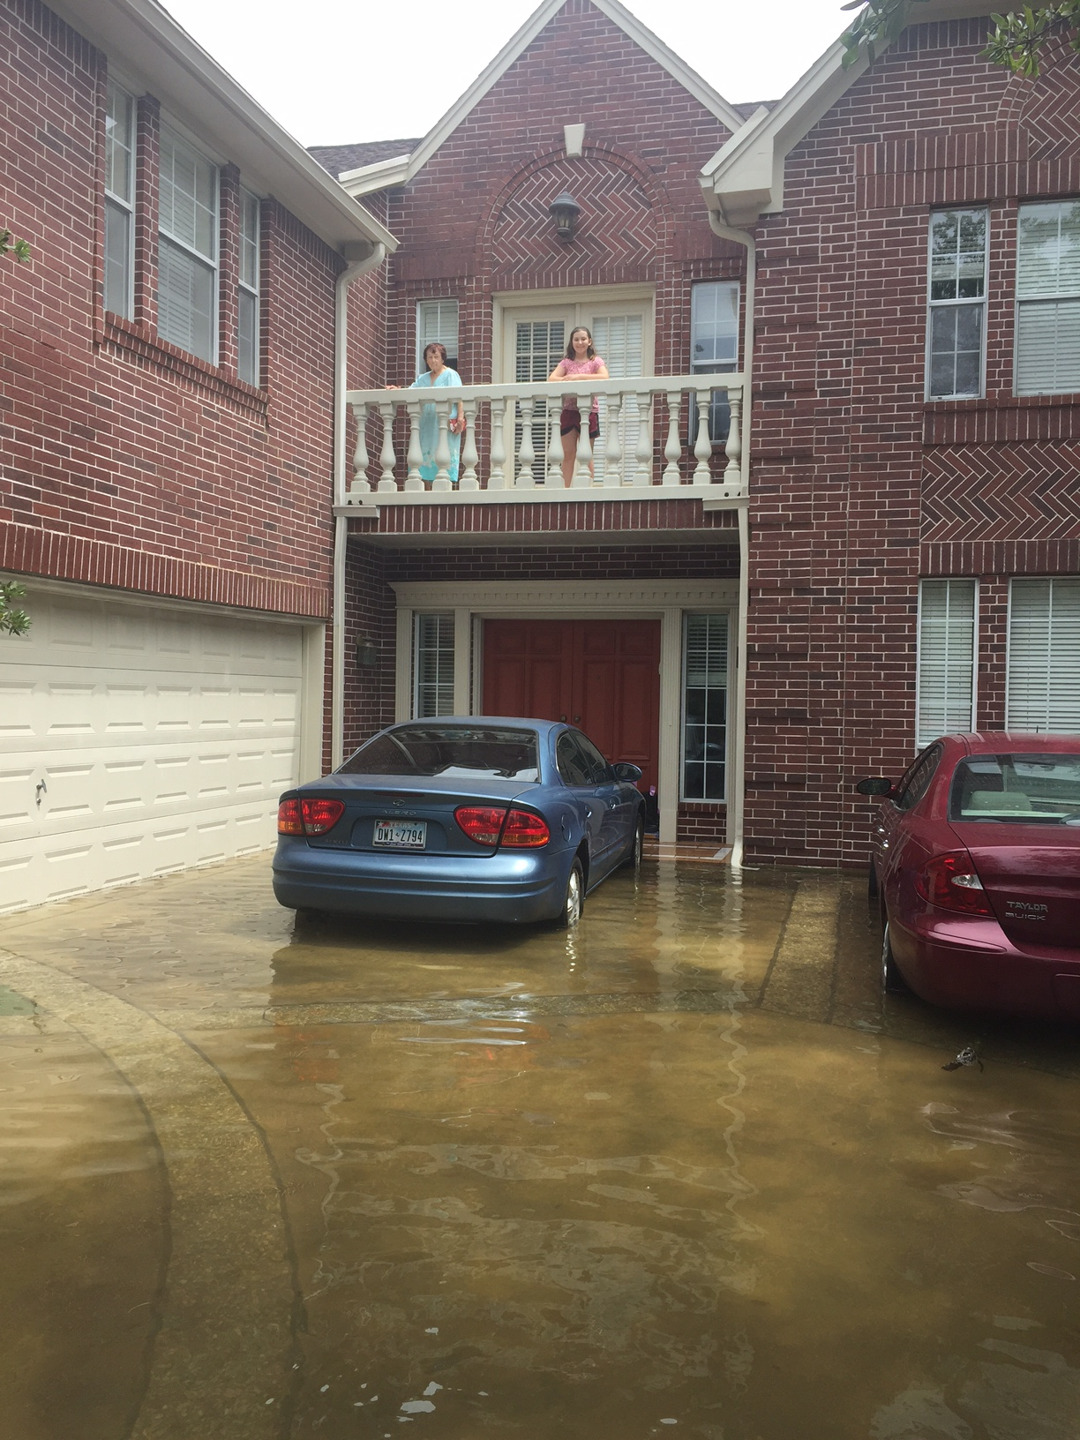

Slide 8
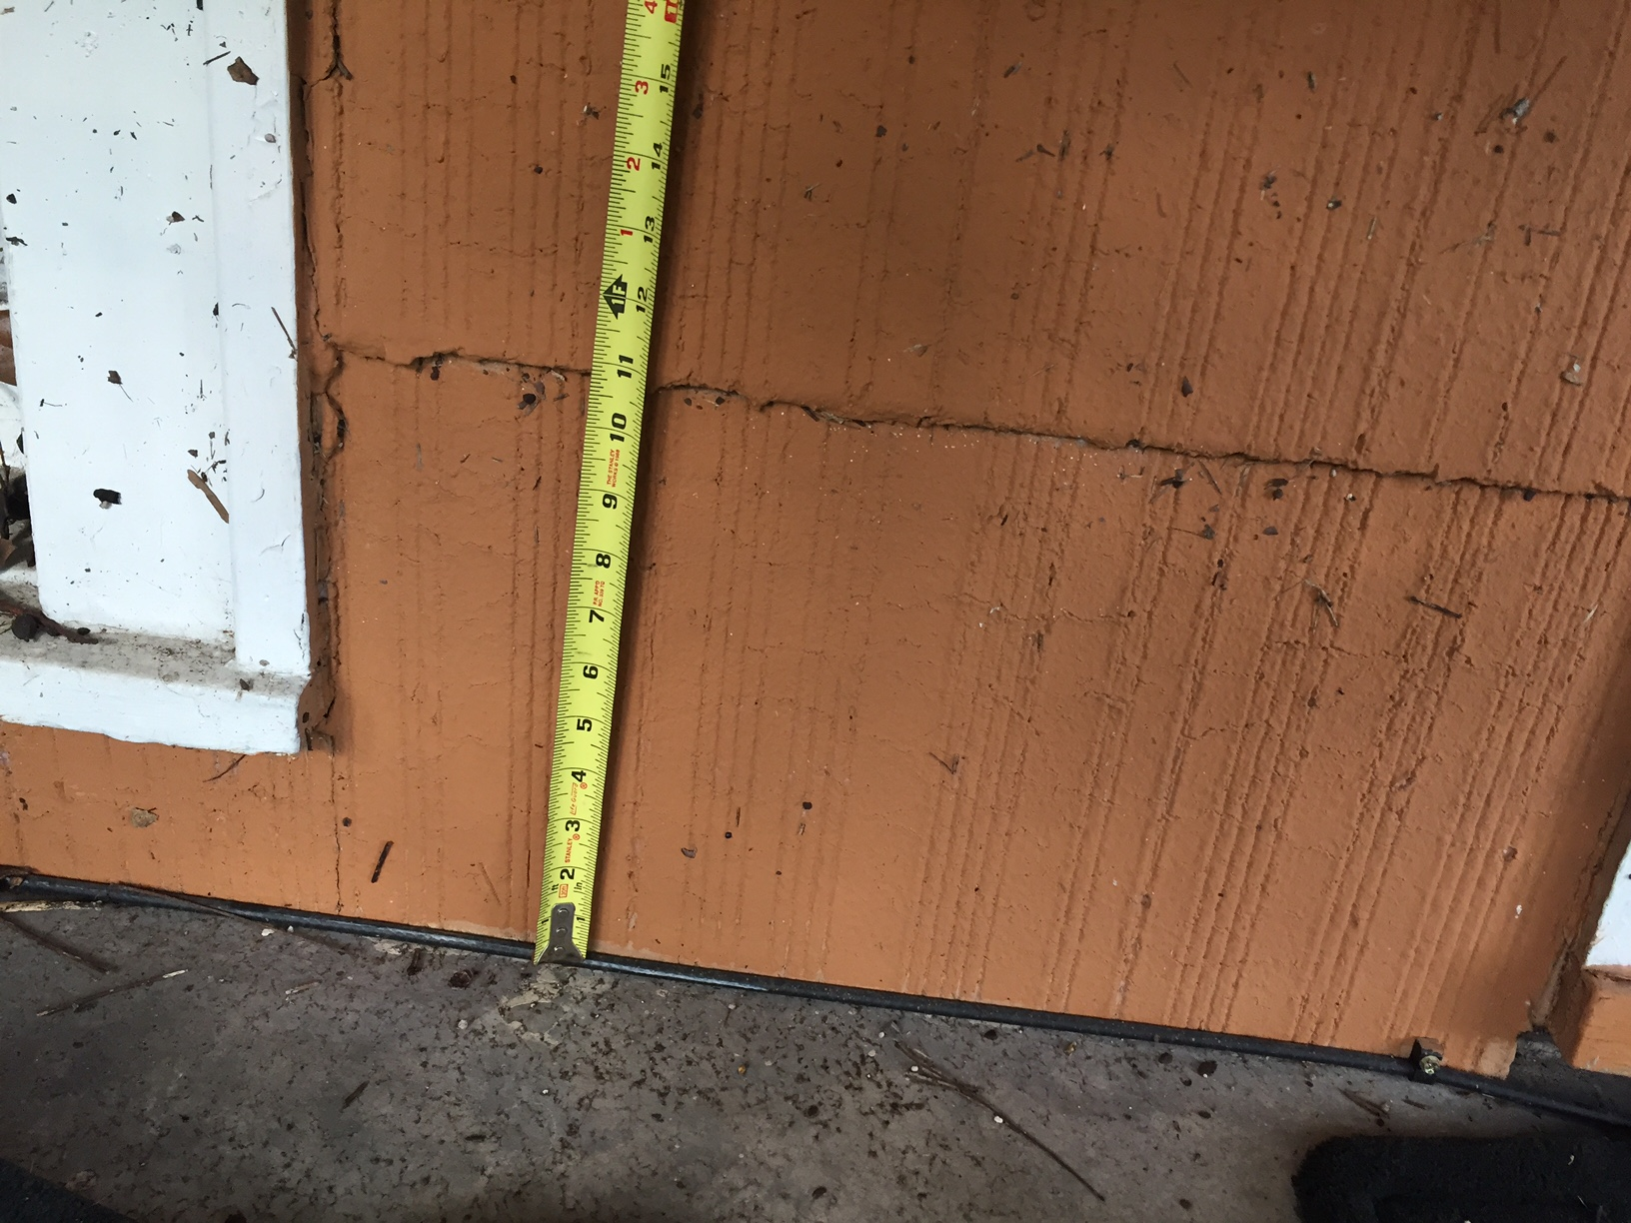

Slide 9
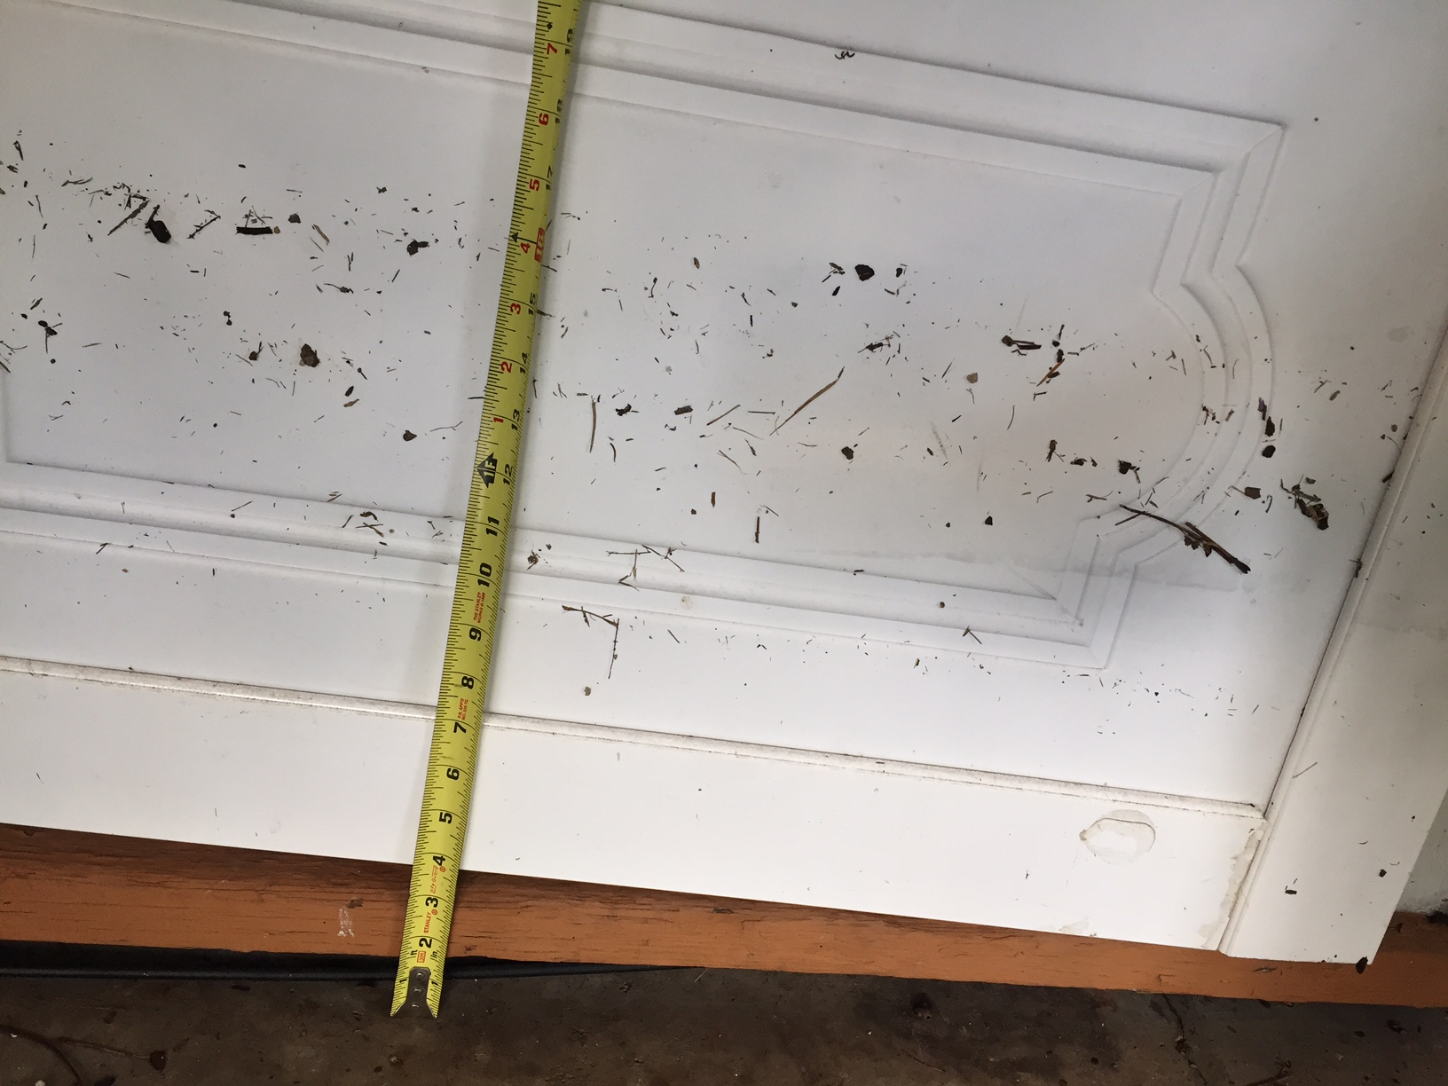

Slide 10
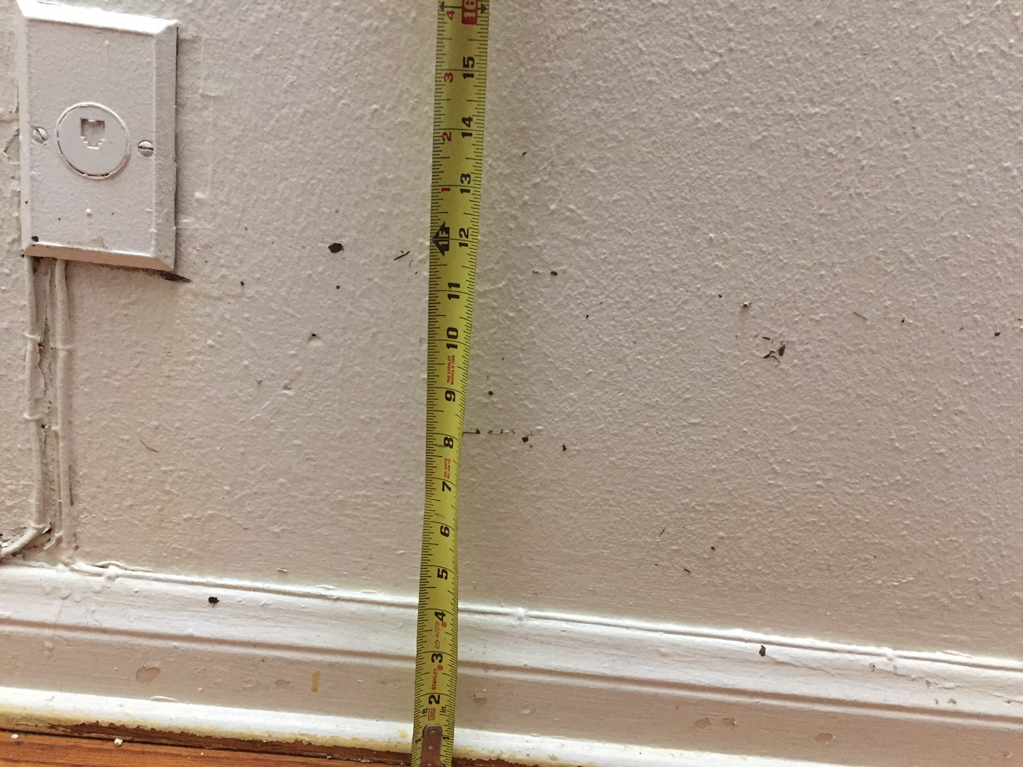

Slide 11
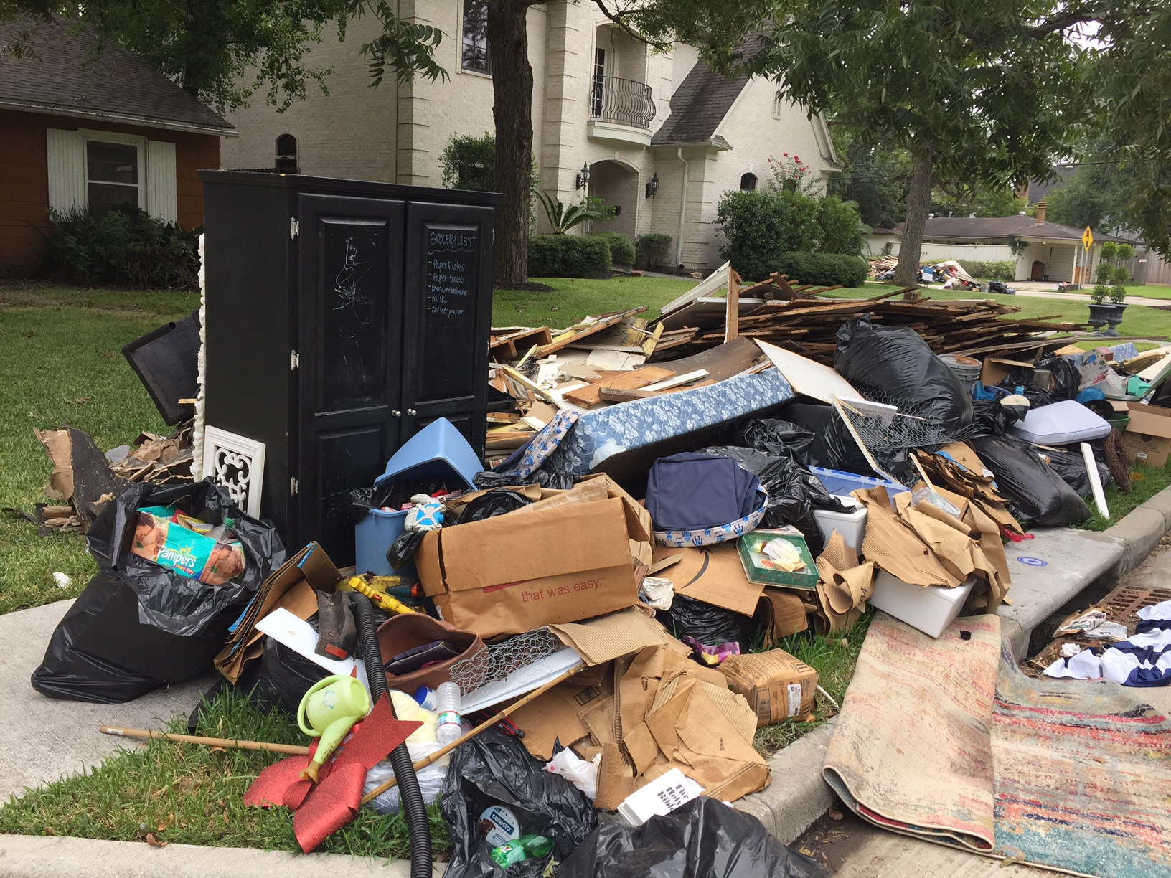

Slide 12
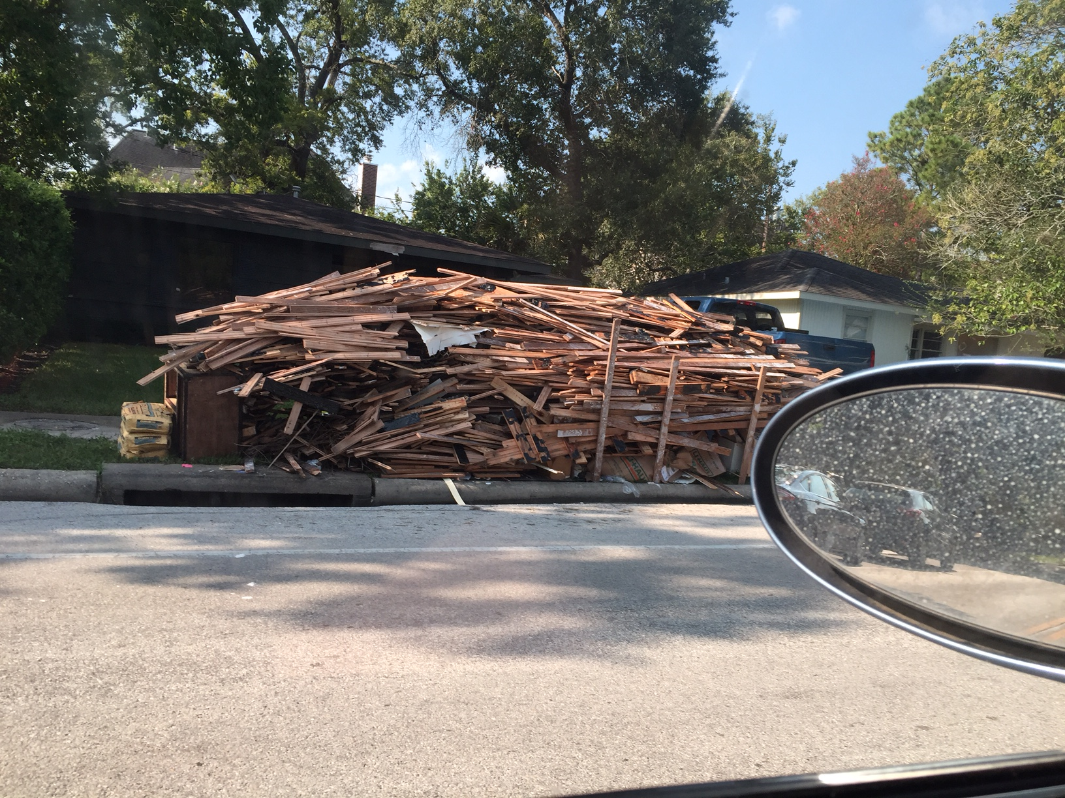

Slide 13
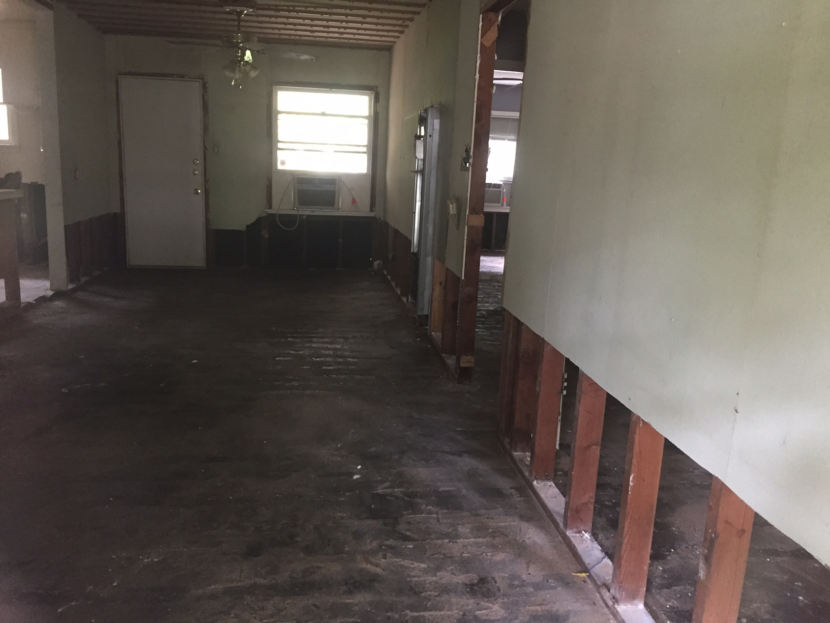

Slide 14
GIST Pathology: Lecture Overview
What information should be in my pathology report?
Why is this information there?
What is the evidence that the information is useful?

Slide 15
What happens to my tumor in pathology?

Slide 16
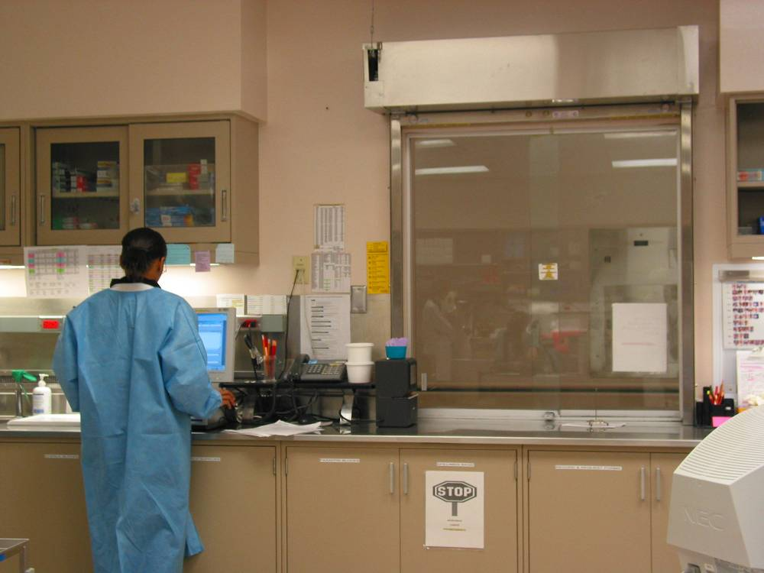
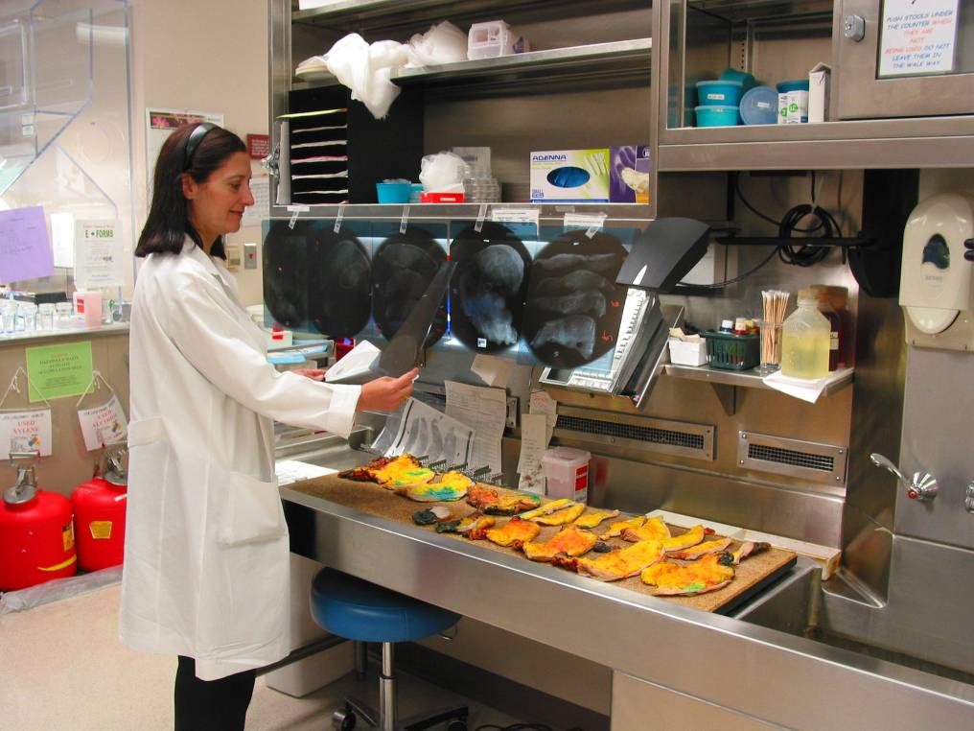
Tumor is examined by a pathologist.
Tumor sample is received from the OR and logged into computer.

Slide 17
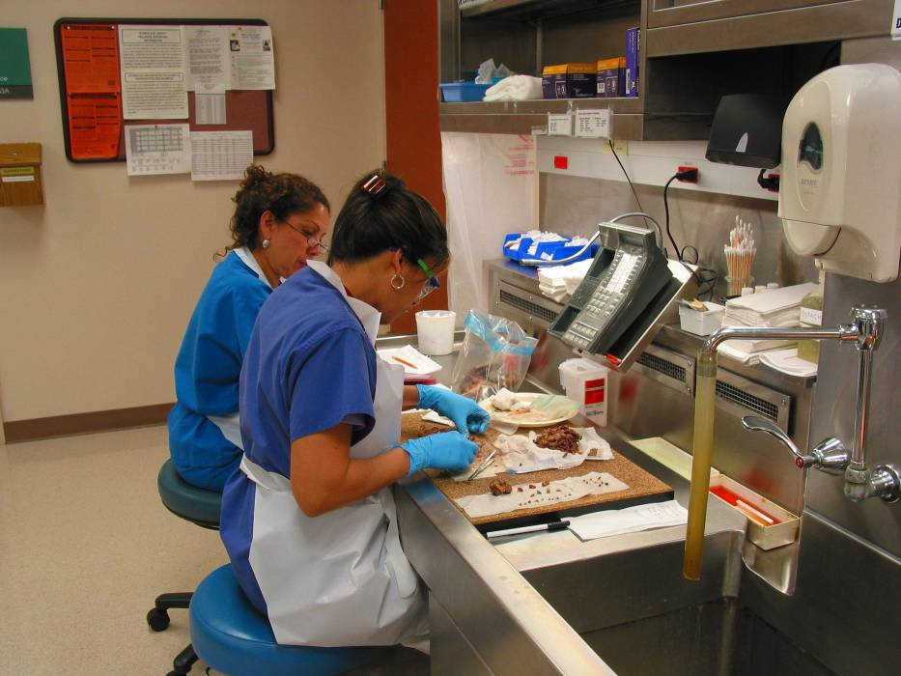
Tumor is also given to cytogenetics, tumor bank, molecular diagnosis and electron microscopy when appropriate.
Tumor is sampled and placed in plastic cassettes for further processing.

Slide 18
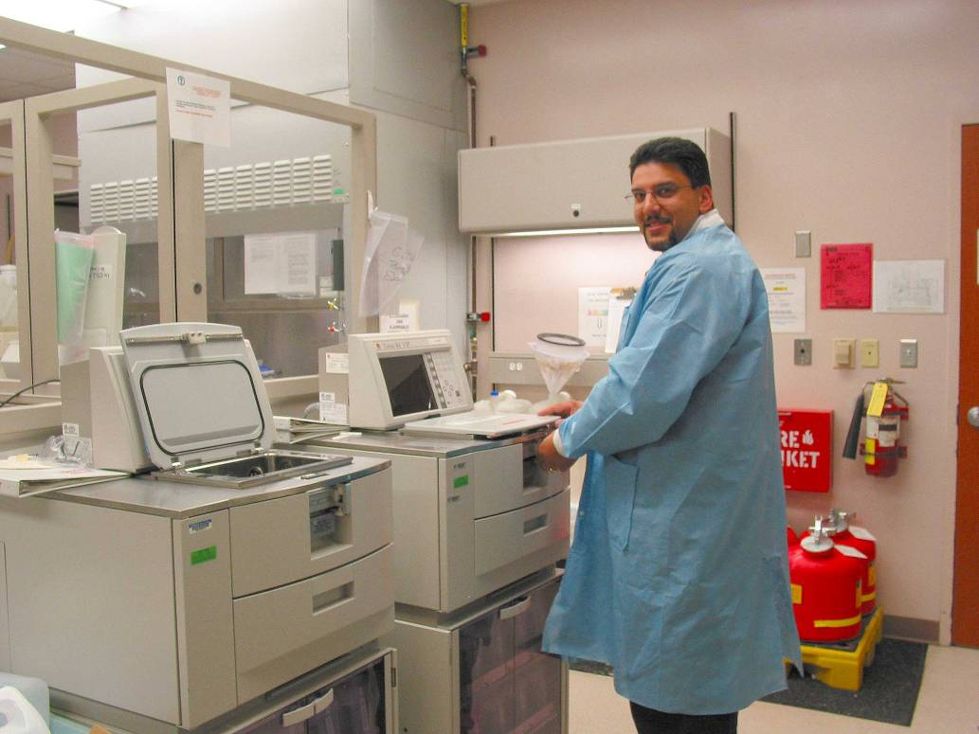
The tissue blocks are fixed in formalin and then loaded on a tissue processor overnight.

Slide 19
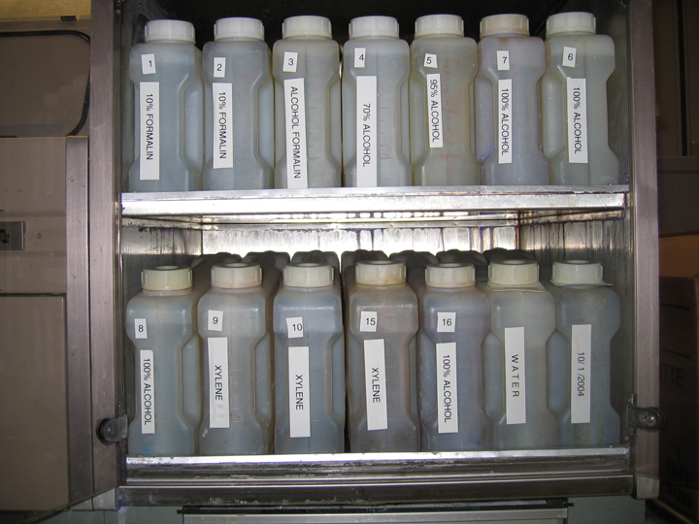
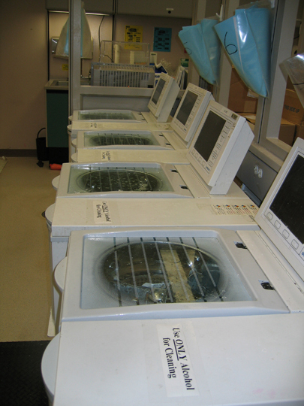
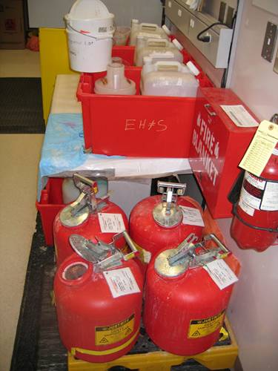
Tissue processing is done overnight and utilizes graded treatments of formalin, ethanol, xylene and paraffin.

Slide 20
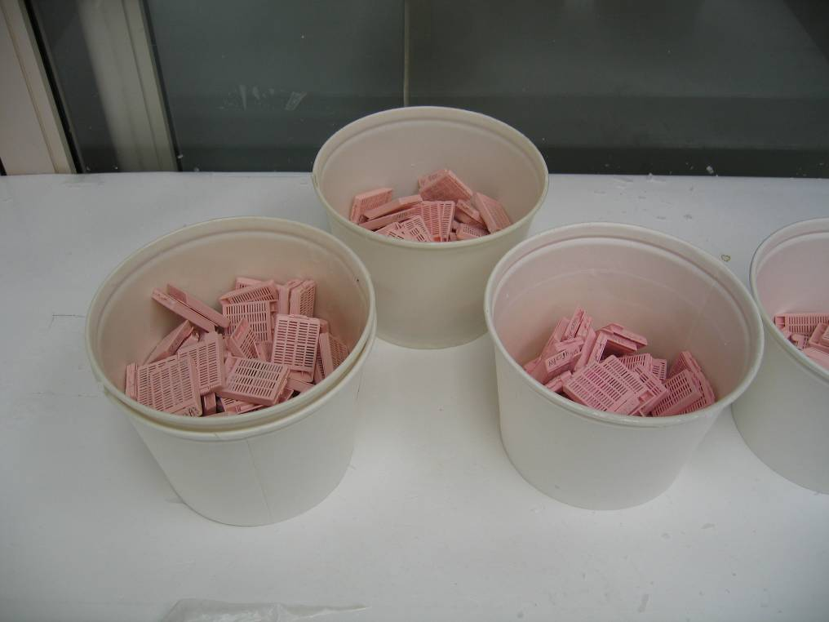
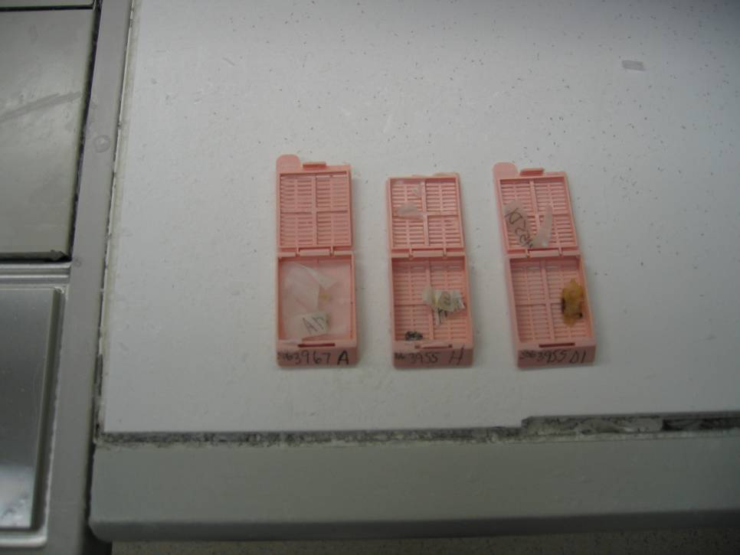
Blocks are retrieved from the tissue processor.

Slide 21
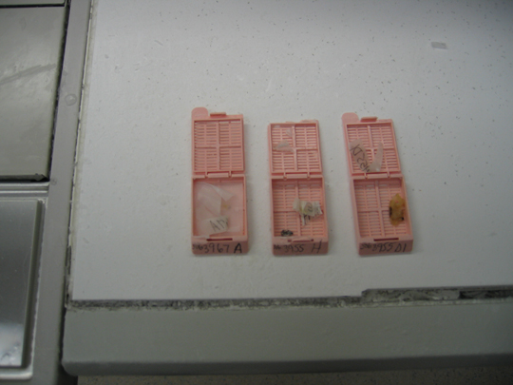
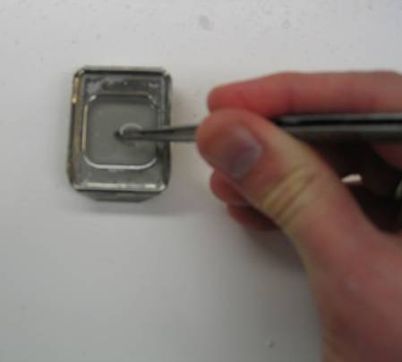
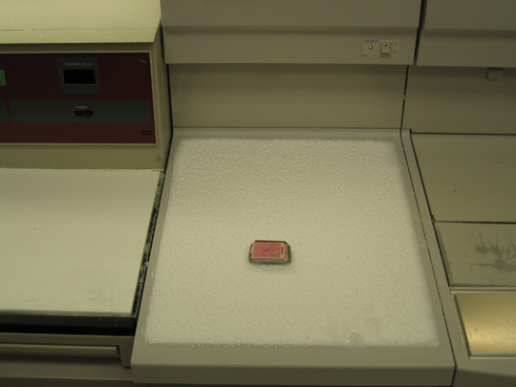
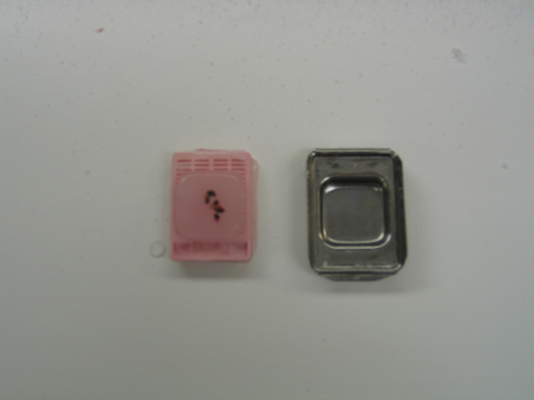
The tissue fragments are embedded in a paraffin mold and cooled – resulting in a tissue block.

Slide 22
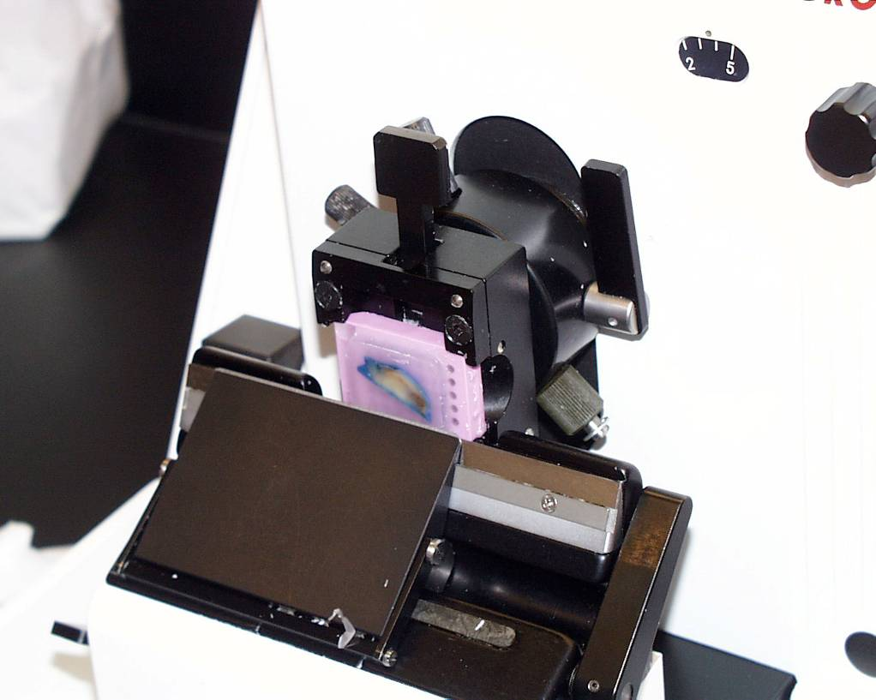
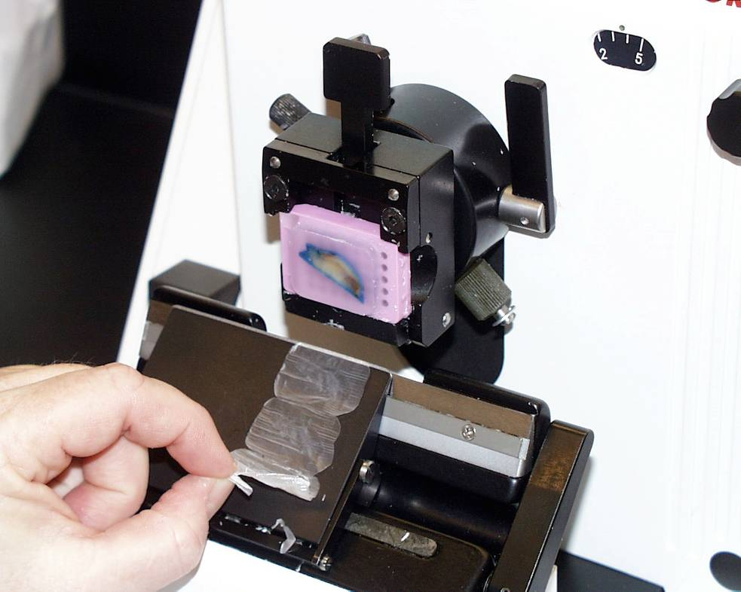
The paraffin-embedded blocks are loaded and cut using a microtome.

Slide 23
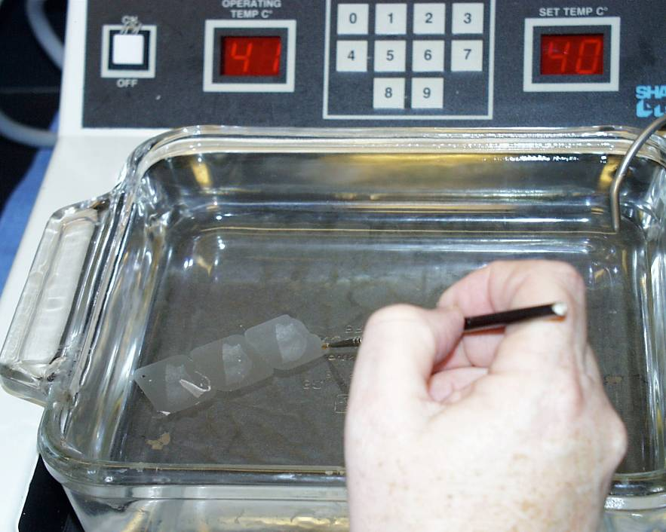
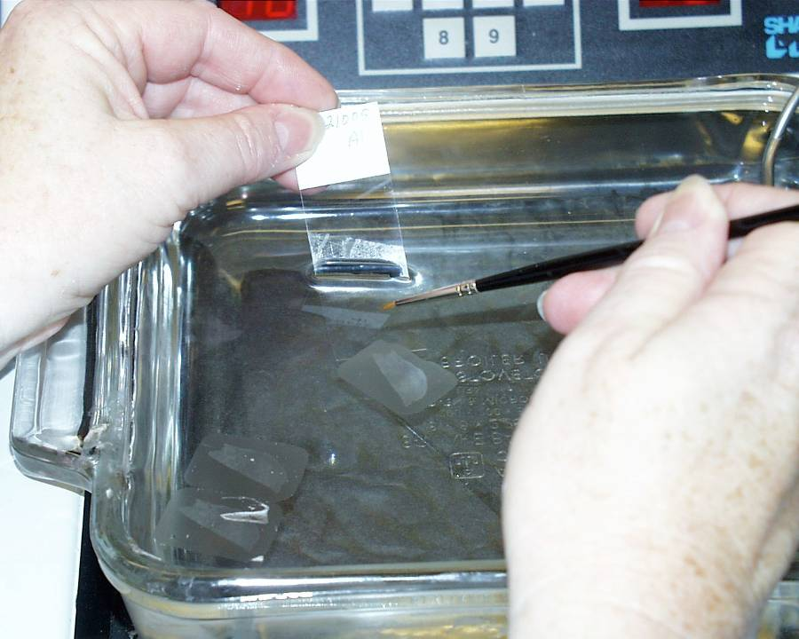
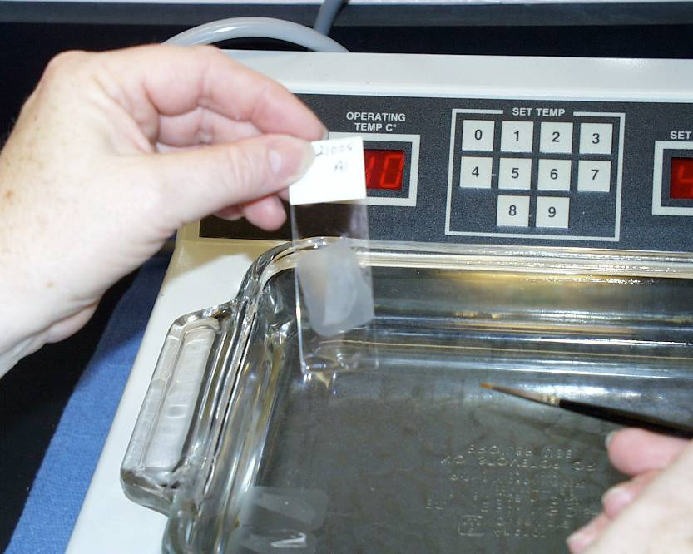
Tissue paraffin ribbons are placed in a warm waterbath and then picked up on glass slides.

Slide 24
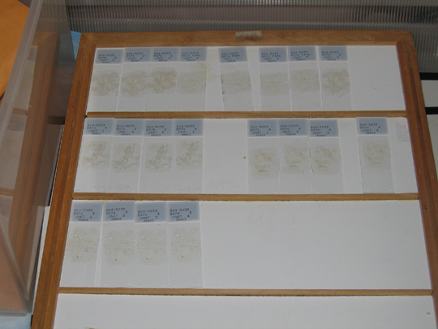
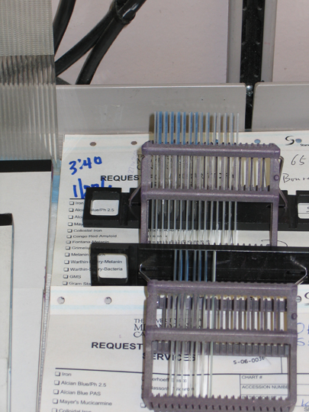
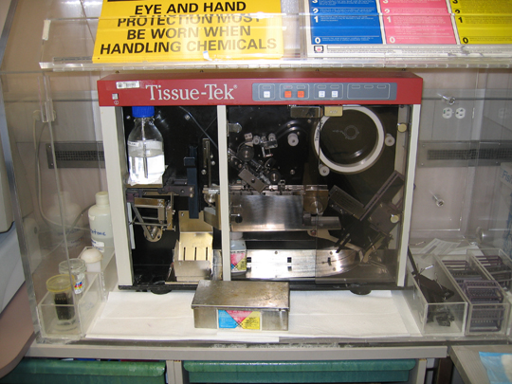
The unstained slides can be used for H&E, special stains, immuno-histochemistry, molecular studies, etc.

Slide 25
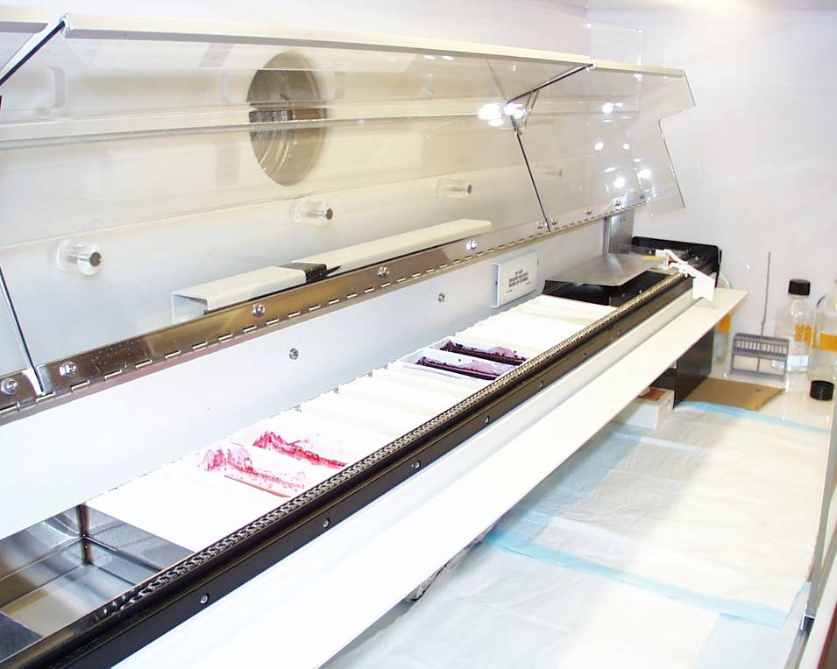
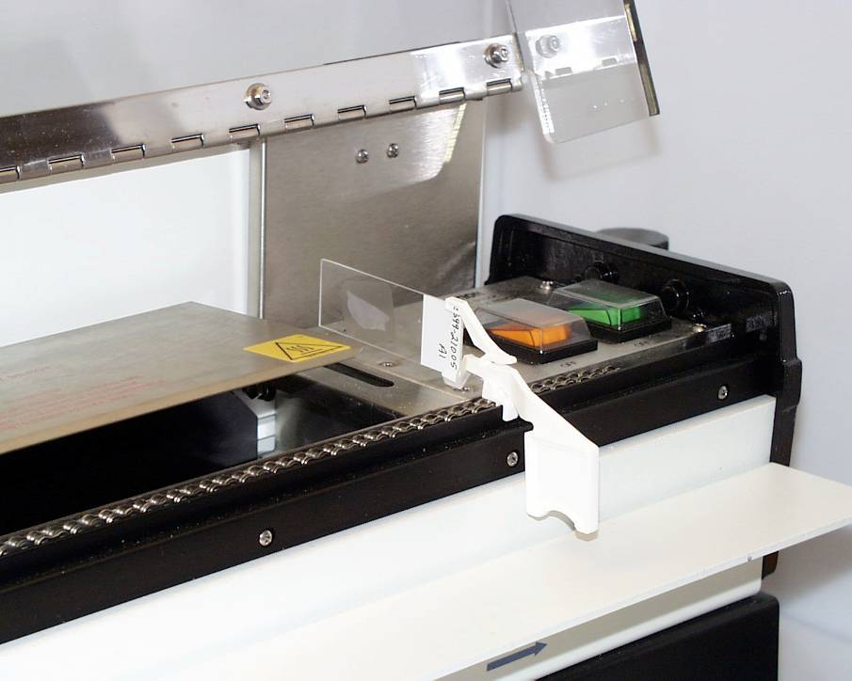
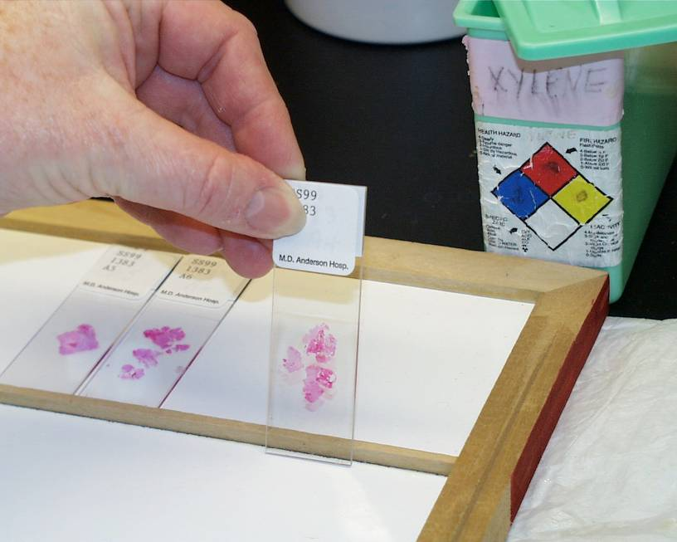
Most slides are H&E (hemotoxlin & eosin) stained, given coverslips, organized and delivered to the proper pathologist.

Slide 26
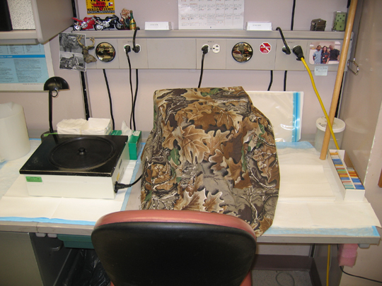
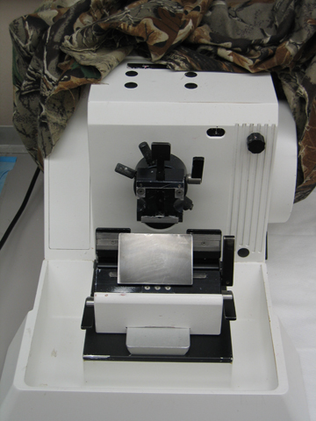
Additional unstained slides can be cut at a later time.

Slide 27
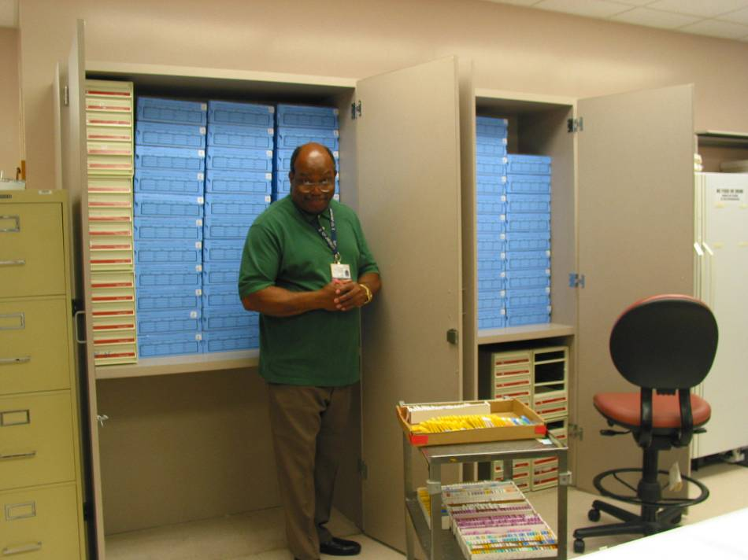
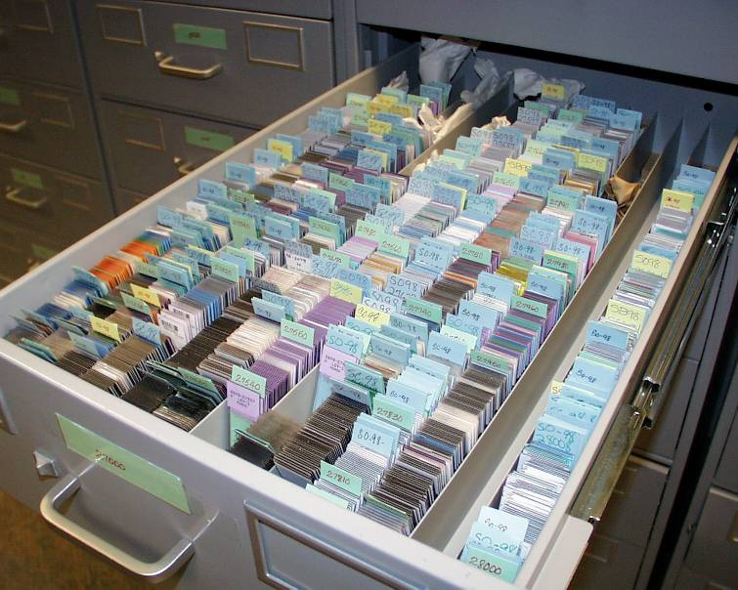
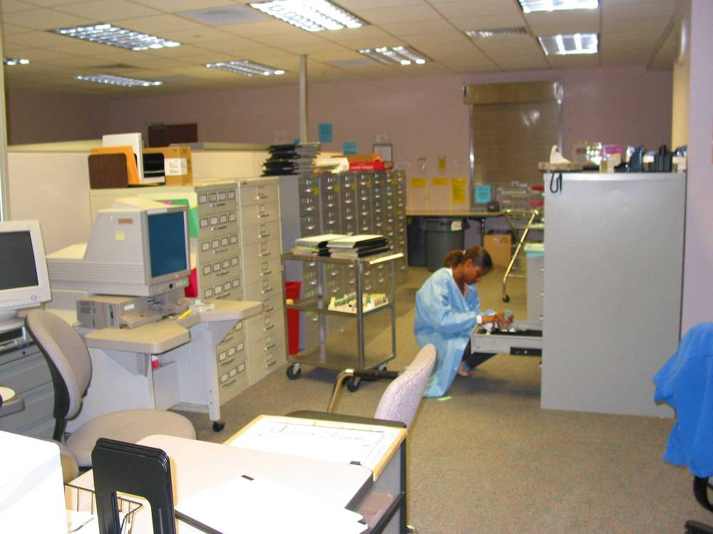
After final diagnosis, both slides and the paraffin blocks from which they are cut are cataloged and stored for future use.

Slide 28
What information should be in my pathology report?

Slide 31
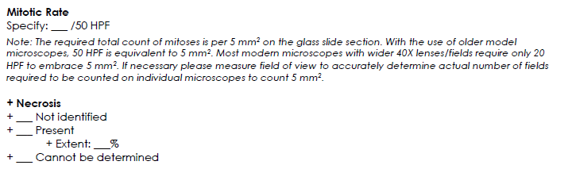

Slide 34
Getting the diagnosis right

Slide 35
Case 1
Female, aged 40, with 25 cm mass involving the small bowel.

Slide 36
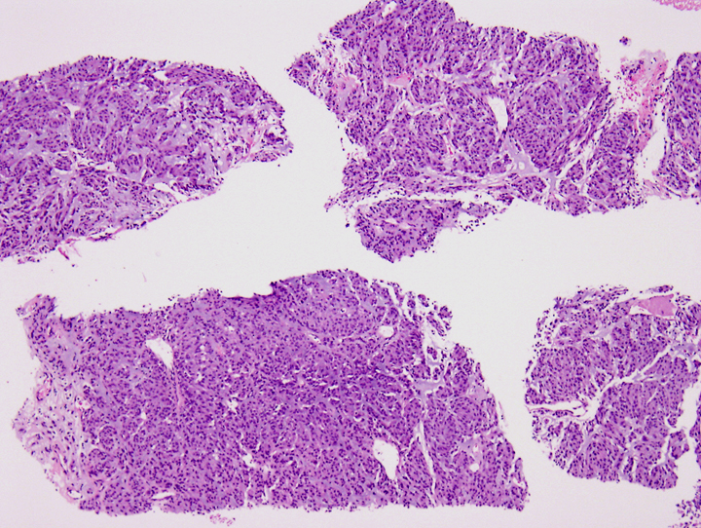
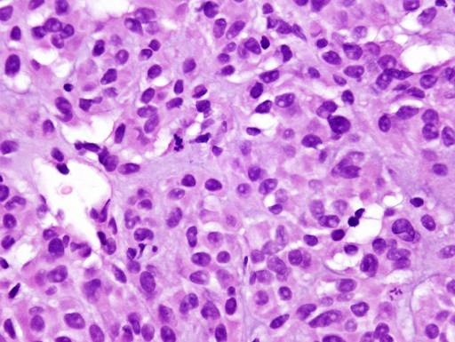

Slide 37
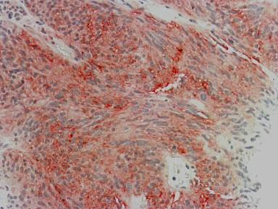
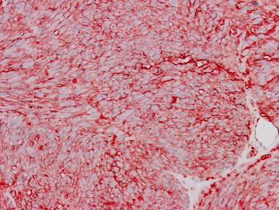
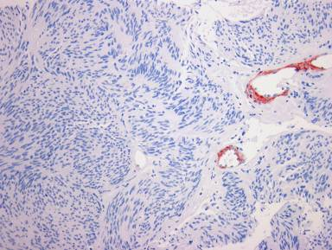
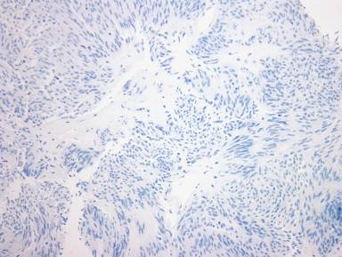
KIT
CD34
SMA
S100p

Slide 38
Case 2
Male, aged 38, with 10 mm polyp at 10 cm in rectum.

Slide 39
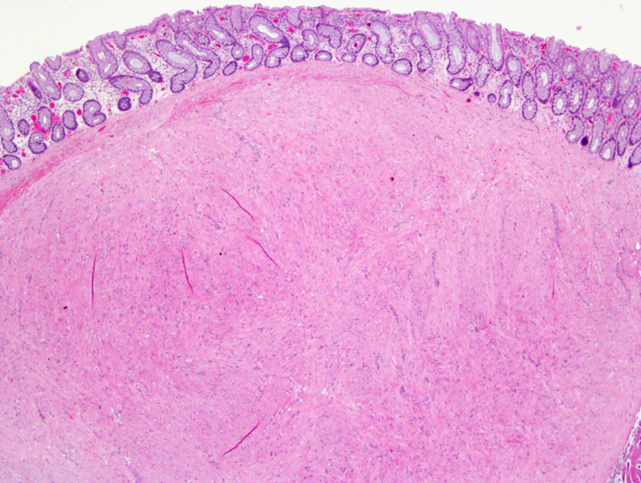
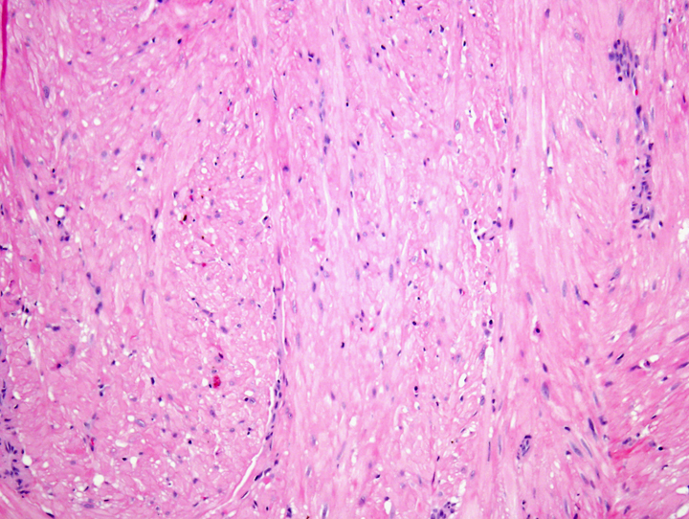

Slide 40
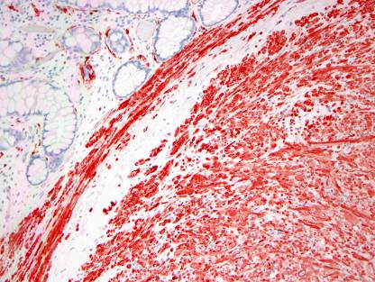


Des
CD34
KIT

Slide 41
Case 3
Male, aged 37, with 13 cm gastric wall mass.

Slide 42



Slide 43






SMA
Des
panK
KIT
S-100 p

Slide 44



Slide 45


Des
KIT

Slide 46


Slide 47
Case 4
Male, aged 36, with 17 cm gastric wall mass.

Slide 48



Slide 49


Slide 50



Slide 51
Case 5
Female, aged 29, with 10 cm gastric wall mass.

Slide 52



Slide 53



Slide 54




Slide 55



β-catenin
β-catenin

Slide 56


Slide 57
DIAGNOSIS | KIT | CD34 | Ker | SMA | DES | S-100
GIST | + | +(70%) | - | +(40%) | - | -
Carcinoma | - | - | + | +(sar) | - | -
Melanoma | +/- | - | - | - | - | +
Leiomyoma | - | +/- | +/- | + | + | -
Leiomyosarcoma | - | +/- | +/- | + | +/- | -
Schwannoma | - | - | - | - | - | +
Fibromatosis | - | - | - | - | - | +/-

Slide 58

Immunohistochemical Profile of GISTs
(Circa 1997 and prior)
CD34 +ve (70%)
SMA +ve (30-40%)
Desmin –ve
S-100 protein –ve
Keratin –ve
Courtesy of Brian Rubin, U. Washington

Slide 59


Gastrointestinal Stromal Tumor
Arise from the interstitial cells of Cajal (ICC)
ICC have a “pacemaker” function and are important in coordinating peristalsis
CD117
Hornick & Lazar. GSI website: Understanding Your Pathology Report for GIST

Slide 60

Immunohistochemical Profile of GIST
KIT (CD117) +ve (95%)
CD34 +ve (70%)
SMA +ve (30-40%)
Desmin –ve
S-100 protein –ve
Keratin –ve
Liegl B et al. Hematol Oncol Clin North Am 2009; 23:49-68

Slide 61

KIT
DOG1
CD34

Slide 62
The many faces of GIST

Slide 63



Slide 64


Slide 65



Slide 66


Slide 67


Slide 68


Slide 69



Slide 70


Slide 71


Slide 72
Clinical Characteristics of GIST
Wide age range – peak in 5th-7th decade
M = F
Small lesions = “incidentalomas”
Presenting symptoms include:
abdominal pain,
gastrointestinal bleeding,
early satiety,
symptoms referable to a mass

Slide 73



KIT
courtesy of Susan Abraham,
UTMDACC, Houston, TX

Slide 74


Slide 75



Slide 76


Exon 11
V559_V560del

Slide 77

Exon 9
A502_Y503dup
A502_Y503 dup

Slide 78


Detection of SNV in KIT Exon 10,
Negative
Patient Sample
Confirmation by Sanger
ATG→CTG, M541L
KIT EXON 10
75% Tumor

Slide 79

KIT immunoreactivity in GIST

Slide 80

KIT-negative GIST

Slide 81
Gastric GISTs with Distinctive Histology (Multinodular/Plexiform)
Pediatric GISTs
  Female predominance (peak 2nd decade)
  Indolent, but late metastases common
  Molecular genetic basis unknown
Carney Triad
  Gastric GIST, pulmonary chondroma, paraganglioma
  Molecular genetic basis unknown
Carney-Stratakis Syndrome
  Gastric GIST and paraganglioma
  Germline mutations in succinate dehydrogenase subunit genes (SDHA, SDHB, SDHC, or SDHD)

Slide 82
GIST with Distinctive Histology
Multinodular/plexiform growth pattern
Epithelioid or mixed morphology
“Pediatric-type” or “type 2” GISTs
Loss of SDHB staining by IHC
Lymph node metastases common
Distant metastases common – clinically indolent
Current risk assessment criteria do not reliably predict behavior
No response to imatinib

Slide 83

11-year-old female
Courtesy of Jason Hornick, BWH/Harvard, Boston, MA

Slide 84

Pediatric-type GIST in an Adult
49-year-old female
Courtesy of Jason Hornick, BWH/Harvard, Boston, MA

Slide 85



Slide 86

Metastatic pediatric-type GIST

Slide 87

SDHB
KIT exon 11-mutant GIST

Slide 88

SDHB
“Wild-type” gastric GIST

Slide 89
Risk assessment in GIST

Slide 90
GIST – Prognostic Factors
Size
Mitotic Rate
Anatomic Location
Pleomorphism
Cellularity
Necrosis
Mucosal Invasion
Proliferation Markers (Ki-67, Mib-1, PCNA, etc)
DNA Flow Cytometry
Image Analysis
Nuclear Organizer Regions
Problem – Small GISTs without mitoses
can metastasize!

Slide 91
NIH Consensus Risk Assessment
 | Size | Mitotic Count
Very Low Risk | < 2 cm | < 5/50 HPF
Low Risk | 2-5 cm | < 5/50 HPF
Intermediate Risk | < 5 cm | 6-10/50 HPF
 | 5-10 cm | < 5/50 HPF
High Risk | > 5 cm | > 5/50 HPF
 | > 10 cm | Any Mitotic Rate
 | Any Size | > 10/50 HPF
Fletcher et al., Hum Pathol, 2002

Slide 92
GIST: Sites of Involvement
Rectum (5%)
Esophagus (2%)
Other (colon,
mesentery,
retroperitoneum)
8%
25%
Small
intestine
60%
Stomach
Omentum, mesentery, pelvis and retroperitoneum = EGIST (<1%)
Hornick & Lazar. GSI website: Understanding Your Pathology Report for GIST.

Slide 93
2007/2010/2014 NCCN GIST Risk Assessment Guidelines***
Tumor | Parameters | Risk of | Progressive | Disease# (%)
 | Size | Gastric | Duodenum | Jejunum/Ileum | Rectum
Mitotic | ≤ 2 cm | None (0%) | None (0%) | None (0%) | None (0%)
Index | > 2 ≤ 5 cm | Very low (1.9%) | Low (8.3%) | Low (4.3%) | Low (8.5%)
≤ 5 per 50 hpf | > 5 ≤ 10 cm | Low (3.6%) | (Insuff. data) | Moderate (24%) | (Insuff. data)
 | > 10 cm | Moderate (10%) | High (34%) | High (52%) | High (57%)
Mitotic | ≤ 2 cm | None* | (Insuff. data) | High* | High (54%)
Index | > 2 ≤ 5 cm | Moderate (16%) | High (50%) | High (73%) | High (52%)
> 5 per 50 hpf | > 5 ≤ 10 cm | High (55%) | (Insuff. data) | High (85%) | (Insuff. data)
 | > 10 cm | High (86%) | High (86%) | High (90%) | High (71%)
Miettinen et al. 2005 and 2006
***Modified from Miettinen & Lasota, Semin Diagn Pathol, 2006 by Dr. Chris Corless, OHSU
Data based on long-term follow-up of 1055 gastric, 629 small intestinal, 144 duodenal and 111 rectal GIST

Slide 94

GIST - Gross Appearance
Courtesy of Brian Rubin, Cleveland Clinic

Slide 95


Slide 96


Slide 97
2007/2010/2014 NCCN GIST Risk Assessment Guidelines***
Tumor | Parameters | Risk of | Progressive | Disease# (%)
 | Size | Gastric | Duodenum | Jejunum/Ileum | Rectum
Mitotic | ≤ 2 cm | None (0%) | None (0%) | None (0%) | None (0%)
Index | > 2 ≤ 5 cm | Very low (1.9%) | Low (8.3%) | Low (4.3%) | Low (8.5%)
≤ 5 per 50 hpf | > 5 ≤ 10 cm | Low (3.6%) | (Insuff. data) | Moderate (24%) | (Insuff. data)
 | > 10 cm | Moderate (10%) | High (34%) | High (52%) | High (57%)
Mitotic | ≤ 2 cm | None* | (Insuff. data) | High* | High (54%)
Index | > 2 ≤ 5 cm | Moderate (16%) | High (50%) | High (73%) | High (52%)
> 5 per 50 hpf | > 5 ≤ 10 cm | High (55%) | (Insuff. data) | High (85%) | (Insuff. data)
 | > 10 cm | High (86%) | High (86%) | High (90%) | High (71%)
***Modified from Miettinen & Lasota, Semin Diagn Pathol, 2006 by Dr. Chris Corless, OHSU
Data based on long-term follow-up of 1055 gastric, 629 small intestinal, 144 duodenal and 111 rectal GIST
Miettinen et al. 2005 and 2006

Slide 98


Slide 99


Slide 100
GIST - Recurrence-Free Survival Following Surgical Treatment of Primary GIST
Recurrence-free survival is predicted by tumor size and mitotic index
1.0
1.0
≤3 mitoses/30 HPF
0.75
<5 cm
0.75
>3 to ≤15 mitoses/30 HPF
5-10 cm
Recurrence-free
survival
Recurrence-free
survival
0.50
0.50
>10 cm
0.25
0.25
P=0.03
>15 mitoses/30 HPF
P=0.0001
0
0
0
20
40
60
80
0
20
40
60
80
Months
Months
Singer et al. J Clin Oncol. 2002;20:3898

Slide 101
FNCLCC Grading
All three numbers are summated to determine degree of differentiation
Grade 1 : 2-3
Grade 2 : 4-5
Grade 3 : 6-8
Proven to correlated well with survival
Mitotic Count. In the most mitotically active area, ten successive high-power fields (at 400x magnification=0.1734 mm²) using a 40x objective.
0-9 mitoses per 10 HPFs
10-19 mitoses per 10 HPFs
>20 mitoses per 10 HPFs
Tumor necrosis. Evaluated on gross examination and validated with histological sections
0 No tumor necrosis
<50% tumor necrosis
>50% tumor necrosis
Degree of Differentiation. 1-3

Slide 102
GIST - Overall Survival by Risk Group
1.0
Risk Groups
0.9
Normal pop.
0.8
Very low
Low
0.7
Intermediate
0.6
High
0.5
Overtly malignant
Estimated proportion surviving
0.4
0.3
0.2
0.1
0
0
1
2
3
4
5
6
7
8
9
10
11
12
13
14
15
16
17
Years since diagnosis
Kindblom. at: http://www.asco.org

Slide 103
Genomic complexity and prognosis
Possible approaches
(Histological grading)
Risk assessment +:
  Array-CGH
  Carter signature
  Next generation Sequencing
Courtesy of J-M Coindre & F Chibon, Bordeaux, France (Fresch Sarcoma Group)
Notes:
103

Slide 104

Spectrum of KIT Exon 11 Mutations
N-term
Mid
C-term
Debiec-Rychter et al., J Pathol, 2004.

Slide 105


The recommendations for adjuvant imatinib therapy by integration of the risk assessment (based on modified NIH classification) and tumor genotype [KIT ex. 9 p.A502_Y503dup, KIT ex. 11 (KITdel-inc557/558 and other), and PDGFRA ex. 18 (p.D842V and other)] in ...
Agnieszka Wozniak et al. Clin Cancer Res 2014;20:6105-6116
©2014 by American Association for Cancer Research
Notes:
The recommendations for adjuvant imatinib therapy by integration of the risk assessment (based on modified NIH classification) and tumor genotype [KIT ex. 9 p.A502_Y503dup, KIT ex. 11 (KITdel-inc557/558 and other), and PDGFRA ex. 18 (p.D842V and other)] in patients with localized GIST. KIT/PDGFRA WT GIST and tumors with rare mutations (non-p.A502_Y503dup KIT ex. 9 as well as KIT mutations in exons 8, 13, and 17) are not included due to insufficient data.

Slide 106

Chromosomal complexity and prognosis
Courtesy of J-M Coindre & F Chibon, Bordeaux, France (Fresch Sarcoma Group)
97 chromosomes and more than 50 translocations

Slide 107

CINSARC : GO analysis of the 67 significant genes
GO.ID | selection | array | pValue | Z-Score | GO.Term
GO:0000775 | 10 | 37 | 1,06E-14 | 23,58 | chromosome, pericentric region
GO:0005819 | 7 | 14 | 3,88E-12 | 27,03 | spindle
GO:0005876 | 6 | 12 | 1,48E-10 | 25,02 | spindle microtubule
GO:0005694 | 10 | 118 | 3,49E-10 | 12,73 | chromosome
GO:0005875 | 6 | 54 | 3,42E-07 | 11,42 | microtubule associated complex
GO:0005874 | 8 | 178 | 2,32E-06 | 7,88 | microtubule
GO:0000776 | 4 | 21 | 5,18E-06 | 12,42 | kinetochore
GO:0005871 | 3 | 16 | 9,08E-05 | 10,67 | kinesin complex
GO:0005813 | 4 | 48 | 0,0001 | 7,96 | centrosome
GO:0000940 | 2 | 3 | 0,0002 | 16,72 | outer kinetochore of condensed chromosome
GO:0030496 | 2 | 7 | 0,0008 | 10,84 | midbody
GO:0005657 | 2 | 8 | 0,0010 | 10,12 | replication fork
GO:0005814 | 2 | 9 | 0,0012 | 9,52 | centriole
GO:0015630 | 2 | 13 | 0,0022 | 7,84 | microtubule cytoskeleton
GO:0000922 | 2 | 16 | 0,0032 | 7,02 | spindle pole
GO:0000785 | 3 | 75 | 0,0059 | 4,47 | chromatin
GO:0000786 | 2 | 32 | 0,0111 | 4,77 | nucleosome
GO:0001939 | 1 | 3 | 0,0187 | 8,30 | female pronucleus
GO:0005816 | 1 | 3 | 0,0187 | 8,30 | spindle pole body
GO:0000930 | 1 | 4 | 0,0233 | 7,15 | gamma-tubulin complex
GO:0005664 | 1 | 4 | 0,0233 | 7,15 | nuclear origin of replication recognition complex
GO:0015030 | 1 | 4 | 0,0233 | 7,15 | Cajal body
GO:0005881 | 1 | 6 | 0,0325 | 5,78 | cytoplasmic microtubule
GO:0043234 | 2 | 64 | 0,0385 | 3,10 | protein complex
CINSARC is a signature related
to chromosome management and mitosis control
associated with genome complexity
Courtesy of J-M Coindre & F Chibon, Bordeaux, France (Fresch Sarcoma Group)

Slide 108
Chromosomal complexity in sarcomas
Alain Aurias and Frédéric Chibon
Sarcomas with a complex genetic profile
Array-CGH and expression profile analyses
Which genes / pathways are related to the chromosomal complexity ?
Is there a link between chromosomal complexity and prognosis ?
Courtesy of J-M Coindre & F Chibon, Bordeaux, France (Fresch Sarcoma Group)
Notes:
108

Slide 109
Chromosomal instability signature
Carter et al Nat Genet 2002
Computational method for evaluating aneuploidy
Analysis of genes differentially expressed according to the level of aneuploidy
Aneuploidy is a consequence of chromosomal instability (CIN)
CIN70 signature predicts survival in several types of cancers
No prediction in French series of sarcomas
Courtesy of J-M Coindre & F Chibon, Bordeaux, France (Fresch Sarcoma Group)
Notes:
109

Slide 110




CINSARC : arrayCGH analysis and correlation with FNCLCC grading
« Arm » Profile
G3
G2
p=.001
« Rearranged » Profile
G2
G3
Courtesy of J-M Coindre & F Chibon, Bordeaux, France (Fresch Sarcoma Group)

Slide 111
Molecular grading in sarcomas
3 tests to compare the expression profiles of tumors classified according to:
CGH
Grade
Carter
(Carter et al 2006)
86 genes
73 genes
39 genes
GO analysis:
To identify the underlying pathways
Selection of genes involved in the most
significantly overrepresented pathways (p<10⁻⁵)
Courtesy of J-M Coindre & F Chibon, Bordeaux, France (Fresch Sarcoma Group)
37 genes
18 genes
39 genes
4
8
4
2
Complexity INdex
In SARComas
CINSARC
16
11
22
Chibon et al, Nat Med 2010; 16: 781-7
67 genes

Slide 112
CINSARC: Prognostic signature ?
Prognostic value of CINSARC:
Metastasis free survival
Cohort 1
Cohort 2
n=42
n=83
Metastasis free survival
n=100
n=85
n=183
p=1 x10⁻⁷
n=127
p=5 x10⁻⁴
Courtesy of J-M Coindre & F Chibon, Bordeaux, France (Fresch Sarcoma Group)
Multivariate analysis
HR = 3.1; 95% CI [1.8 – 5.4]
CINSARC is an independent prognostic factor

Slide 113



CINSARC and GIST
In-silico study of 32 GISTs
(Yamaguchi et al 2008)
n=16
Metastasis free survival
n=16
n=32 p=0.003
Courtesy of J-M Coindre & F Chibon, Bordeaux, France (Fresch Sarcoma Group)

Slide 114

GIST (n=42)
Ylipää A, et al. Cancer 2011 117(2)380-9, 2011
LMS (n=30)

Slide 115

Ylipää A, et al. Cancer 2011 117(2)380-9, 2011

Slide 116


Ylipää A, et al. Cancer 2011 117(2)380-9, 2011

Slide 117

GIST and molecular signature
(Lagarde et al. Clin Cancer Res 2012;18: 826-838)
CINSARC
67 patients
(Leuven + Bordeaux)
Localised GIST
No adjuvant treatment
Frozen tissue from primary
Miettinen classification
Follow-up
Courtesy of J-M Coindre & F Chibon, Bordeaux, France (Fresch Sarcoma Group)

Slide 118





Genomic Index (GI) is a prognostic factor in GIST…
Frozen tissue is rarely available
Method applicable on paraffin tissue ?
Genomic Index (GI) on CGH
GI = Alt² / nb of altered chr.
GI<10
DFS
GI>10
n = 66
p = 8.9 x 10⁻¹⁰
Courtesy of J-M Coindre & F Chibon, Bordeaux, France (Fresch Sarcoma Group)

Slide 119


GIST and molecular signature
(Lagarde et al. Clin Cancer Res 2012;18: 826-838)
Miettinen classification
CGH-Genomic Index
Frozen Tissue
FFPE bloc
Courtesy of J-M Coindre & F Chibon, Bordeaux, France (Fresch Sarcoma Group)

Slide 120


Latest Data
82 intermediate-risk (AFIP) GISTS
Array CGH from FFPE blocks
Leuven (M Debiec-Rychter)
Köln (E Wardelmann)
Warsaw (P Rutkowski)
Treviso (AP Dei Tos)
French Sarcoma Group
Chibon & Colleagues. Eur J Cancer 2014; 51(1):75-83.

Slide 121

Sarcoma TCGA Integrative Analysis
Modified from The Cancer Genome Atlas Pan-Cancer analysis project

Slide 122

Whole Exome Sequencing (WES): Melanoma has the Highest Mutation Rate of Cancers Sequenced to Date
Somatic mutation frequencies observed in exomes from 3,083
tumour–normal pairs.
Broad Institute
Mike Lawrence
Gad Getz
Nature, 2013
Notes:
Lead-in slide to the mutation data: Lessons learned from TCGA studies and other WES analysis that have shown melanoma possesses the highest mutation rate of any cancer analyzed to date.

Slide 123






A
TCGA-DX-AM
TCGA-DX-A7EQ
B
D
TCGA-DX-A8BM
TCGA-3B-A7EQ
E
C

Slide 124





A
B
D
E

Slide 125
Treatment can cause big changes.

Slide 126



Treatment effect
Pre-Imatinib
Post-Imatinib (8 weeks therapy)
Notes:
126

Slide 127


Slide 128



Slide 129


Case No. 22 - Marked Effect – 7 days pre-op (exon 11)

Slide 130


Case No. 12 - Marked Effect – 5 days pre-op (exon 11)

Slide 131


Case 8. - Moderate Effect – 3 days pre-op (exon 11)

Slide 132

Case 11. - Moderate Effect – 5 days pre-op (exon 11)

Slide 133


Case 20. Minimal Effect – 5 days pre-op (exon 11)

Slide 134
Results
Minimal effect: 11/25 (44%)
Moderate effect: 10/25 (40%)
Marked effect: 4/25 (16%)
No moderate or marked changes seen in control cases (p<0.0009)
Notes:
P<0.0004

Slide 135
Early Histologic Effects of Imatinib
Duration of Therapy
p<0.37
Minimal and Moderate effects were seen across all durations of therapy
Marked effect appeared to be a late finding peaking at 5 days
Notes:
In terms of whether duration of therapy played a role in when we saw histological changes …..

Slide 136

Long term Imatinib Tx

Slide 137

Long term Imatinib Tx

Slide 138


Slide 139


Slide 140
Thanks!

Slide 141
Acknowledgements
Brian Rubin, Cleveland Clinic.
Jason Hornick, Brigham & Women’s Hospital/Harvard
Jean-Michel Coindre & Frederic Chibon, Bordeaux, France (French Sarcoma Group)
Michael Heinrich & Chris Corless, University of Oregon.
Jon Trent, University of Miami.
Many Fine Colleagues at UTMDACC.

