Slide 1

Genomics of “Wild-Type” GIST:
Domestication In Progress
Jason Sicklick, MD
Associate Professor of Surgery

Slide 2
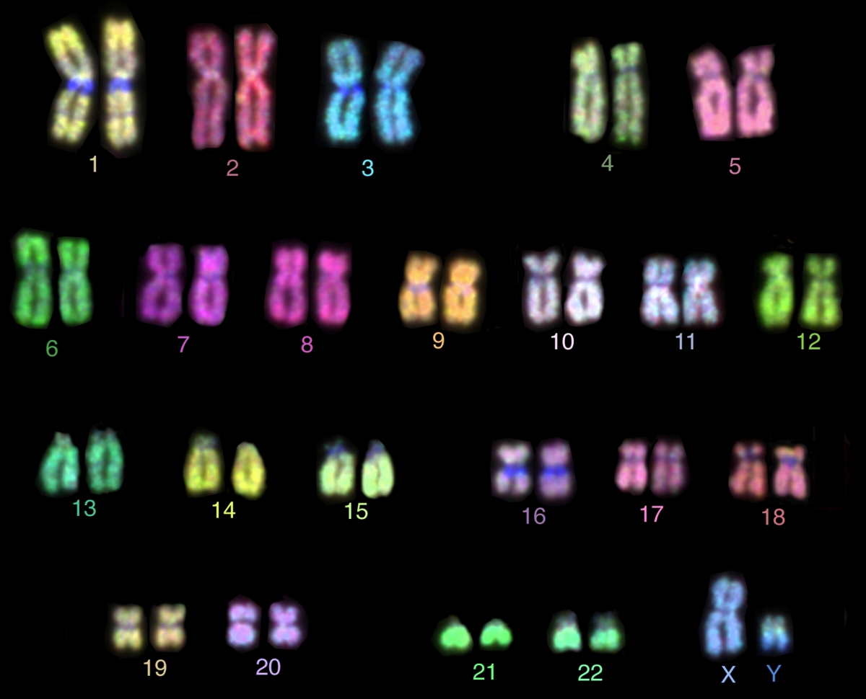
Genomics 101
23 + 23 = 46 chromosomes

Slide 3
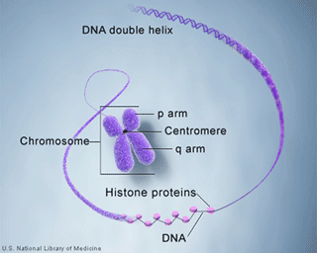
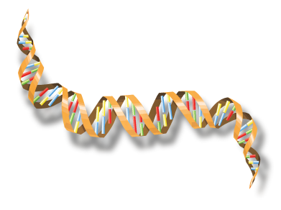
Genomics 101
A = T
C = G

Slide 4


Cancer Is A Disease Of The Genome
Radiation
Carcinogens
Virus and infection
Mistakes in DNA copying
DNA is exposed to carcinogenic events every day; this causes gene alterations to occur
Exposure to cancer risk factors increases the chances of gene alterations

Slide 5
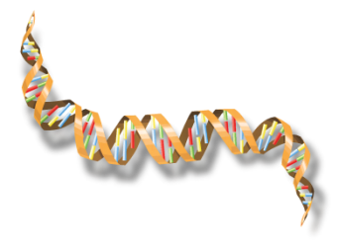

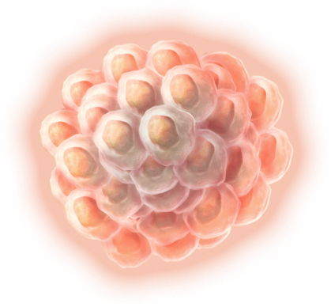
How Gene Alterations Can Cause Cancer
ALTERED GENES
ALTERED
PROTEINS
ALTERED PATHWAYS
RAS
Code
for
CDKN2a
PTEN
Resulting
in
RAS
RAF
MAPK
RAF
mTOR
AKT
MAPK
CANCER

Slide 6
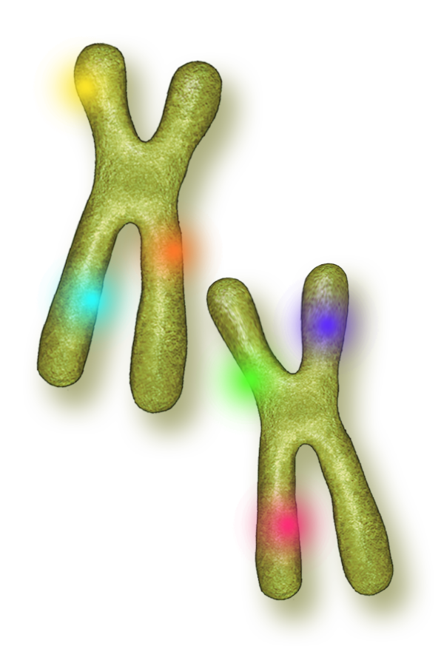
Cancer Related Genes
Gene names
KIT
PDGFRA
BRAF
KRAS
HRAS
NRAS
FGFR1
Of the ~20,000 genes in the genome, only a subset of a few hundred are unambiguously associated with cancer

Slide 7









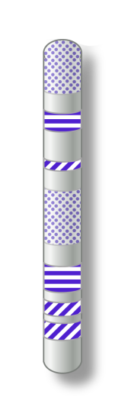
Types Of Alterations In Cancer Genes
Normal
Copy number
alterations
Substitutions
(Missense)
Insertions and deletions
Rearrangements
Fusions

Slide 8

The Shift Toward Targeted Therapy
Chemotherapy
Targeted Therapy
Anticancer drugs may be highly effective in some, but less effective in others
Patients encounter side effects which are often significant
In personalized medicine, clinicians use biomarkers to predict a patient's response to therapy
Patients are more likely to get therapies with the greatest impact which often have fewer side effects

Slide 9
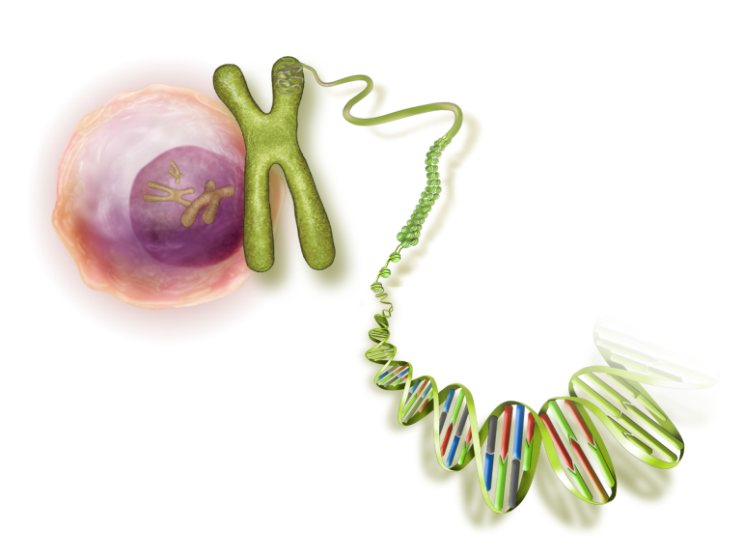
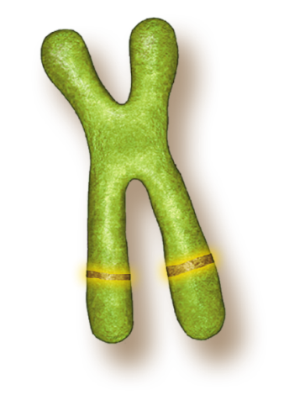
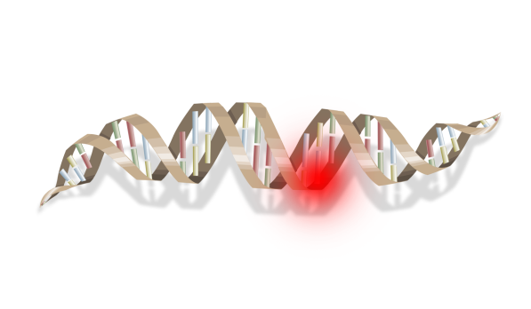
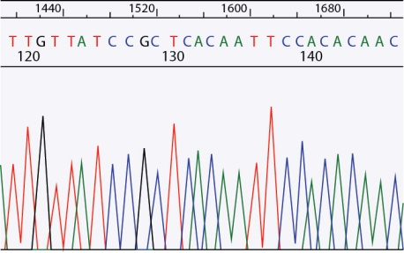

Advantages Of Comprehensive Genomic Profiling (CPG) vs. Traditional Hot Spot Testing
Hot Spot or Single-Marker Testing
  Misses some types of mutations (rearrangements/fusions, copy number alterations)
  Limited number of alterations screened at once
  Results are specific for the test used: need to know ahead of time what questions to ask
  Exhausts tissue
CGP
  Able to identify hundreds of clinically relevant mutations
  at once
  Allows the opportunity to identify all alterations
  Tissue sparing

Slide 10


CPG vs. Hot Spot
Substitutions
Missense
Copy number
alterations
Insertions and deletions
Rearrangements
Fusions
Alterations Detected
Normal
CGP
Hot Spot

Slide 11
Cancer Related Genes in GIST
Gene names
KIT
PDGFRA
BRAF
KRAS
HRAS
NRAS
FGFR1

Slide 12
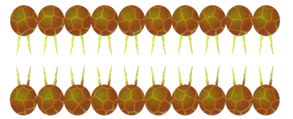
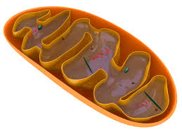
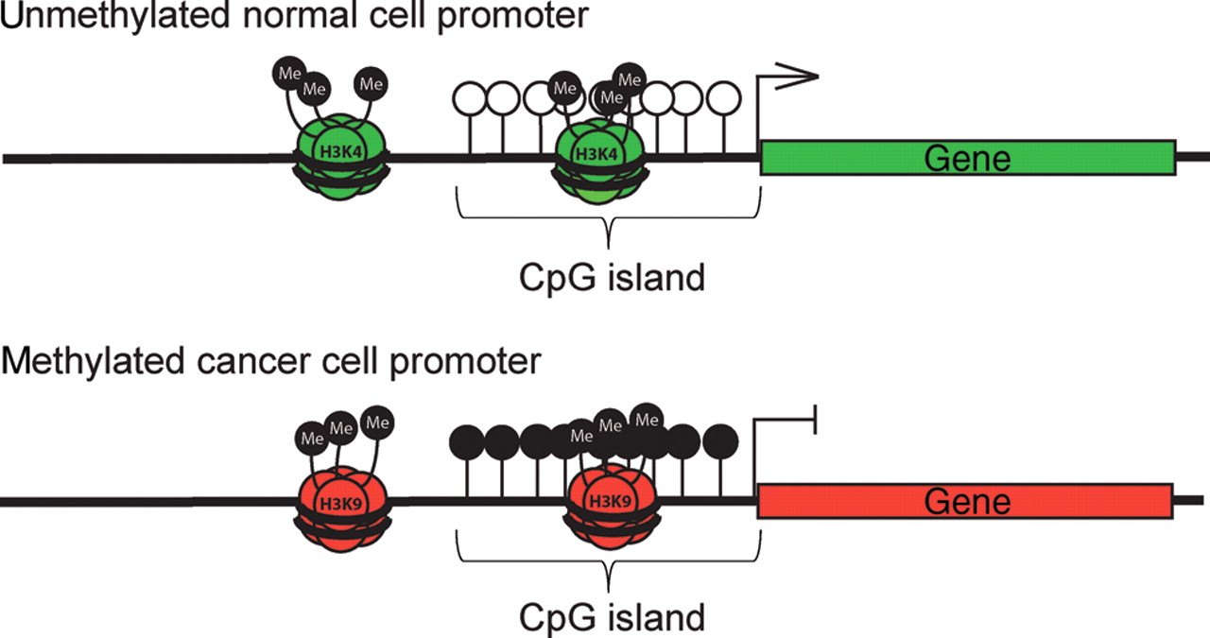
Known Driver Genes in 85-90% of GIST
KIT
PDGFRA
Succinate
SDHC
SDHA
SDHB
SDHD
GDP
RAS
Fumarate
GTP
RAS
Unmethylated SDHC promoter
BRAF
SDHC gene
NF1
Methylated SDHC promoter
MEK
SDHC gene
ERK
Corless et al., Nature Reviews Cancer. 2011.
Pantaleo et al., Cancer Medicine. 2015.
Killian et al., Sci Transl Medicine. 2014.

Slide 13
Lack Mutations in KIT, PDGFRA, RAS Pathway (NF1, RAS, BRAF) and SDH Subunits
Quadruple Wild-type (qWT) GIST
SDHB+
IGF1R-
Any age?
Equal sex?
Site?
Multifocality?
Genomics?
Epidemiology?
Disease Biology?
Pantaleo et al., Cancer Medicine. 2015.

Slide 14
Hypothesis
Broad genomic profiling of “quadruple-WT (qWT)” GISTs would reveal insights into the genomic alterations and disease biology of this understudied patient population.

Slide 15
Methods
Patient Population and Data Collection
Foundation Medicine, Inc. (FMI) database consisting of de-identified patients from across the U.S. (October 2012 – May 2015).
Retrospectively analyzed this prospectively collected data.
Broad Genomic Profiling
DNA was extracted from FFPE tumor specimens.
NGS assay utilizes the Illumina HiSeq 2500 instrument to sequence against hybridization-captured, adaptor ligation-based libraries for coding regions of 315 cancer-related genes plus introns from 28 genes frequently implicated in cancer transformation.

Slide 16
Methods (Continued)
Data Analysis
Genomic alterations were further categorized:
  Known somatic
  Likely somatic
  Variant of unknown significance (VUS).
To understand of the potential deleterious effects of all missense VUS’s, we analyzed them with 4 prediction modeling programs (SIFT, PolypPhen, MutationTaster, and MutationAssessor).
Considered potentially deleterious if they were predicted deleterious by ≥50% tools. Of 1240 VUS’s, we considered 325 (26.2%) potentially deleterious.
Exome Aggregation Consortium (ExAC) Browser was used to exclude missense variants with a minor allele frequency >1% (NOTCH2, FANCD2, MAP3K1, MSH3, and ZNF217).

Slide 17
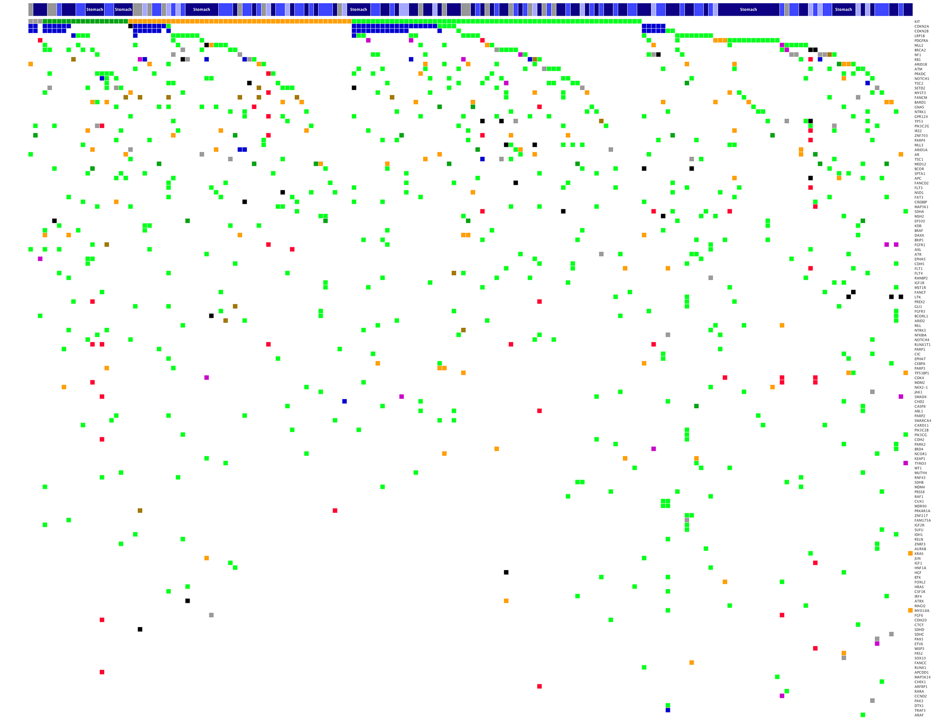
Somatic Genomic Landscape in 186 GIST
Tumor Site
Genomic Alteration
in frame indel

Slide 18
Driver Mutations in 186 GIST
qWT
(N=12)
tWT*
(N=12)
[KHN]-RAS (N=4)
BRAF(N=7)
SDHx (N=14)
NF1 (N=18)
KIT (N=129)
PDGFRA (N=22)
tWT* = sequencing performed before FMI testing of SDHx genes

Slide 19
Demographics of GIST Patients
Variables |  | WT GIST N (%) | Non-WT GIST N (%) | P-value
Total Patients |  | 24 | 162
Age (years, mean ± SD) |  | 44.4 ± 15.7 | 58.3 ± 14.1 | <0.01
Sex | Female | 12 (50.0) | 66 (40.7) | 0.51
 | Male | 12 (50.0) | 94 (58.0)
 | Not Reported | - | 2 (1.2)
Primary GIST Site | Colon | 2 (8.3) | 15 (9.3) | 0.26
 | Small intestine | 9 (37.5) | 44 (27.2)
 | Stomach | 13 (54.2) | 83 (51.2)
 | Other | 0 (0.0) | 20 (12.3)

Slide 20
Demographics of GIST Patients
Variables |  | qWT GIST N (%) | tWT GIST N (%) | P-value
Total Patients |  | 12 | 12
Age (years, mean ± SD) |  | 44.0 ± 14.9 | 44.8 ± 17.1 | 0.90
Sex | Female | 5 (41.7) | 7 (58.3) | 0.68
 | Male | 7 (58.3) | 5 (41.6)
 | Not Reported | - | -
Primary GIST Site | Colon | 0 (0.0) | 2 (16.7) | 0.36
 | Small intestine | 4 (33.3) | 5 (41.6)
 | Stomach | 8 (66.7) | 5 (41.6)

Slide 21
Demographics of GIST Patients
TNM Classification |  | qWT GIST N (%) | tWT GIST N (%) | P-value*
Tumor Size (T) | T1 (≤ 2 cm) | 0 (0.0) | 0 (0.0) | 0.05
 | T2 (>2, ≤5 cm) | 0 (0.0) | 2 (16.7)
 | T3 (>5, ≤10 cm) | 11 (91.7) | 5 (41.6)
 | T4 (>10 cm) | 1 (8.3) | 4 (33.3)
 | Tx | 0 (0.0) | 1 (8.3)
Regional Lymph Nodes (N) | N0 | 6 (50.0) | 2 (16.7) | 0.14
 | N1 | 3 (25.0) | 8 (66.7)
 | Nx | 3 (25.0) | 2 (16.7)
Distant Metastases (M) | M0 | 0 (0.0) | 0 (0.0) | 1.0
 | M1 | 9 (75.0) | 8 (66.7)
 | Mx | 3 (25.0) | 4 (33.3)

Slide 22
Types of Genomic Alterations Detected
Percent

Slide 23
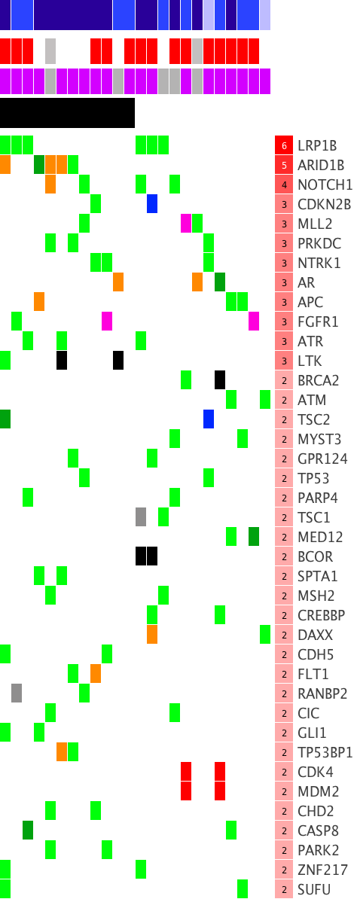
Heterogeneous Set of Genomic Alterations*
(Known/Likely + Potentially Deleterious VUS)
Tumor Site
Lymph Node (N stage)
Distant Metastasis (M stage)
Tumors
qWT
Tumor Site
Genes
Metastasis
Lymph Node
Distant
Unknown
Genomic Alteration
in frame indel
* Include only genes with ≥2 genomic alterations

Slide 24
7 Genes Significantly More Affected
Gene | Aliases | Alterations in non-WT (%) | Alterations in WT (%) | P-value
ARID1B | AT Rich Interactive Domain 1B | 11 (6.79%) | 5 (20.83%) | 0.04
FGFR1 | Fibroblast growth factor receptor 1 | 4 (2.47%) | 3 (12.5%) | 0.047
ATR | Ataxia telangiectasia and Rad3 related | 4 (2.47%) | 3 (12.5%) | 0.047
LTK | Lymphocyte receptor tyrosine kinase | 2 (1.23%) | 3 (12.5%) | 0.02
SUFU | Suppressor of Fused | 0 (0%) | 2 (8.33%) | 0.02
ZNF217 | Zinc Finger 217 | 0 (0%) | 2 (8.33%) | 0.02
PARK2 | Parkin RBR E3 Ubiquitin Protein Ligase | 1 (0.62%) | 2 (8.33%) | 0.044

Slide 25
FGFR1 Gene Fusions Identified in 2/3rd GISTs

Slide 26
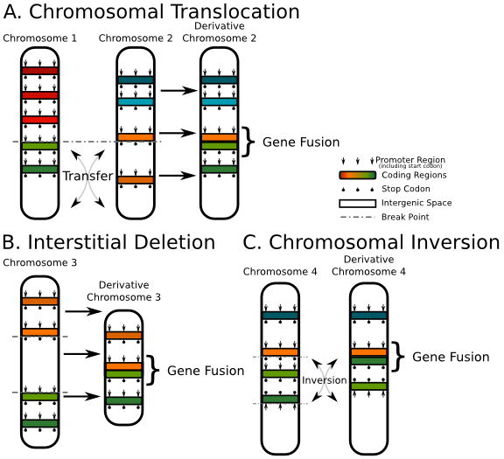
Gene Fusions
Hybrid gene formed from 2 previously separate genes
It can occur as a result of 3 mechanisms:

Slide 27
CTOS in November 2015
Gene | Fusion | Previously Reports
FGFR1 | FGFR1-TACC1 | Glioblastoma multiforme
 | FGFR1-HOOK3 | RET-HOOK3 fusion in papillary thyroid cancer
ETV6 | ETV6-NTRK3 | Infantile fibrosarcoma secretory breast carcinoma salivary gland tumors
Shaw et al., Nature Reviews Cancer. 2013.

Slide 28
ETV6-NTRK3 in qWT GIST
Brenca et al., J Pathology. March 2016.

Slide 29
OHSU Validation in 2nd Study Population
Target Kinase | Fusion Partners
AKT3 | MAGI3
ALK | ATIC, C2orf44, CARS, CLTC, EML4, FN1, KIF5B, KLC1, MSN, NPM1, PPFIBP1, PTPN3, SEC31A, SQSTM1, STRN, TFG, TPM3, TPM4, TRAF1, VCL
BRAF | AGK, AGTRAP, AKAP9, CLCN6, FAM131B, FCHSD1, GNAI1, KCTD7, KIAA1549, MAD1L1, MKRN1, NUDCD3, PLIN3, RNF130, SLC45A3, SOX6, TRIM24, ZKSCAN5
EGFR | EGFR variant III, CAND1, PSPH, SEPT14, SLC12A9
ERBB4 | EZR
ERG | TMPRSS2
FGFR1 | BAG4, CPSF6, ERLIN2, PLAG1, TACC1, ZNF703
FGFR2 | AFF3, AHCYL1, BICC1, CASP7, CCDC6, CIT, KIAA1967, OFD1, SLC45A3
FGFR3 | BAIAP2L1, TACC3
MET | MIR548F1, TPR
NTRK1 | BCAN, CD74, MIR548F1, MPRIP, NFASC, TFG, TPM3, TPR
NTRK2 | NACC2, QKI
NTRK3 | ETV6
NRG1 | CD74, SLC3A2
PDGFRA | KDR, SCAF11
PDGFRB | NIN
RAF1 | DAZL, ESRP1, MSS51, SRGAP3
RET | AFAP1, CCDC6, ERC1, HOOK3, KIAA1468, KIF5B, NCOA4, PARG, PCM1, PRKAR1A, TRIM27, TRIM33
ROS1 | CCDC6, CD74, CEP85L, EZR, GOPC, KDELR2, LRIG3, SDC4, SLC34A2, TFG, TPM3
Compliments of M. Heinrich and C. Corless, OHSU.

Slide 30
5 qWT GIST in OHSU Study Population
Age (Years) | Gender | Primary Tumor Location | Tumor Stage | SDHB Immunostaining | Fusion Panel Result
54 | Male | Pelvic mass | Unknown | Unknown | FGFR1-TACC1
54 | Male | Colon | Unknown | Positive | ETV6-NTRK3
49 | Male | Small intestine | T3NxMx | Positive | None detected
51 | Female | Unknown | TxN1Mx | Positive | None detected
53 | Male | Stomach | Unknown | Unknown | None detected
Compliments of M. Heinrich and C. Corless, OHSU.

Slide 31
ETV6-NTRK3 Sensitizes Cells to
IGF1R and ALK Inhibitors
Infantile Fibrosarcoma & Osteosarcoma Cell Lines
IGF-1R inhibitors
ALK inhibitors
Brenca et al., J Pathology. March 2016.

Slide 32
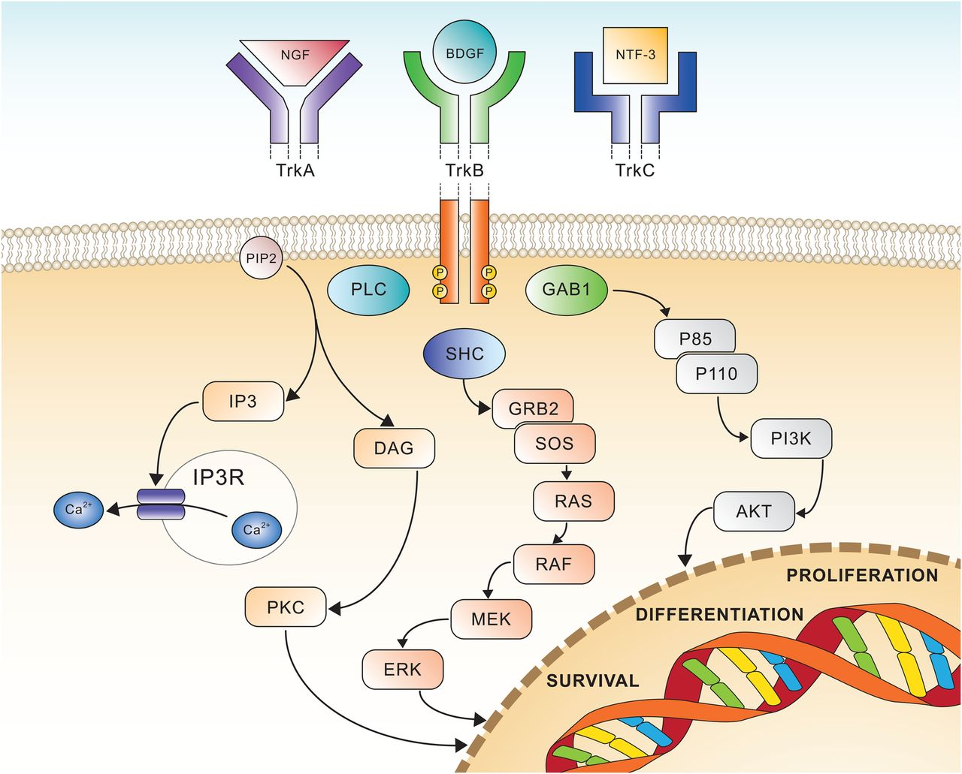
Neurotrophic tropomyosin receptor kinase (NTRK)
Amatu et al., ESMO Open. 2016.

Slide 33
NTRK Inhibitors
Amatu et al., ESMO Open. 2016.

Slide 34
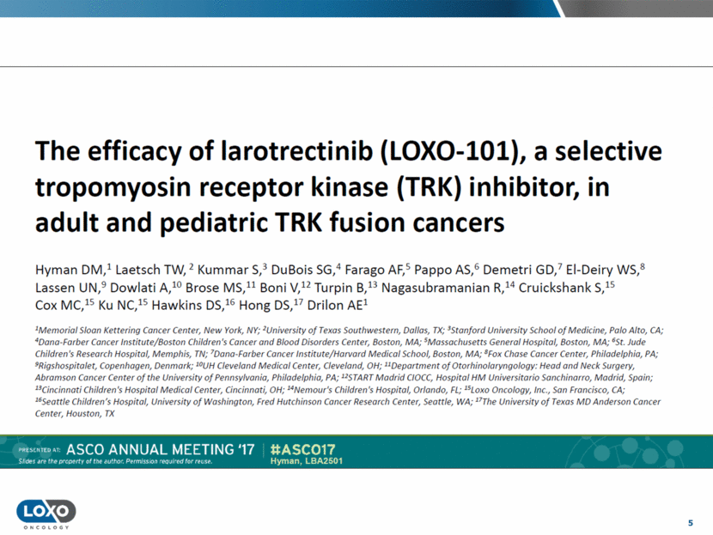

Slide 35
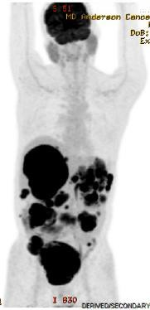
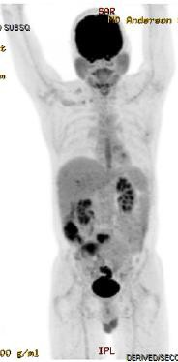
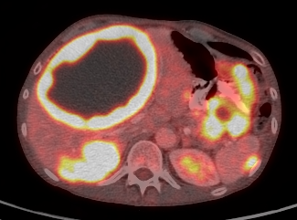
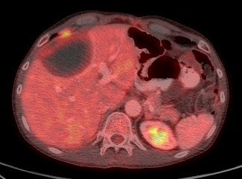
Treatment Refractory ETV6-NTRK3 GIST
Baseline
Week 8
LOXO-101
Larotrectinib
Shi et al,, JTM 2016.

Slide 36
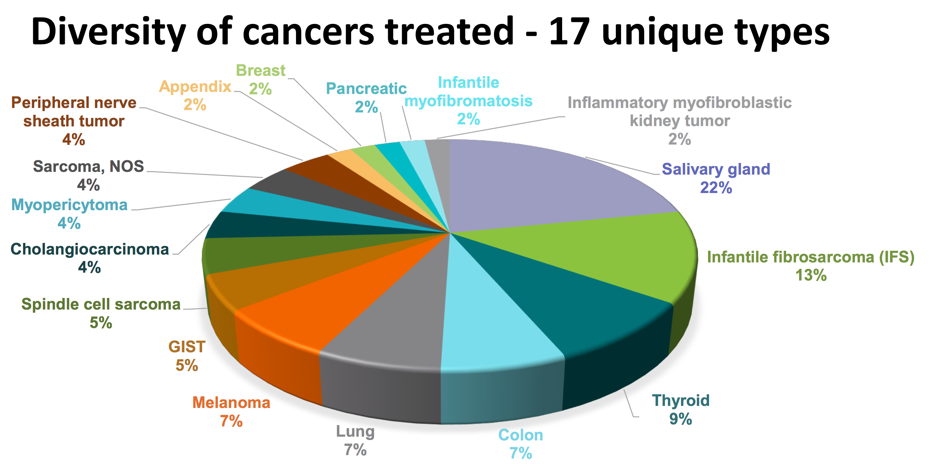

Slide 38
FGFR1 Gene Fusions Identified GIST

Slide 39
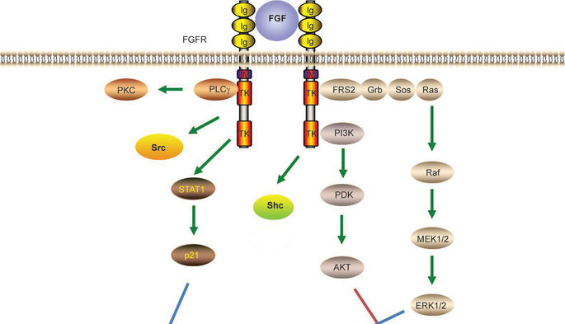
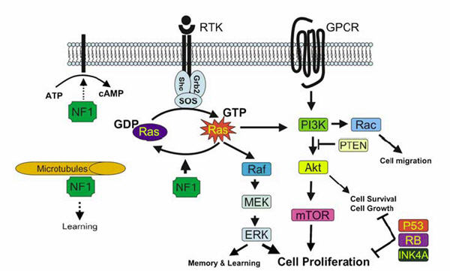
Fibroblast Growth Factor Receptor 1 (FGFR1)
Amatu et al., ESMO Open. 2016.
GSI Website

Slide 40
Lack Mutations in KIT, PDGFRA, RAS Pathway (NF1, RAS, BRAF) and SDH Subunits
Quadruple Wild-type (qWT) GIST
SDHB+
IGF1R-
Any age?
Equal sex?
Site?
Multifocality?
Genomics?
Epidemiology?
Disease Biology?
Pantaleo et al., Cancer Medicine. 2015.

Slide 41
Lack Mutations in KIT, PDGFRA, RAS Pathway (NF1, RAS, BRAF) and SDH Subunits
Quadruple Wild-type (qWT) GIST
SDHB+
IGF1R-
Any age?
Equal sex?
Site?
Multifocality?
FGFR1 fusions
ETV6-NTRK3 fusions
ARID1B, ATR, LTK, SUFU, ZN217, PARK2 mutations
30s-50s
M≥F
Stomach > SB > Colon
Nodal and Distant Mets
Shi et al., JTM. 2016.

Slide 42
NIH Wild-Type GIST Clinic: KIT-PDGFRA fusion
Boikos et al., JAMA Onc. 2016.

Slide 43
9 Known Gene Fusions in GIST
Patient | Age (Years) | Sex | Primary Tumor Location | Tumor Stage | Gene Fusion
1 | 55 | Male | Small bowel | T3N0M1 | ETV6-NTRK3
2 | 54 | Male | Colon | Unknown | ETV6-NTRK3
3 | 44 | Male | Rectum | T2NxM0 | ETV6-NTRK3
4 | 54 | Male | Pelvis mass | Unknown | FGFR1-TACC1
5 | 54 | Male | Stomach | T3N1M1 | FGFR1–TACC1
6 | 38 | Female | Small bowel | T3N1M1 | FGFR1–HOOK3
7 | Unknown | Female | Unknown | Unknown | KIT-PDGFRA
8 | 63 | Female | Small bowel | T3N0M1 | MARK2-PPFIA1 SPRED2-NELFCD
9 * | 30 | Female | Small bowel | T4NxM0 | PRKAR1B-BRAF
Summary | Average: 48 Median: 54 | Male 56% Female 44% | 44% small bowel, but spans stomach to rectum | 22% nodal metastases 44% distant metastases | 33% ETV6-NTRK3 33% FGFR1 33% Others
Shi et al. J Translational Med. December 2016.
Brenca et al., J Pathology. March 2016.
Boikos et al., JAMA Onc. July 2016.
Pantaleo et al., Mol Cancer Res. July 2017.
* UCSD Patient (unreported to date)

Slide 44
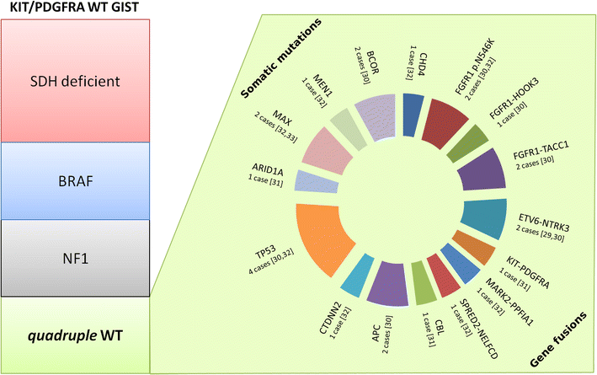
Progressive Fragmentation of “WT” GIST
Nannini et al., JTM. May 2017.

Slide 45
Abandoning WT GIST
Alkhuzeim et al., JNCCN. May 2017.

Slide 48
Summary #1
“Quadruple Wild-Type: or “Unclassified” GIST occur in younger patients, occur in similar locations as non-qWT GIST, frequently metastasize to lymph nodes, and most are not truly “WT.”
Potentially deleterious gene fusions occur in adults with GIST and these are potentially targetable with drugs.
  KIT inhibitors (KIT-PDGFRA fusion)
  NTRK3 inhibitors (ETV6-NTRK3 fusion)
  FGFR1 inhibitors (FGFR1-TACC1/HOOK3 fusions)
  BRAF inhibitors (BRAF-PRKAR1B fusion)
Other driver genes at play:
  ARID1A/D, ATR, LTK, MAX, PARK2, SUFU, ZNF217
Shi et al. J Translational Med. December 2016.
Boikos et al., JAMA Onc. July 2016.
Pantaleo et al., Mol Cancer Res. July 2017.
Alkhuzeim et al., JNCCN. May 2017.

Slide 49

Is Location is a Biomarker for Gene Mutations?

Slide 50
Known Driver Genes in GIST
KIT
PDGFRA
Succinate
SDHC
SDHA
SDHB
SDHD
Fumarate
GEF
GDP
GTP
RAS
RAS
SDHC gene
X
NF1
BRAF
SDHC gene
MEK
FGFR1-HOOK3 or –TACC1 fusions
Corless et al., Nature Reviews Cancer. 2011.
Pantaleo et al., Cancer Medicine. 2015.
Killian et al., Sci Transl Medicine. 2014.
Shi et al., J Transl Medicine. 2016 (In Press).
ERK
ETV6-NTRK3 fusion
Notes:
NF1 = GTPase-Activating Protein (GAP)

Slide 51
Anatomic Localization of GIST
Stomach
Colon
55%
Small Intestine
3%
29%
Duodenal-Jejunal Flexure (DJF)
[Ligament of Treitz]
?
Ma et al., CEBP. 2015.

Slide 52
Genes and Localization of GIST
Stomach-55%
Colon-3%
PDGFRA & SDH
Small Intestine-29%
Germline NF1
KIT Exon 9
Duodenal-Jejunal Flexure (DJF)
[Ligament of Treitz]
?
Ma et al., CEBP. 2015.

Slide 53
Background: NF1 Mutant GIST
Often multifocal small intestine GISTs associated with Neurofibromatosis type 1 (NF-1)
NF-1 associated with 1.5% of GISTs
Somatic NF1 mutant small bowel GIST was recently reported in the absence of a germline NF1 mutation (Belinsky et al., BMC Cancer, 2015).
NF1 gene mutations associated with NF-1 were recently reported (Gasparotto et al., Clin Cancer Research, 2016):
  Frequent in GISTs lacking KIT/PDGFRA/BRAF mutations or SDH inactivation
  Especially if multifocal or with a multinodular growth pattern and a non-gastric location.

Slide 54
New Key Findings
In three series, GISTs more frequently than 1.5% possess NF1 genomic alterations
  6.1% (MSKCC, 7/115)
  9.7% (UCSD, 6/62)
  9.7% (FMI, 18/186)

Slide 55
New Key Findings
Stomach
Colon
PDGFRA & SDH
Small Intestine
Germline NF1
KIT Exon 9
Duodenal-Jejunal Flexure (DJF)
5.5% of GISTs
Germline NF1 mutations even without clinical NF-1
Somatic only NF1 mutations
Can have NF1 + KIT mutations
Ma et al., CEBP. 2015.

Slide 56
Methods
Primary Study Population
Retrospective study of 165 GIST patients with from January 1, 2000 to April 30, 2017 at the UC San Diego Moores Cancer Center
Data collected included age, sex, race, ethnicity, primary GIST site, tumor size, and mitotic index.
Next Generation Sequencing
62 patients underwent NGS of cancer-related genes beginning in 2014:
  Foundation Medicine (315 genes)
  UC San Diego Heath System Clinical Genomics Laboratory (397 genes)
Burgoyne et al., JCO Precision Oncology. 2017.

Slide 57
Driver Mutations in 62 UCSD GIST
Burgoyne et al., JCO Precision Oncology. 2017.

Slide 58
NF1 Genomic Alterations are Frequent at DJF
GIST Patients
N = 165
NGS
N = 62
(37.6%)
No NGS
N = 103
(62.4%)
NF1 Alteration
N = 6
(9.7%)
Stomach
N = 1
(16.7%)
DJF
N = 5
(83.3%)
DJF
N = 2
(2.1%)
No NF1 Alteration
N = 56
(90.3%)
DJF
N = 2
(3.6%)
Burgoyne et al., JCO Precision Oncology. 2017.

Slide 59
9 DJF GIST Patient Demographics
Characteristic | Number | %
Age, years
Median (range) | 55 (36-80)
Average | 55.9 ± 15
Sex
Male | 4 | 44.4%
Female | 5 | 55.6%
Race
Caucasian | 7 | 77.8%
African American | 1 | 11.1%
Asian/Pacific Islander | 1 | 11.1%
Ethnicity
Non-Hispanic white | 5 | 55.6%
Hispanic/Latino | 4 | 44.4%
Burgoyne et al., JCO Precision Oncology. 2017.

Slide 60
DJF GIST Clinicopathologic Features
Characteristic | Number | %
Stage
Localized | 6 | 66.7%
Regional | 0 | 0.0%
Distant | 1 | 11.1%
Unknown | 2 | 22.2%
Tumor Size, cm
Median (range) | 9 (1.5 - 15)
Average | 8.0 ± 5.0
Mitotic Index
Low | 4 | 44.4%
High | 3 | 33.3%
Unknown | 2 | 22.2%
Cell Morphology
Spindle | 5 | 55.6%
Epithelioid | 0 | 0.0%
Mixed | 3 | 33.3%
Unknown | 1 | 11.1%
Burgoyne et al., JCO Precision Oncology. 2017.

Slide 61
MSKCC Validation Cohort
MSK-IMPACT NGS (341 genes)
N = 115
NF1 Alteration
N = 7
(6.1%)
Multifocal
N = 2
(28.6%)
Unifocal
N = 5
(71.4%)
DJF
(No Clinical NF-1)
N = 2
(40%)
Burgoyne et al., JCO Precision Oncology. 2017.

Slide 62
3 | 11 | 2 | 1 | 4 | 5 | 10 | 7 | 6 | CASE
15 | 8 | 1.5 | 13 | 5.3 | 3 | 1 | 2.5 | 2.1 | Size (cm) | Tumor
 |  |  |  |  |  |  |  |  | MI (per 5 mm²)
 |  |  |  |  |  |  |  |  | NF1 (somatic) | Reported GIST Drivers
 |  |  | SNP |  |  |  |  |  | NF1 (germline)
 |  |  |  |  |  |  |  |  | KIT (somatic)
 |  |  |  |  |  |  |  |  | BRAF (somatic)
 |  |  |  |  |  |  |  |  | ARID1A (somatic)
CDC73 | EP300 | NOTCH2 |  | MAML2 |  |  |  |  | Notch Pathway | Others
ASXL1 MEN1 | ERBB4 RB1 TSC2 |  |  |  | BCOR |  |  |  | Others
Mitotic Index
High
Low
Unknown
Genomic Alteration
Nonsense
Frameshift
Missense
In frame indel
Deletion
Splicing
Burgoyne et al., JCO Precision Oncology. 2017.

Slide 63
Summary #2
Duodenal-Jejunal Flexure (DJF) or Ligament of Treitz GISTs frequently possess NF1 alterations (somatic and/or germline), which occur even in the absence of clinical NF-1
This represents a previously unappreciated presentation of clinical NF-1.
Solitary GIST arising at the DJF may be a biomarker for clinically occult NF-1, even if single gene testing reveals a KIT mutation.

Slide 64
NF1 and Notch Genomic Alterations
GIST RFS
Notch ⬆ = High Hes1
p=0.005
Notch ⬇ = Low Hes1
CDC73
Lobry et al., Blood. 2014.
Dumont et al., Carcinogenesis. 2012.

Slide 65
Clinical Implications
Any DJF GIST may be considered for NF1 gene analysis, and any positive result has the following clinical implications:
Additional cancer screening according to expert guidelines.
Familial genetic counseling and screening.
Personalizing systemic therapy as NF1 mutant GISTs tend to be imatinib-resistant.
Burgoyne et al., JCO Precision Oncology. 2017.

Slide 66
Slicing the Pie…It’s Time for Personalization
Shi et al., JTM. 2016.

Slide 67








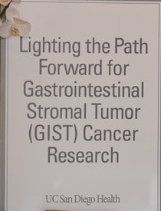


Funding
Anonymous Patient-Advocate Donors
(UCSD Foundation Fund #3661)

Slide 68

Acknowledgements
Sicklick Lab
  Chih-Min Tang
  Adam Burgoyne
  Eileen Shi
  Mayra Yerba
  Sudeep Banerjee
  Grace Ma
  Taylor Coe
  Kelly Fero
  Tracy Lee
UCSD
  Paul Fanta
  Adam Burgoyne
  Olivier Harismendy
  John Thorson
  James Murphy
  Lisa Madlensky
  Elena Martinez
  Dwayne Stupack
  Michael McHale
U of Miami
Jon Trent
MDACC
Neeta Somaiah
David Hong
Billy Wang
MSKCC / U Penn
Ron DeMatteo
OHSU
  Michael Heinrich
  Chris Corless
Mayo Clinic
Tamas Ordog
Sabriya Syed
Columbia
Gary Schwartz
Andrea Califano

Slide 69
QUESTIONS
Jason K. Sicklick, MD, FACS
jsicklick@ucsd.edu

